Slide 1
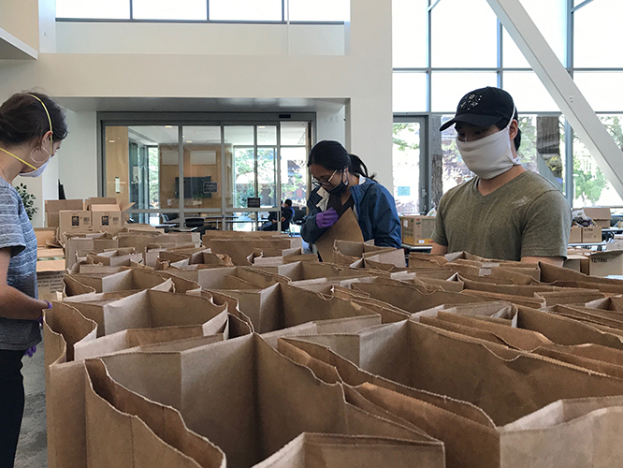
And the survey says -
Preliminary survey data for strategic decisions
University of California, Office of the President
Institutional Research and Academic Planning
Clarence Wheeler Jr.
Jenna Allen
Amit Prayag
CAIR Conference
November 19, 2020

Slide 2

Agenda
Undergraduate Student Experience Survey (UCUES) - Clarence Wheeler Jr.
Supporting strategic decision makers - Jenna Allen
Interdisciplinary team and approach - Amit Prayag
Demo: UCUES Covid19 dashboard

Slide 3

Introduction to UCUES
  Biennial
  Response Rate: 35% to 40%
Reasons to cancel the survey
  Shelter-in-Place Order
  Campus Overload
  Irregular Responses

Slide 4
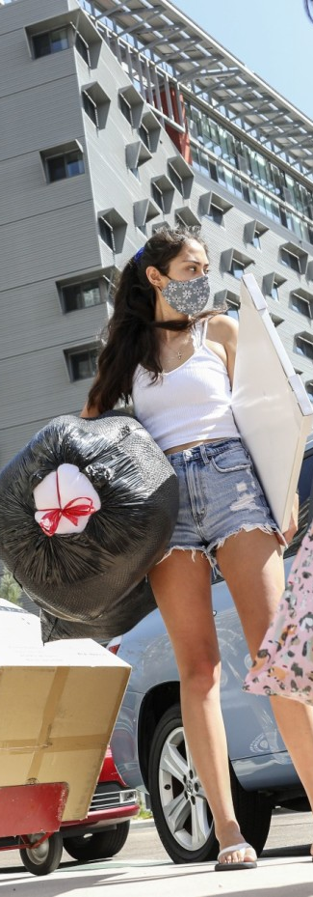
Decision to launch UCUES in Spring 2020
  Feasibility
  Unique perspective
  Large scale response to Covid-19 conditions

Slide 5
New module additions in UCUES 2020
  COVID-19 module
  Impact on academic, personal and family well-being
  Students’ response to prevent COVID-19
  UC campus response to COVID-19
  Plans to enroll at UC in Fall 2020
  Remote Instruction module
  Use of online tools
  Comparing in-person to remote class delivery for student learning, level of interaction, ethical behavior, challenges
  Open-ended question on experience during pandemic

Slide 6
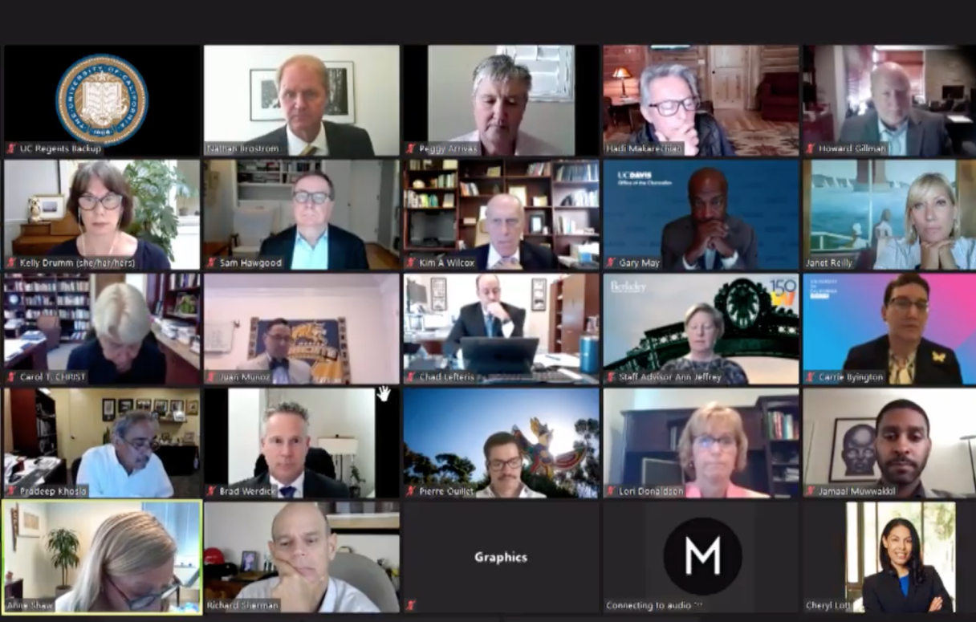
\
Supporting strategic decision makers

Slide 7

Data support for pandemic management & planning
  Would students continue their education during the pandemic?
  How was the pandemic or the
  shift to remote instruction
  impacting students' learning?
  What were students
  experiencing during the
  Pandemic?
  Planning for Summer and
  Fall enrollment

Slide 8
Strategic decision makers
Systemwide Executive Leadership Councils
  Executive Vice Chancellors/Provosts
  Vice Provosts/Deans of Undergraduate Education
  Summer Sessions Directors
Academic Senate Representatives – those who drafted the questions in the Remote Learning module and also launched a faculty survey
Staff Representatives to Regents Special Committee on Basic Needs
May meeting of the UC Regents
  Academic and Student Affairs Committee requested Update on COVID-19 Impact on the University of California: Academic and Student Issues

Slide 9

Interdisciplinary team & approach

Slide 10

Project needs
  Ethical concerns about preliminary data
  Dynamically evolving project requirements
  Demanding stakeholders
  Quick turnaround time to support crisis management
  Higher degree of collaboration
Agile project

Slide 11

Interdisciplinary team
  Resources availability
  Key skills
  Collaboration
  Delivery time

Slide 12
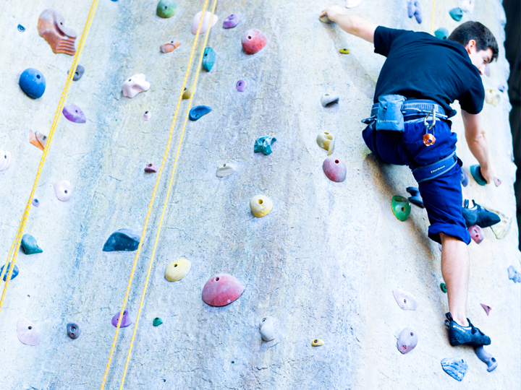
Five keys of Agile IR project management
  Use iterative and inclusive product development
  Perform early and constant stakeholder analysis
  Focus on collaboration
  Don’t forget change management
  Communicate, communicate, and communicate!

Slide 13
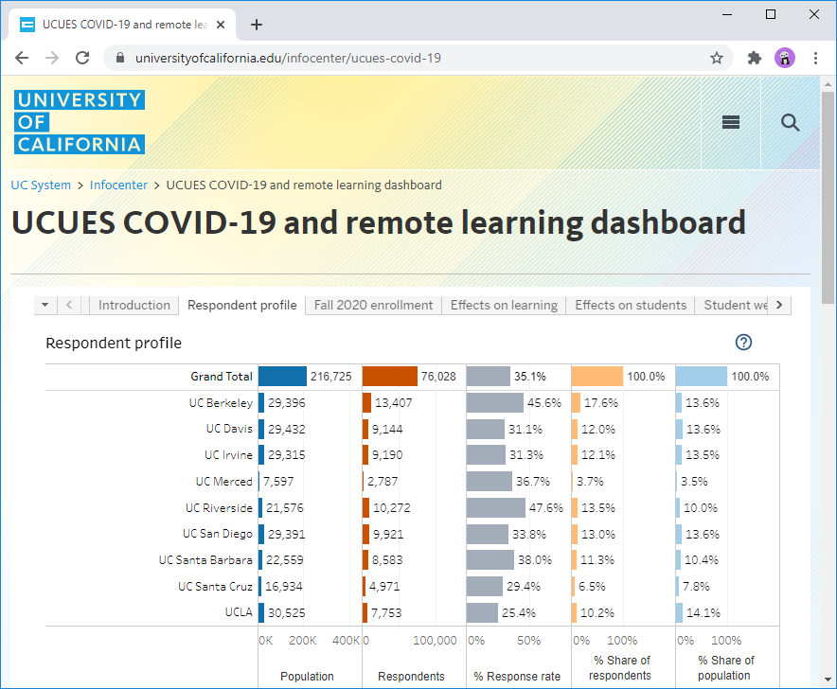
UCUES Covid19 dashboard
https://www.universityofcalifornia.edu/infocenter/ucues-covid-19
Notes:
https://www.universityofcalifornia.edu/infocenter/ucues-covid-19

Slide 14
Summary results
  8% unsure if they would return in the fall
  79% of students were concerned/very concerned about being able to effectively learn in the remote instruction environment
  65% had high to very high confidence with ability to use online tools
  69% were concerned/very concerned about COVID-19 impacting their ability to get a job post-graduation
  Open-ended Question
Appreciation for UC efforts recognizing unique circumstances
Worries about family, finances, unemployment and health
Difficulties engaging with friends and social activities
Unique concerns for freshman, seniors, those taking lab and art classes
Challenges balancing life at home and ability to study and take exams
Longing to return to campus

Slide 15
Summary results
  Decided to launch UCUES 2020 on 9 UC campuses when the SERU consortium canceled many surveys at universities across the nation
  UCUES was the only large-scale data set that could give us a view of students’ experience during the pandemic
  Pandemic required rapid and adaptive responses
    Added questions to UCUES
    Developed non-survey team to create dashboards on the fly
    Created a secure model to give access to preliminary data to key decision making groups
  Used collaborative online tools to support agile project management
  Found a new model for future projects

Slide 16

Questions?
Please use the WHOVA Mobile App to rate this session. CAIR uses the session evaluations to determine the winners of the Best New Presenter, and Best Presenter awards each year.
Notes:
Please use the WHOVA Mobile App to rate this session. CAIR uses the session evaluations to determine the winners of the Best New Presenter, and Best Presenter awards each year.

