Slide 1
Does Student Experience Matter?
I
Listening to the Student Voice
Tongshan Chang, UC Office of the President
William Armstrong, Sophia Corona, UC San Diego
Bryan Tan, Bullis High School
California Association for Institutional Research
Virtual Conference
November xx, 2020

Slide 2
Outline
II
What student experience data does UC collect, analyze and report?
How does UC San Diego use student experience survey data to help improve student basic needs, engagement, campus climate, student life, and learning outcomes?
A UC student’s perspective of undergraduate experience
A prospective college student’s expectations for undergraduate experience

Slide 3
Undergraduate Experience Data at UC
III
What did experts say about student experience?
“The quality of education has long been a concern among undergraduate education researchers: at the very core of undergraduate education research is an implicit desire to create a high-quality educational experience for all students.” (Bowers & Simmons, 2017)
“An alternate approach to defining academic quality focuses on fundamental course-level academic processes and describes the quality of such processes in terms of the level of academic demands or rigor expected of students.” (Braxton & Nordval, 1985)
“Decades of studies show that college students learn more when they direct their efforts to a variety of educationally purposeful activities.” (George Kuh, 2003)
“Student involvement refers to the amount of physical and psychological energy that the student devotes to the academic experience.” (Astin, 1984)

Slide 4
Undergraduate Experience Data at UC
IV
What student experience data does UC collect?
University of California Undergraduate Experience Survey (UCUES)
Theoretical concept of UCUES/SERU
CSHE at UC Berkeley, survey concept matp https://cshe.berkeley.edu/seru/about-seru/ugseru-survey-design

Slide 5
Undergraduate Experience Data at UC
V
UCUES data collection process and response rates
Administered to all undergraduate students every other year since 2004
Very high response rates and very representative (2020)
https://www.universityofcalifornia.edu/infocenter/completion-and-response-rates-uc-surveys

Slide 6
Undergraduate Experience Data at UC
VI
UCUES data collection process and response rates
Administered to all undergraduate students every other year since 2006
Very high response rates and very representative (2020)
https://www.universityofcalifornia.edu/infocenter/completion-and-response-rates-uc-surveys

Slide 7
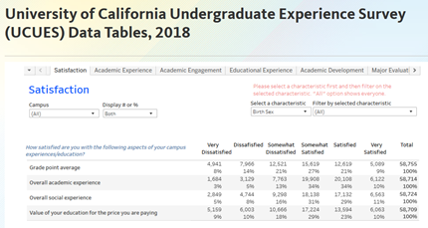
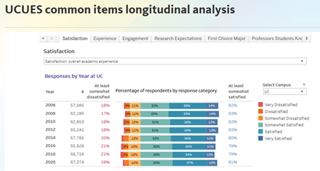
Undergraduate Experience Data at UC
VII
UCUES data reporting and use
Data are shared, reported and used in many different ways
https://www.universityofcalifornia.edu/infocenter/ucues-data-tables-2018
https://www.universityofcalifornia.edu/infocenter/ucues-longitudinal

Slide 8
Undergraduate Experience Data Use
at UC San Diego
VIII
UCUES at UC San Diego Pilot 2003-Sample of 2000
Census approach UCUES 2004 -Present
Average 30-35% Response Rate over 10 Administration Cycles
Over 68,000 Undergraduates Surveyed since 2004
As Campus Programs and Services have expanded :
Greater need for UCUES data
Longer Survey-More Items-New Content
Availability of UC Comparison Data Particularly Useful

Slide 9
UCUES at UC San Diego-Use and Impact
IX
Academic Program Review
Department/Major Comparisons with other UC and SERU Campuses
Campus Climate (EDI, Student Affairs, Residential Life)
Co-Curricular and Learning Assistance Programs Assessment
Affordability
Impact of COVID and Effectiveness of Remote Learning

Slide 10
Undergraduate Experience Data Use at
UC San Diego
X
WASC Learning Competencies
Basic Needs (Food, Housing)
Residential Life
Advising
Counseling and Psychological Services (CAPS)
Student Engagement
Student Satisfaction

Slide 11
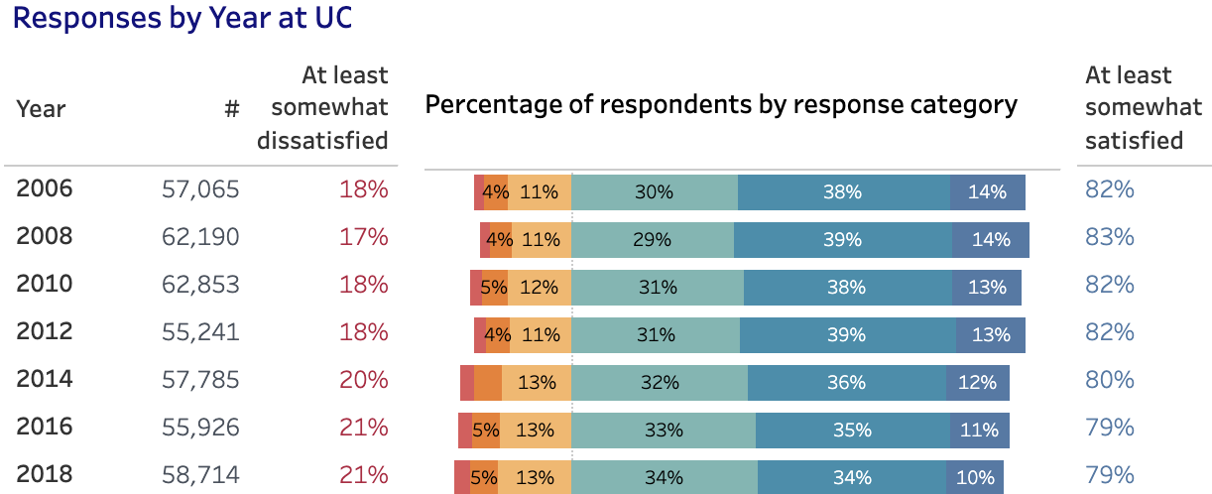
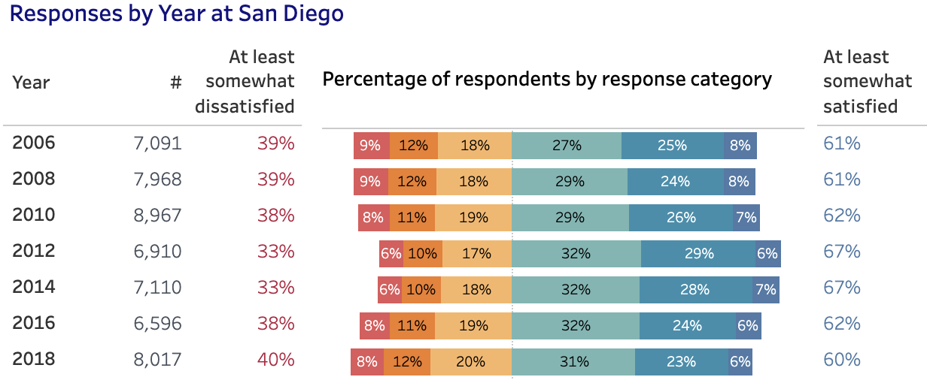
UCUES at UC San Diego
XI
Satisfaction: Academic, Social, GPA, Affordability, Other Metrics

Slide 12
Initiatives, Programs, and Services in Response to UCUES Data
XII
Undergraduate Student Experiences and Satisfaction Committee:
Convocation
Bear Garden
Unifying Campus Events
Triton Food Pantry-2016
Food Security UCSD UCUES Found Approximately 41% Food Insecure (UC-44%)
HUB Basic Needs Center
Homeless: Approximately 5% UCSD Undergraduates Homeless (UC-5%)
Triton Transfer Center and Transfer Housing

Slide 13
College student perspective on college experience
XIII
The Benefit of Pre-College Programs
EAOP - Early Academic Outreach Program
EAOP Events
Presentations from UC Representatives
How did UCUES research contribute to my decision?
Major Satisfaction
Campus Climate
Student Happiness
Prestige

Slide 14
College student perspective on college experience
XIV
What can UCUES continue to work on?
UCSD lacks school spirit - unite the 7 colleges
Improve Campus Climate for underrepresented students - ex. Summer Bridge, Resource Centers, Living Learning Communities, etc.
Is UCUES adaptable?
Accommodates to specific situations and student needs - COVID, Remote Learning, Food Insecurity, Housing Insecurity, etc.
UCUES is catered toward the experience of the student to enhance their time at UC

Slide 15
College student perspective on college experience
XV
Why is UCUES important from a student perspective?
UCUES brings reality into perspective
UCUES illustrates research to benefit us
How has UCUES affected my own and my peers’ college experiences at UCSD?
Student Need Programs - Basic Needs Hub
First Gen Student Success Coaching
Events - Recreation, Concerts, Panels
Student rates on major, college, and prestige
Campus Climate - Resource Centers, DEI, etc.
Self Evaluation - tracking my progress as a student in my prefered profession

Slide 16
Prospective student expectations for college experience
XVI
Reviewed UCUES
Collected information about high school experience and expectations for college experience from my classmates
Identify some criteria important to you when making decisions about college.
What do you want to college experience to be like for you?
What do you want to learn in college?
What are your expectation about the college community?
How do you think college will help with your future career plan?
Reflect my experience applying colleges
Suggestions for additional areas in UCUES

Slide 17
Prospective student expectations for college experience
 | Activities | In high school | Expectations
Class engagement | Class discussion, bring up ideas, ask questions, make class presentations | Regular discussion and presentation | More opportunities of presentation.
Interaction with teachers | Outside of class about homework, and other things | Close connection with teachers | Easy to schedule time
Team work | Work on team projects, study with a group of classmates outside of class | Groupworks both in class and outside school | Larger groups of teamwork
Class | Small/large classes, taught by professor, graduate teaching assistants | Small classes taught by particular teacher | Small classes
Academics Class | Basic subject classes, Elective classes, AP, Honors. | Freely chosen Classes, AP | Career oriented

Slide 18
Prospective student expectations for college experience
 | Activities | In high school | Expectations
Research | Conduct my own research, assist faculty in their research, research internship | Research Projects | Broader research opportunities
Clubs and student organization | Student Government Social Club: Debate Club Athletic activities: Golf, Football | Variety of Clubs and activities. | Clubs and activities associated with society
Community services | Provide services to the elderly, primary school students, and etc. | Community service group | Still be engaged in Community service
Campus climate | Diverse student population | Mixed-raced Population | Larger population with talented students.
Competencies | Leadership, communication, interpersonal skills | Bullis core values | Building on personal strength

Slide 19
Prospective student expectations for college experience
XIX
Suggestions for additional questions in UCUES
Provide information of how well students prepare for their future career?
How academic classes help them to prepare?
How does school activities help them to prepare?
What does professors provide to help them?
What aspects of opportunities does school offer students?
Do students reflect any discomfort in the school environment?
Do students experience or observe any unrespectful behaviors?

Slide 20
Does Student Experience Matter?
XXI
Undergraduate and Prospective Students’ Perspective and expectation
UCUES Major Satisfaction
Opportunities and Satisfaction for Student Engagement
Experiences and Support Services for First Generation Students
How to Improve Undergraduate Life
High school also values similar experience
Students’ suggestions for future UCUES

Slide 21
XXII

