Slide 1
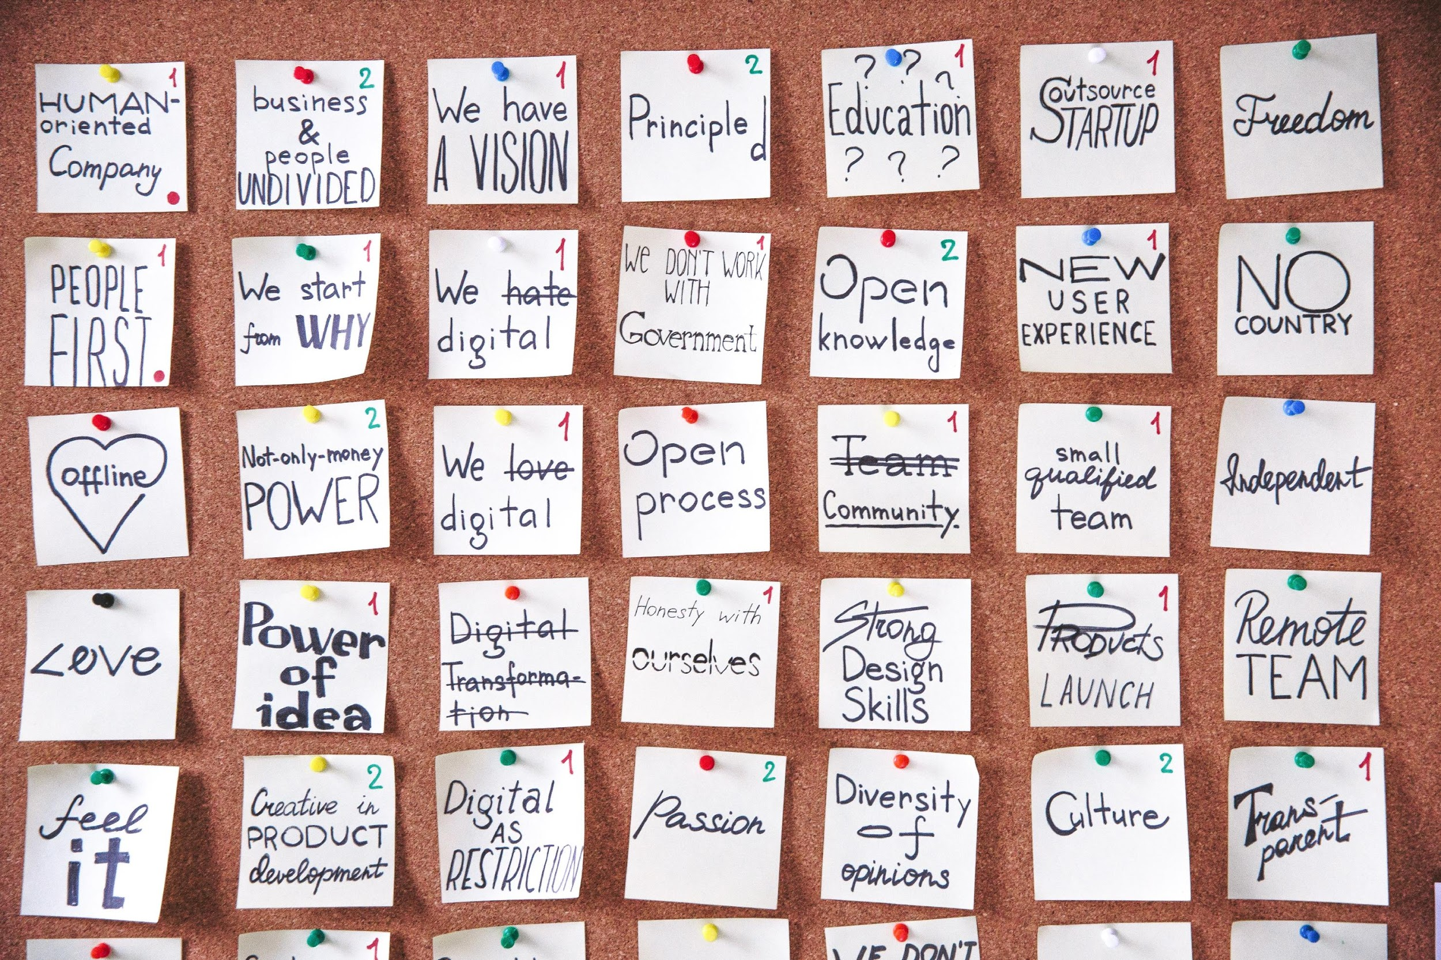
Innovation and Transformational Change
rooted in culture not technology

Slide 2
Change
Planned
Unplanned
Strategic
Deliberate
Mid-to-Long Term Impacts
Unexpected
Urgency
Reactive
Short-Term Wins

Slide 3
Catalysts of Change
Successful change is not fueled by chance or doing things the same way, but by the brave teams looking for greater opportunities.
Regulation
Technology
Societal
Regional
Notes:
Technology- FOMO; Solution Oriented; Competition
Regulation- Government regulations, accreditation, consumer preference
Societal- Cultural and preference
Regional

Slide 4
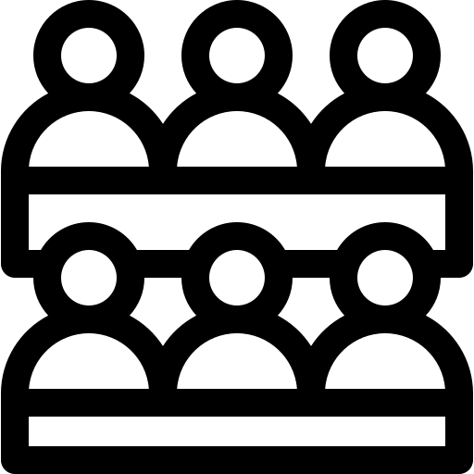
Knowing your Core
Values
Stakeholders
Purpose

Slide 5
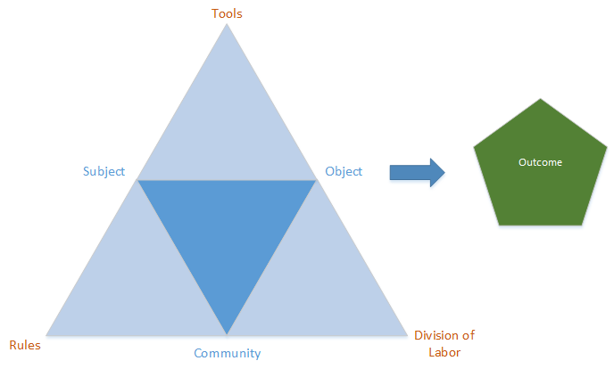
Understanding Culture - Activity Theory

Slide 6
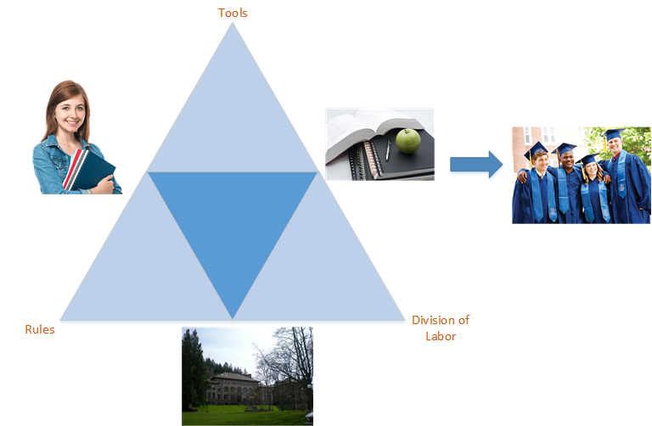
Understanding Culture - Activity Theory

Slide 7
Taking the Pulse of Your Culture
Mindset
Structure
Resources
Support

Slide 8
More than a Survey
Intentionality
Observations
Focus Groups
Non-Participant Perspective
Cross-Functional Dialog
Examine Wins and Failures
Blending/Triangulating

Slide 9
Facilitate not Dictate
Reflect on core institutional values and mission
Inquire how you are achieving them
Cross-functional collaboration
Share opportunities
Plan effectively with consistency and clarity

Slide 10
Remember your Core

Slide 11
azentner@coastline.edu
ecooper1@sierracollege.edu
Questions?

