Slide 1
Telling Your Story with Data
Brad C. Phillips, Ph.D.
President/CEO, IEBC
CAIR
2020 Conference
© all material copyright IEBC, 2017, 2018, 2019, 2020

Slide 2
Telling Your Story
What is your favorite kind of story?
Hero
Boy meets girl: Girl meets boy
Overcoming a challenge
Memorable, impactful and personal

Slide 4
Today’s Learning Objectives
Upon completion of this workshop, participants will:
Understand the importance of telling a story with data
Identify the types of stories that can be told
Identify the different types of data to include in stories

Slide 5
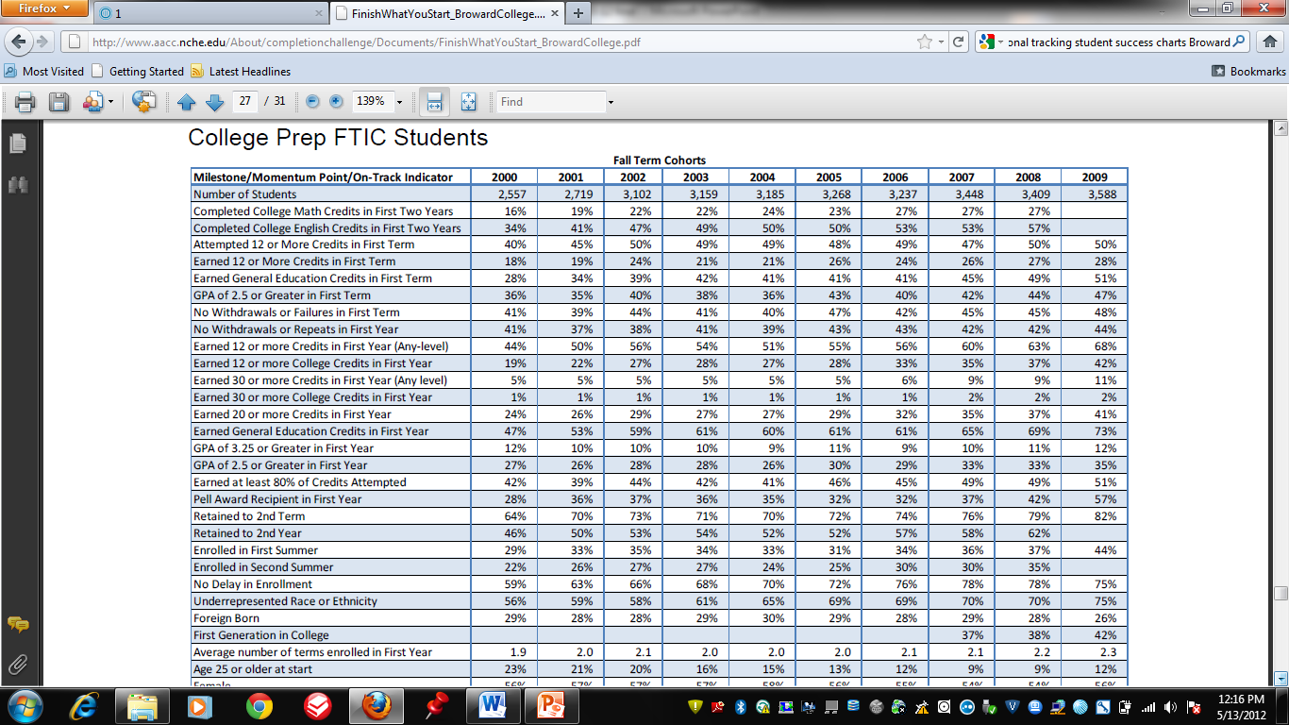
What Is Often Produced…

Slide 6
Overarching Rule
Any data shared must be useful, useable and actionable…
Useful – addresses the problem educators are trying to solve
Useable – easily understood – judgements are clear
Actionable – leads to a decision - not just “nice to know”

Slide 7
Stories Start with a Headline

Slide 8
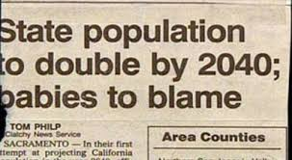
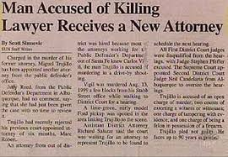
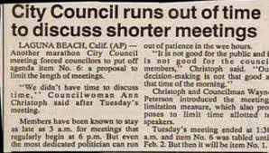
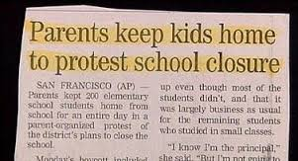

Slide 9
What’s In A Headline?
The “Take Away”
What you want the audience to remember
Needs to be only one sentence
Ideally should create a visual in their head
A lemon

Slide 10
Headline Practice: Lets Take a Look at Some Data
Credit Enrollment Over Time
 | Fall 2017 | Fall 2018 | Fall 2019 | Fall 2020
Credit Enrollment: | 6,501 | 6,242 | 6,101 | 5,844
Part-time students: | 75.2% | 78.1% | 78.2% | 78.3%
Female: | 61.8% | 61.1% | 62.6% | 61.5%
Hispanic or Latino: | 44.3% | 44.7% | 44.3% | 44.6%
American Indian or Alaska Native: | 4.8% | 4.6% | 4.7% | 5.3%
Other Minorities: | 9.6% | 9.3% | 8.5% | 8.2%
Exercise – Write the headline for the table above.

Slide 11
A New Headline
Our Enrollment is Declining!
 | Fall 2017 | Fall 2018 | Fall 2019 | Fall 2020
Credit Enrollment: | 6,501 | 6,242 | 6,101 | 5,844
Part-time students: | 75.2% | 78.1% | 78.2% | 78.3%
Female: | 61.8% | 61.1% | 62.6% | 61.5%
Hispanic or Latino: | 44.3% | 44.7% | 44.3% | 44.6%
American Indian or Alaska Native: | 4.8% | 4.6% | 4.7% | 5.3%
Other non-Majority: | 9.6% | 9.3% | 8.5% | 8.2%

Slide 12
Story Telling
The Disney way
Once upon a time – context
Problem
What happened to resolve the problem
The outcomes

Slide 13
The Disney Way - Actualized
Story Element | Fairy Tales | Your College
Context | Once upon a time in a land far, far away | Our institution has a population that is over 40% under the age of 20 and growing.
Conflict | There was a young girl who lived in misery with her evil stepmother and stepsisters | The completion rate for our 20 and under students is half of the completion rate for the over 20 population
Resolution | She married a prince | We piloted a support program with peer mentoring and the rate increased to almost that of the over 20 student population for students in the pilot program
Outcomes | She lived happily ever after | The program is being expanded and institutionalized; and we will continue to monitor impact

Slide 14
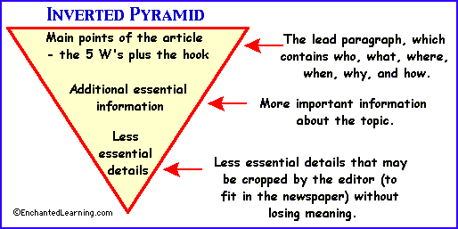
How To Talk About Data

Slide 15
Stories to Tell
What’s happening now

Slide 16
What’s Happening Now
Over 100 students are being served by our program
25% of students were proficient in math
40% of the 2018 class completed
Notes:
Tends to be the kind of data you receive. Is it very helpful?

Slide 17
Stories to Tell
What’s happening now
Comparisons to other groups

Slide 18
Comparisons to Other Groups
ABC program students persisted at higher rates than the comparison group

Slide 19
Comparisons to Other Groups
ABC Program students had a 50% higher persistence rate than the comparison group in Fall 2018 to Fall 2019
Students enrolled in an accelerated basic skills course were twice as likely to pass the course than their peers in traditional basic skills curriculum

Slide 20
Stories to Tell
What’s happening now
Comparisons to other groups
Where we’ve been and where we are now (comparison to baseline)

Slide 21
Then and Now
The withdrawal rate for ABC program students has been reduced by 30% among students identified at risk since we implemented our mentor program.
Compared with last year, ABC program students are four times more likely to persist fall to spring since we implemented our collaborative program with social services.

Slide 22
Stories to Tell: Recap
What’s happening now
Comparisons to other groups
Where we’ve been and where we are now (comparison to baseline)

Slide 23
The Basics: Your Stories to Tell
Telling a Positive Story
Key is to highlight what specifically made a difference. What was the key element or elements?
Designed to motivate others to do more of the success behavior
Telling a story where there is a challenge to overcome
Describe the problem and why it matters
Focus on the causes and what we as educators can do about addressing the challenge
Provide examples of how these challenges are being (or can be) overcome

Slide 24
The Power of One

Slide 25
Process and Outcome
Process: Activities that go on between educators and students or among educators
Outcome: The change in the target population of students

Slide 26
The Importance of Audience
Public – want to know their tax dollars are put to good use
Parents – want their children to be successful
Students – want to complete and get a good paying job
Funders – want to know that their dollars are used efficiently and effectively and share how they are making a difference
Governing Board – want to be proud of the work that “their” college does and represent the community well
College leadership – want to demonstrate that the programs and services are appropriate and effective
Faculty/Staff – want to be proud of their work and the students they serve. They want to make a difference
Legislature – want to know how your work improves outcomes. What is the ROI?

Slide 27
7 Types of Stories
Values – connects you to the audience
The Why – what you should care about
The Origin – create a deeper brand connection
Vision – where you are going
Teaching – share a lesson
Impact – how a difference was made
Objections – validate then reframes

Slide 28
Overarching Rule: Use Pictures Instead of Tables and Charts

Slide 29
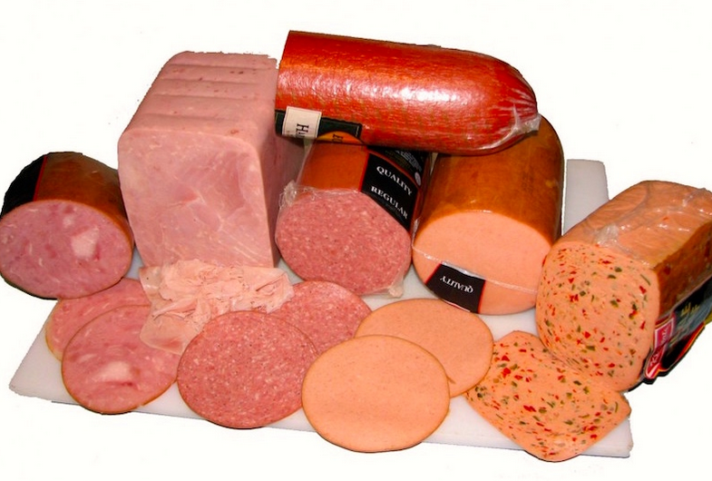
Overarching Rule: Frame the Data to Elicit Action
Stating that a cold cut is 70% fat free elicits a different emotion then saying a cold cut is 30% fat.
Saying that a surgery results in 5% morbidity or mortality yields a different emotion than saying a surgery is 95% successful

Slide 30
Overarching Rule: A Cheat Sheet from the Heath Brothers
Believe
Care
Act

Slide 31
Celebrate!

