Slide 1
Clarifying the Path to Completion and Transfer with Intersegmental Program Mapping
CAIR
November 6, 2020
Craig Hayward
Chenoa S. Woods

Slide 2
Agenda
Introductions
All about the Program Pathways Mapper
Why we built it and how it works
Scaling up
UC Transfer Mapping Project
CSU Transfer Mapping Project
Impact
Getting involved & staying in touch
CCH

Slide 3
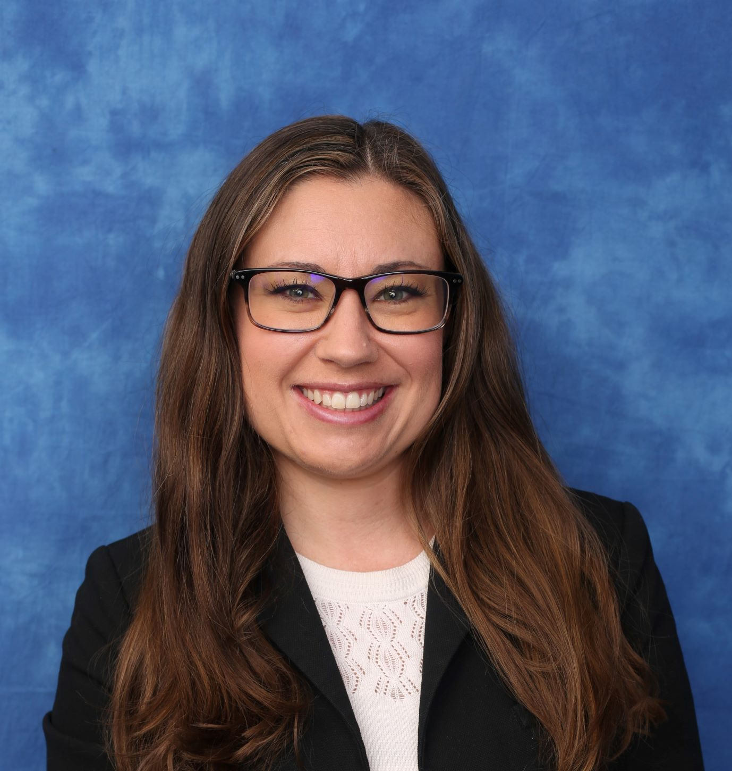
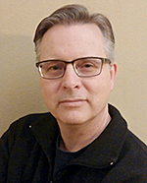
Who we are
Chenoa S. Woods, Ph.D.
Assistant Director of Research and Programs
CSU Chancellor’s Office
Craig Hayward, Ph.D.
Dean of Institutional Effectiveness
Bakersfield College
Notes:
Acknowledgements to RP and to the Chancellor’s Office as well as to those who shared program review information

Slide 4
Overview of the Program Pathways Mapper

Slide 5
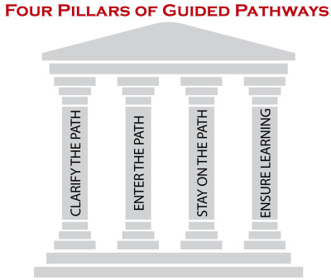
Why?
Notes:
Front-end of our Pillar One and a safety net for students.
Why? Counselors & advisors are the primary source of program information for less than half of our students (42.6%).
Counselors are using it extensively.
Research shows that students are more likely to complete a program of study if they better understand the career rewards at the end of the educational journey.
Research also shows that students tend to have an unrealistic sense of the job market and of the salaries associated with particular occupations, often basing career and course choices on imperfect information centered around their peers.

Slide 6
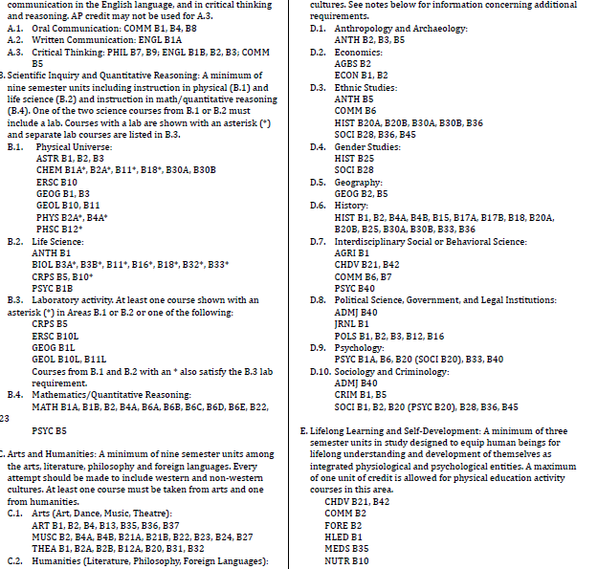
Cognitive Overload!
Notes:
Choice architecture – based on classic research study by Iyengar & Lepper (2000) in which students who had watched “Twelve Angry Men” as part of a class had the option to write a short essay about the film for extra credit. Some students were given 30 possible prompts to choose from, while other students were given 6 possible prompts. What do you think happened? 74% of the students who had six prompts to choose from completed the extra credit assignment while only 60% of those who had 30 prompts to choose from opted to participate. Moreover, students from the limited choice condition actually performed slightly but significantly better.
GP Conclusion → We need to provide default program maps that cuts through the catalog craziness, transforming the catalog into something that is easy to understand…

Slide 7
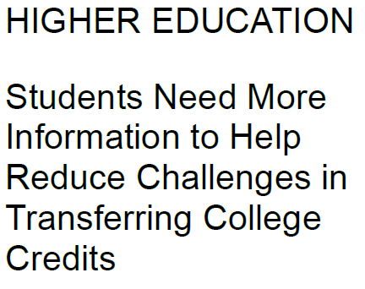
http://bit.ly/GAO-Transfer-Report-2017
Notes:
Students who transfer from a public school to public school lose 37% of their credits, on average.
GAO examined (1) transfer rates and challenges students face in transferring credits, (2) the possible financial implications of transfer, and (3) the extent to which students are provided with transfer information to help them plan their college path. GAO analyzed Education's data, including its most recent available transfer data from the 2004-2009 student cohort, interviewed a non-generalizable sample of stakeholders from 25 schools and higher education organizations, and reviewed a nationally-representative sample of 214 school websites.
According to Campaign for College Opportunity: The challenging transfer process leads to profound impacts on the systems too. Transfer students are graduating with a bachelor’s degree from the CSU with, on average, 40 units they don’t need-20 at the community college and 20 at the CSU. This means that both students and the state are spending more time and money on the degrees earned.

Slide 8
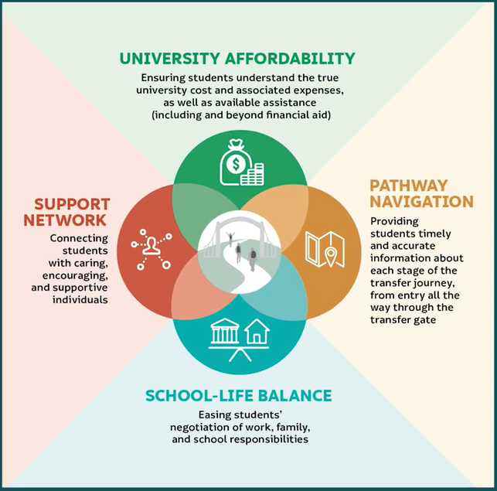
Transfer Stories and Strategies:
A “Through the Gate” Research Paper
http://bit.ly/Transfer-Stories-RP
Notes:
Pathway Navigation was one of four factors the could either facilitate or impeded transfer that the RP Group identified from its analysis of over 800 student interviews. The four factors that influence transfer according to a qualitative analysis of student stories are: 1) Pathway navigation information; 2) Perceptions of university affordability; 3) Having a support network; and 4) Ability to balance school and life responsibilities.

Slide 9
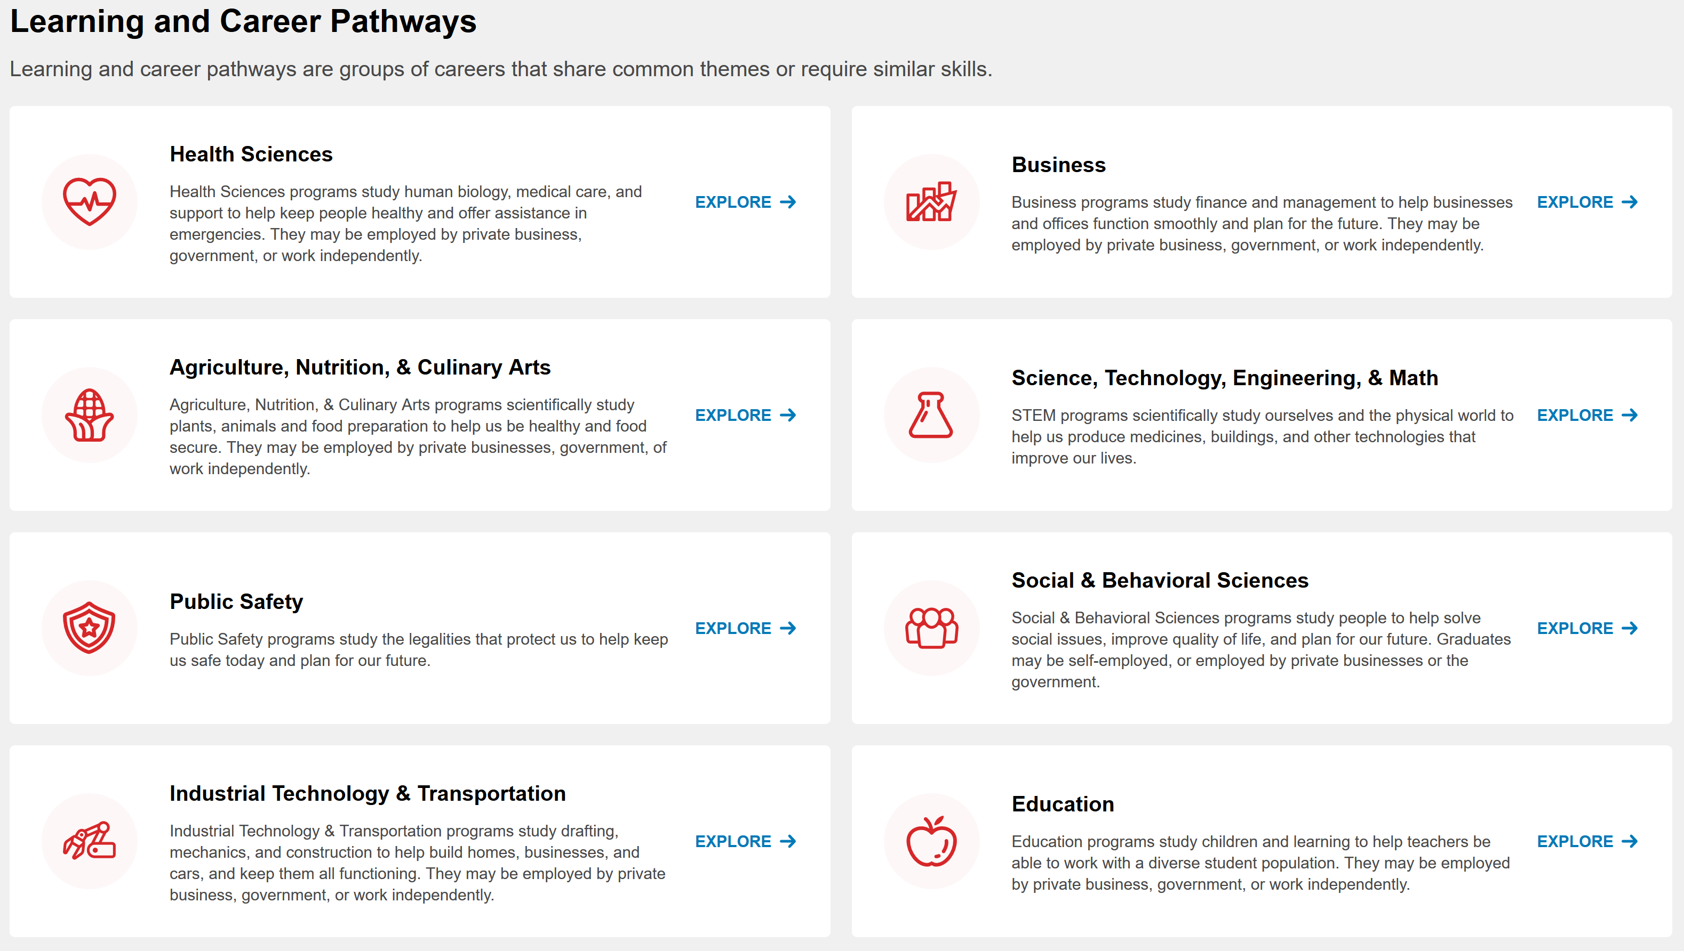

Slide 10
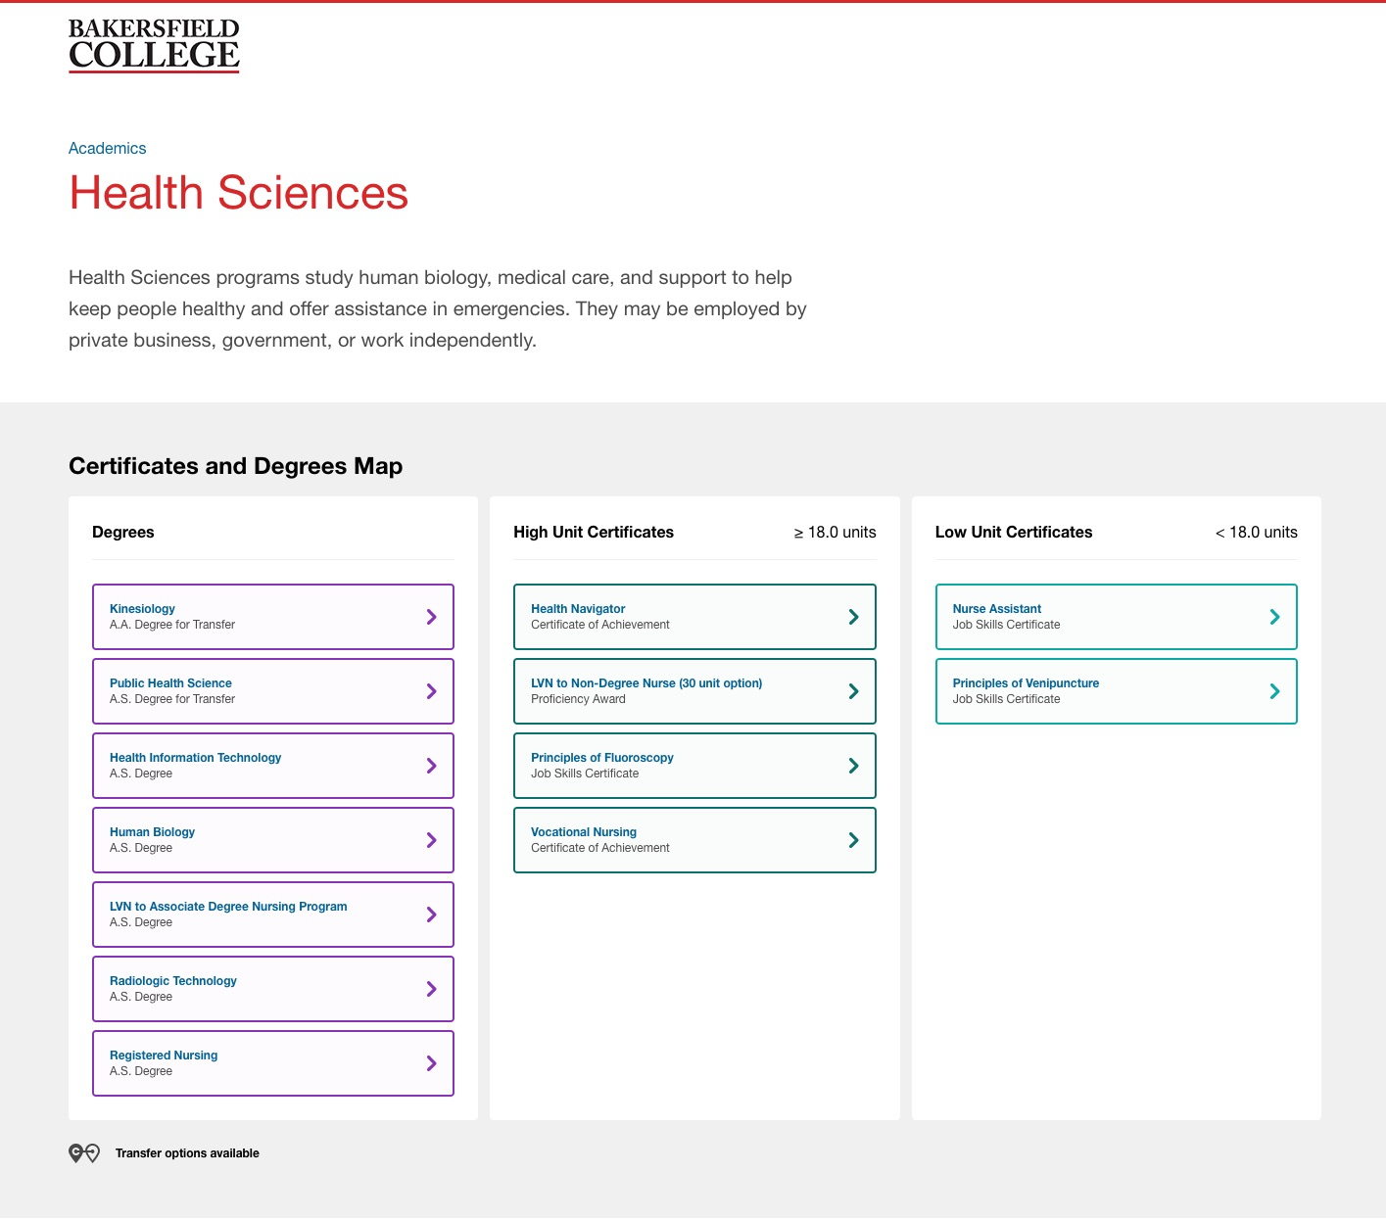

Slide 11
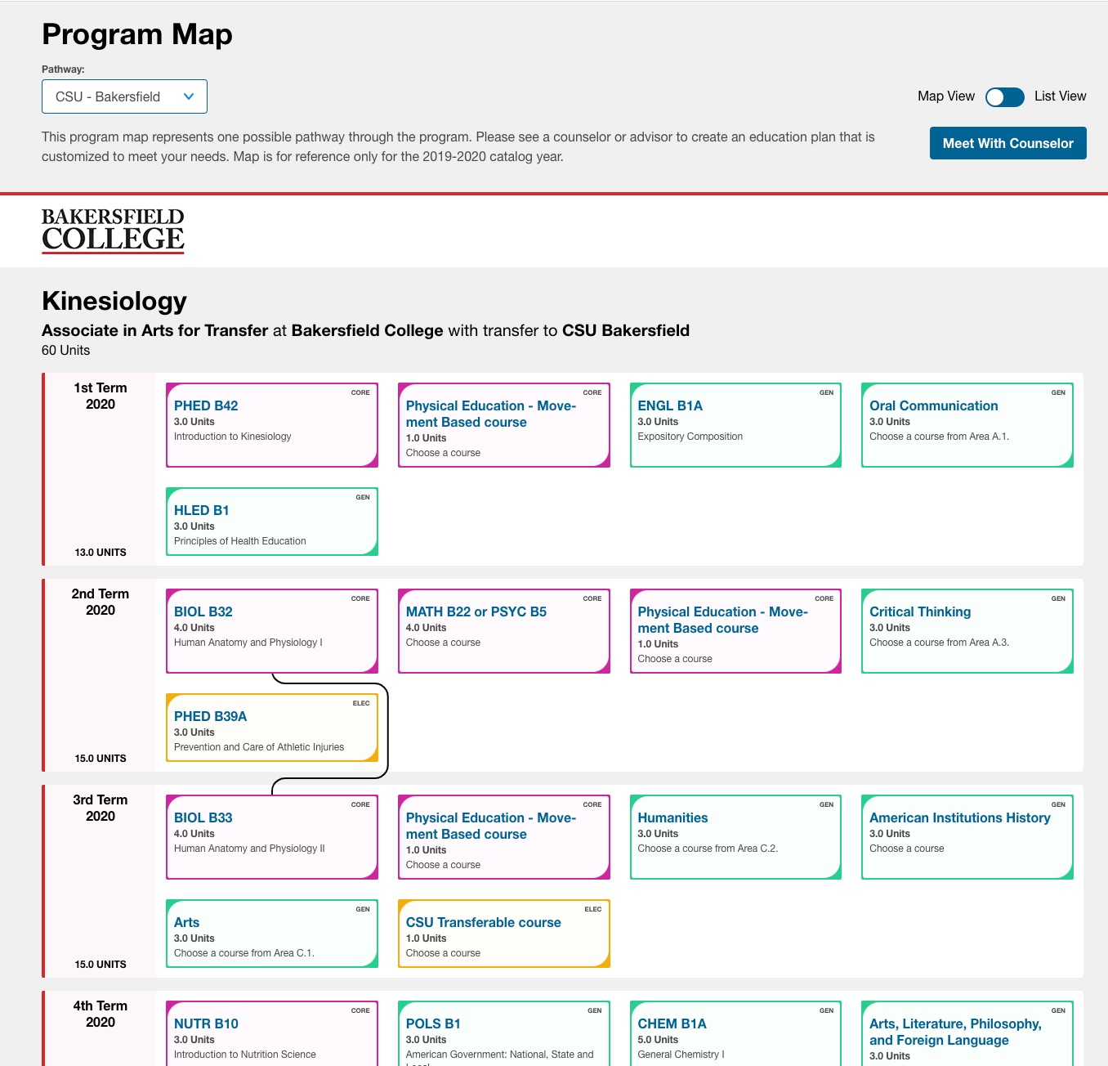
Notes:
Also has the video, the program learning outcomes, the labor market information, etc.

Slide 12
Scaling up

Slide 13
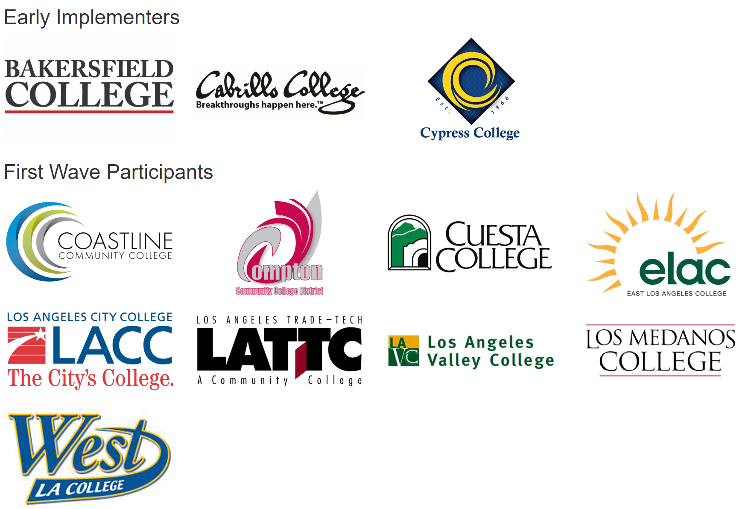
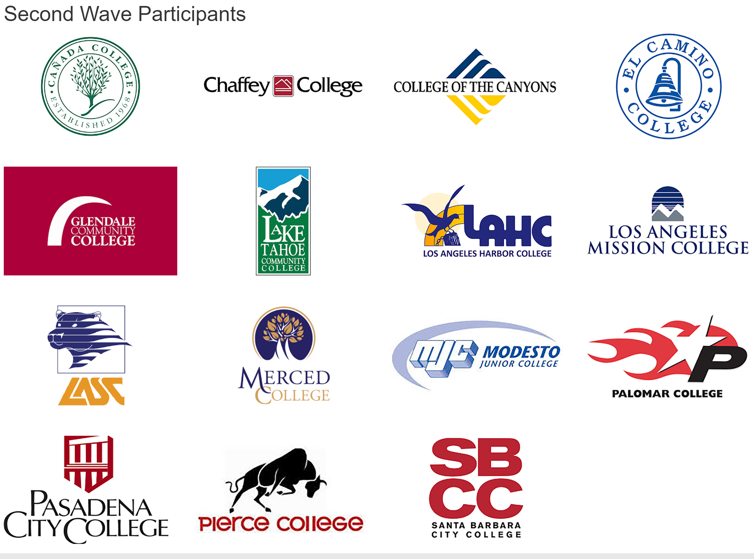
Third Wave Participants

Slide 14
CSUs
UCs

Slide 15
CSU Program Pathways Mapper

Slide 16
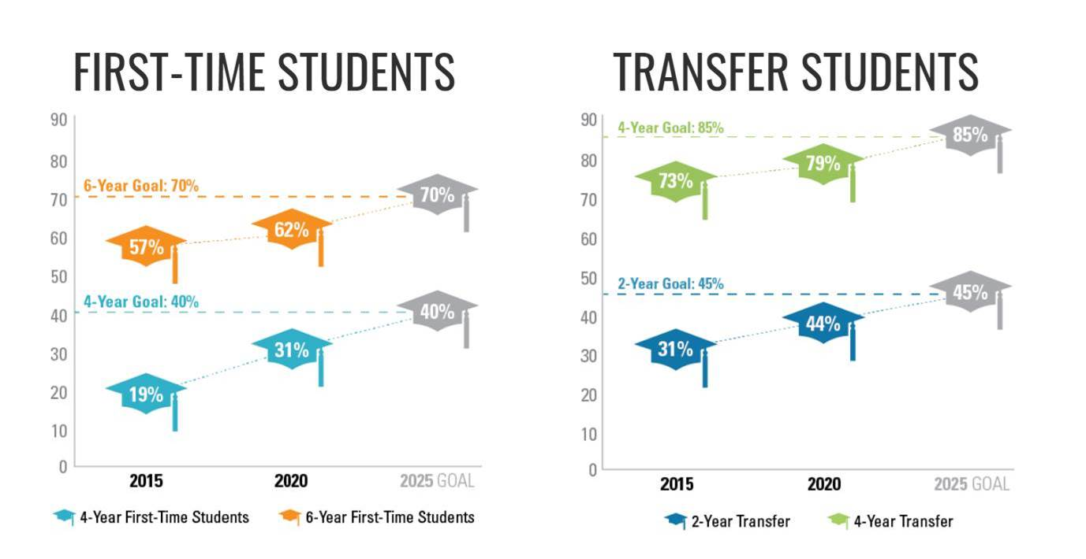
Graduation Initiative 2025
Closing equity gaps and improving graduation rates
Notes:
Update with latest data

Slide 17
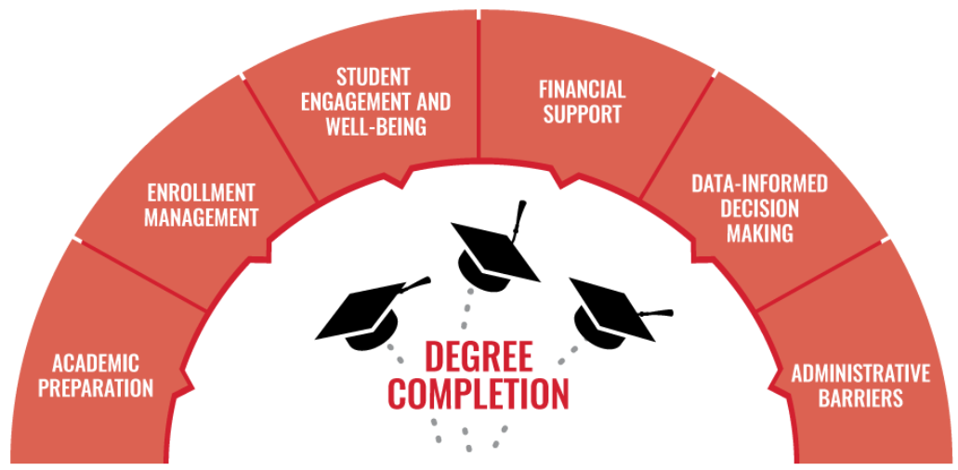
Graduation Initiative 2025
Closing equity gaps and improving graduation rates

Slide 18
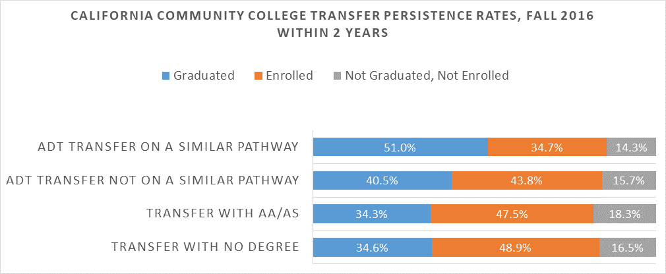
Associate Degree for Transfer
Evidence of Student Success

Slide 19
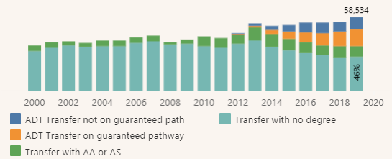
Associate Degree for Transfer
Progress Toward Being on the “Preferred Pathway”

Slide 20
Current State of CSU Transfer Pathways
Spoiler Alert: It is Still Confusing

Slide 21
Timely completion of
Math & English general education
Look at course catalog
Discuss Plans with Advisor
Ensure completion of lower-division GE
Community College Enrollment & Attendance
Community College Progress
Completion of Transfer Requirements
Potential Transfer Student
Look at ASSIST
Apply to CSU
Successful Transfer
Explore transfer campus options
Look at CSU Transfer Page
Enrollment in relevant courses
Complete ADT, AS or AA
Confirm graduation/ transfer timeline
Steady progress in major courses
Consult with an ed planner
Successful community college application, enrollment & attendance
Major selection
Look at Degree with a Guarantee

Slide 22
Removing Barriers to Student Success
Transfer Pathway Mapping to CSUs
Timeline of the Pilot Project
March 2020 – December 2020 March 2021
Goals of the Pilot Project
Strengthen CCC and CSU partnerships through program pathway mapping
Refine and clarify Associate Degree for Transfer pathways
Produce the digital mapping tool for at least 10 ADT pathways per partnership
Increase the percentage of students transferring with an ADT and remaining on a similar pathway

Slide 23
Five Campus Partnerships
Chaffey College and California State University, San Bernardino
Compton College and California State University, Dominguez Hills
Long Beach City College and California State University, Long Beach
Los Medanos College and California State University, East Bay
Palomar College and California State University, San Marcos

Slide 24
It Takes a College!
Transfer Pathways Mapper Project
Discipline
faculty
CSU
campus
CCC campus
Students
IT
Support
staff
Advisors/
counselors
Articulation/transfer officers
IR
Curriculum expert
Campus
leads

Slide 25
Project Timeline: Momentum Points
March 2020
Project kick-off meeting
April to June 2020
Individual campuses work to create 2-year sequenced maps
June to October 2020
Partnership meeting #2
Align maps to create intersegmental 4-year sequenced maps
October to December 2020
Technology and training with Concentric Sky (data cleanup tool, authoring tool, mapper customization)
Review and upload maps to Program Pathways Mapper
10 ADTs mapped “on paper”
January to March 2021
Unveil Transfer Pathways Maps
Develop plan to communicate and market digital mapper to campus stakeholders
Next steps: Ensure institutionalization and sustainability

Slide 26
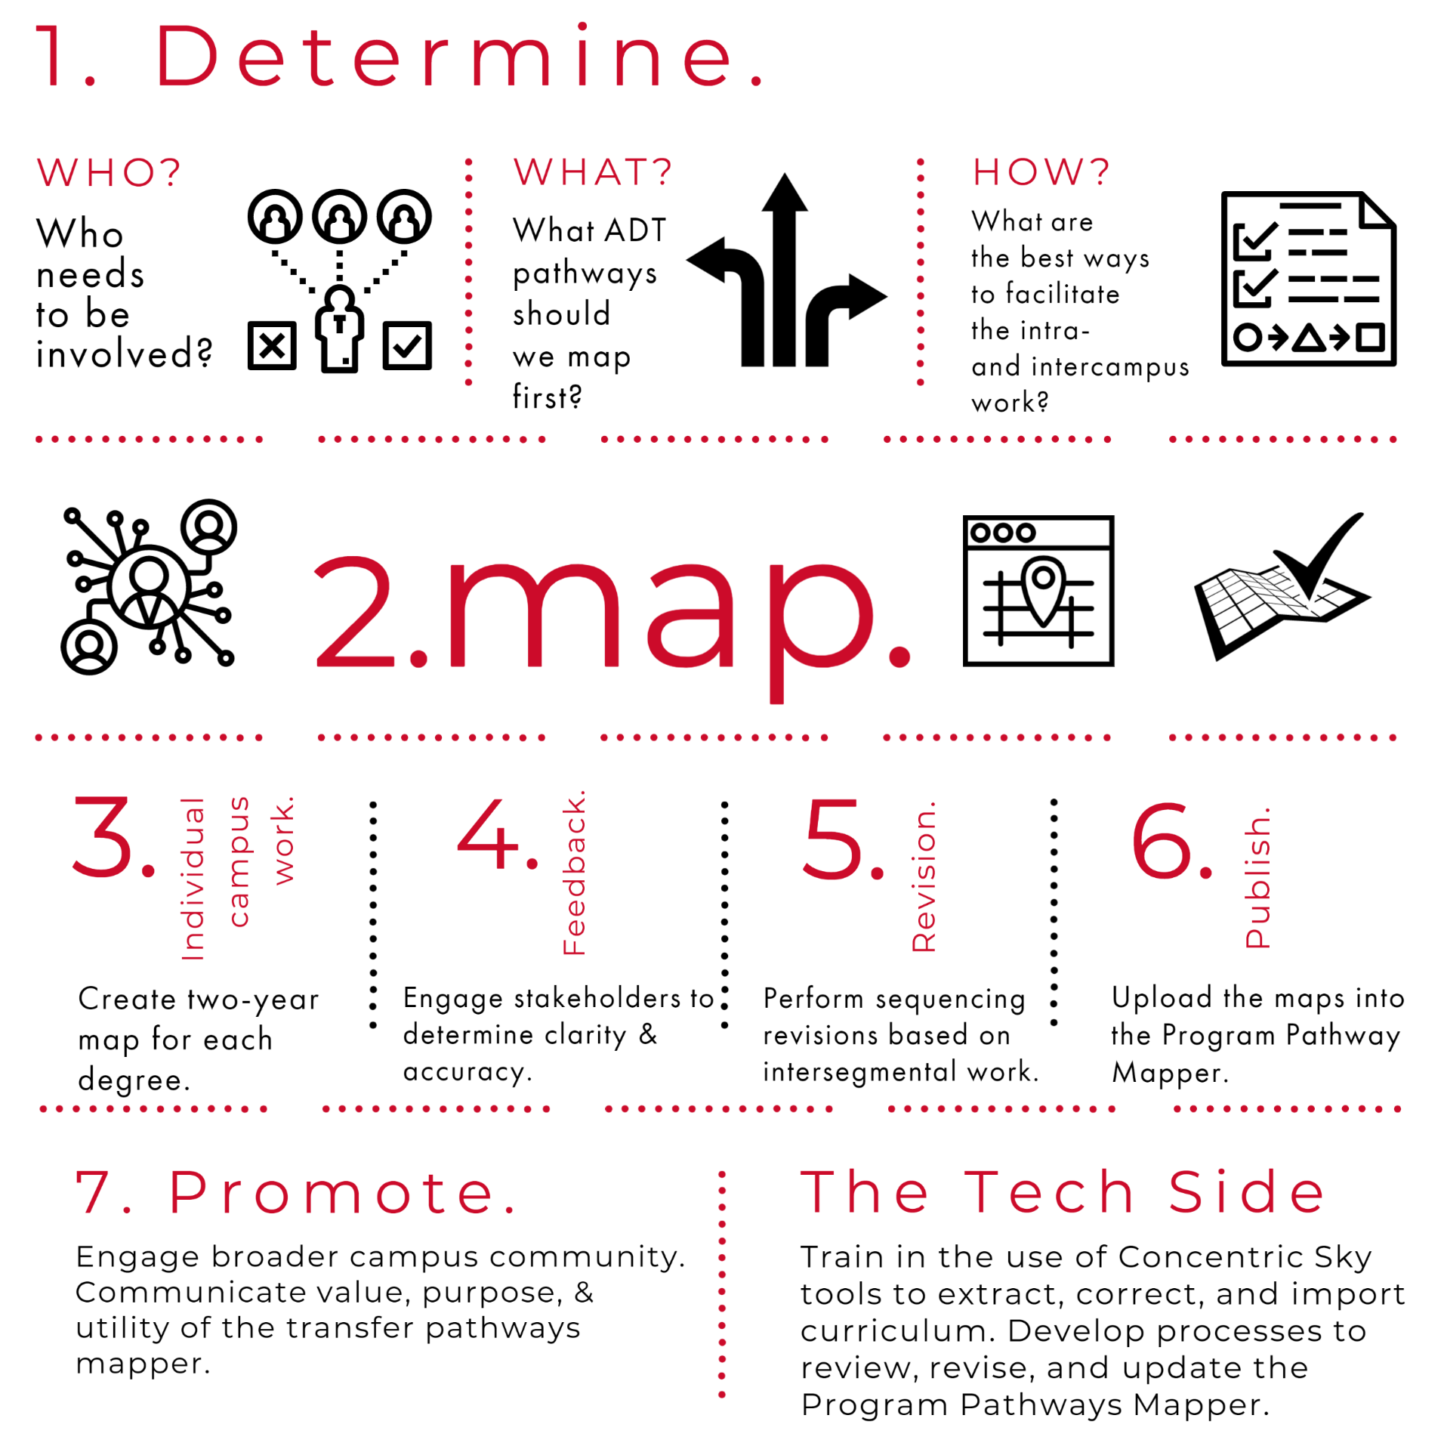

Slide 27
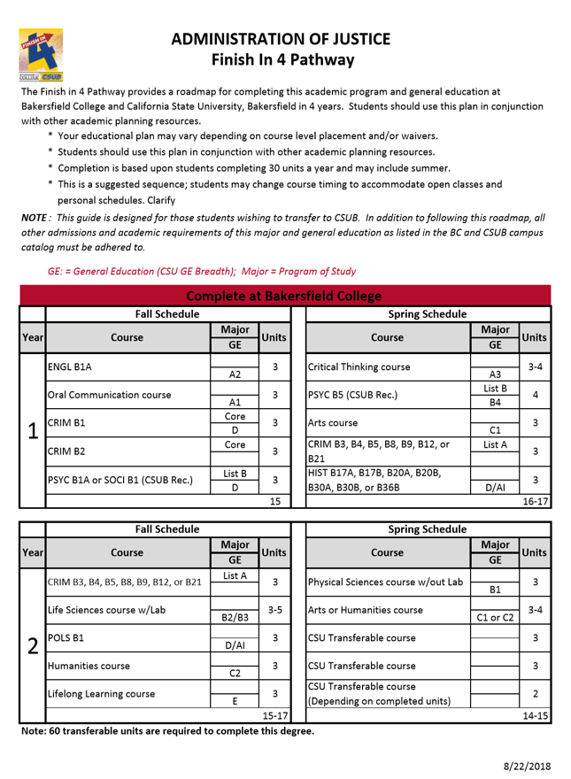
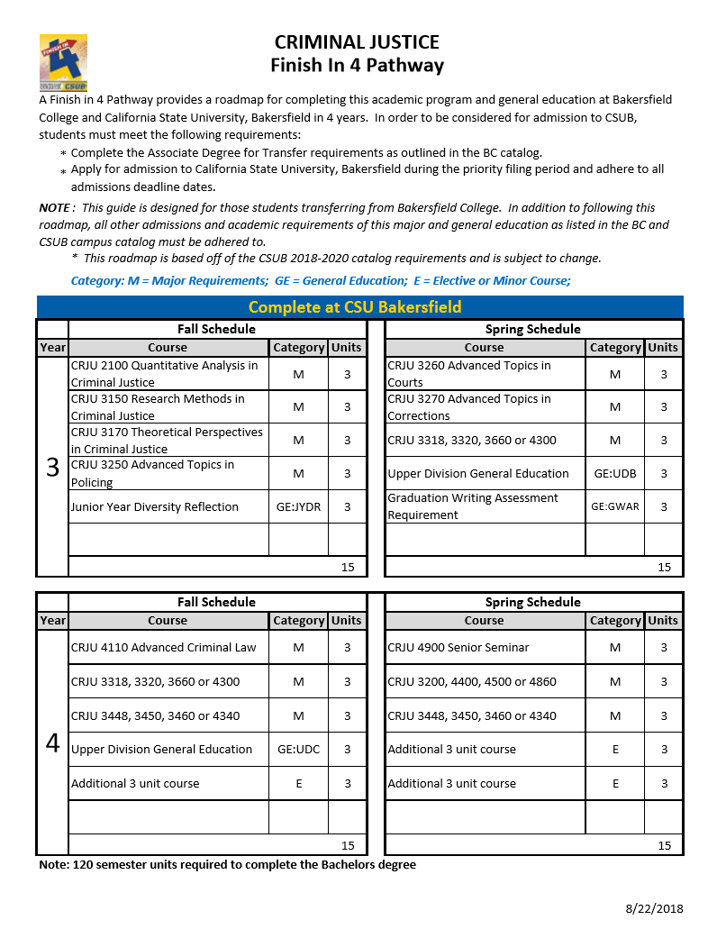
The Paper Maps

Slide 28
Program Pathways Mapper: Impact

Slide 29
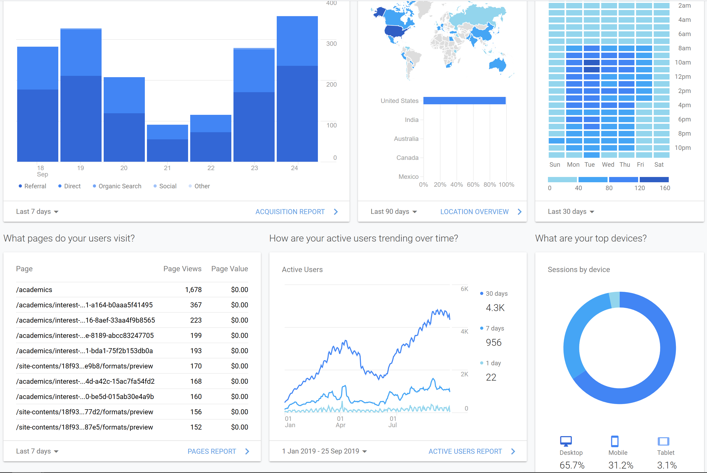
Notes:
Usage is taking off. Not only are students using it extensively but it is now a key tool for counselors.
Since January PPM has hosted over 25,000 users and 48,000 sessions with 6.39 page views per session. That’s over 300,000 pageviews! We are pushing a lot of information.

Slide 30
On-Path Percentage
Leading Indicator of Completion Momentum and Efficiency

Slide 31
Student Course-Taking Becomes More Focused

Slide 32
Student Voice on Program Maps
The salary growth and career section helped me to get a stepping-stone into researching more specifics about what I wanted to start a career in.
The counseling department . . . [has] become very busy and high volume with a lot of students. So I think that because of that, the program mapper is very helpful…because [students] don't have to worry about waiting for a counselor to show them what to do. And some students want to be hands-on and be independent and do [education planning] on their own. So, it kind of gives them the ability to map out exactly what they want to do and how they want to do it. And if they want to change it, they don't have to worry about asking a counselor what classes that they need to take for their new route.
When I was still debating on what to major in, it gave me like an understanding of what courses I would be taking. So that was helpful in helping me make my decision. . . . And when I was told to double major, I could go [to the maps] and check . . . comparisons of [the] overlap between my current major. . . . I was still able to go back and forth.
[Program Mapper] puts you at ease as a college student, like, okay, this is what I need to do. This is what has to happen next. . . .[I like] just how simple it is and how organized it is. I think that's my favorite part.
If you follow Program Mapper or the pathways, you probably could have gotten everything out of the way and then been done on time. . . So it helps you with efficiency and being clear about how to get out as quickly as possible.
It's really useful to figure out which [classes] can transfer over into your certain area to the certain [transfer destination] because you don't want to take a class that's not going to mean anything.

Slide 33
The PPM has already advanced our equity agenda
Notes:
Among students pursuing an ADT, White students increased their on-path percentage by 11 percentage points while Black students increased by 15 percentage points and Latinx students increase by 18 percentage points.

Slide 34
Getting On The Path
Program Mapper Onboarding

Slide 35
Getting on the Path
To learn more about getting on path with the program mapper, complete the Program Pathways Mapper readiness assessment: http://bit.ly/PM-readiness
Check out Bakersfield College’s Program Pathways Mapper site here: http://bit.ly/CS-map
Participate in the Community of Practice on the Vision Resource Center: http://bit.ly/VRC-Login

Slide 36
Q & A

Slide 37
Contact Info
Chenoa S. Woods
cswoods@calstate.edu
@CSWoodsPhD
Craig Hayward
Craig.Hayward@bakersfieldcollege.edu
@doc9x

Slide 38
Thank you!

Slide 39
Please use the WHOVA Mobile App to rate this session. CAIR uses the session evaluations to determine the winners of the Best New Presenter, and Best Presenter awards each year.
Thank you!

