Slide 1
Text Analysis Without Complex Machine Learning Techniques
Presenters: Giang Do
Amy Tieu
Visal Dom

Slide 2
Introduction
Westcliff University Department of Institutional Research Team Members:
Amy Tieu
Giang Do
Visal Dom
Notes:
Giang

Slide 3
Agenda
Abstract
Current Use of Survey Data and Issues Identified
The Use of Text Analysis
Suggested Tools
Notes:
Giang

Slide 4
2. Abstract
Student feedback at the end of each course is significantly valuable for universities to improve programs, courses and the quality of instruction.
Notes:
Giang

Slide 5
3a. Current Use of Student Survey Data
Evaluations uploaded onto GAP*
Download evaluations as an Excel
Organize and analyze data
Format evaluations and send to Program Chairs, Faculty and Leadership for review
Determine if any changes are required for the courses or faculty
Make quantitative and student satisfaction information public
*Global Academics Portal (GAP) is Westcliff University’s Learning Management System (LMS)
Notes:
Visal

Slide 6
3b. Current Use of Student Survey Data
Student evaluations are used to diagnose strengths and weaknesses of the courses.
Westcliff University published survey data analysis on the Institutional Research website. The public is able to view the student’s opinions regarding the quality of the course and learning environment and support.
http://ir.westcliff.edu/course-evaluations/
Notes:
Visal

Slide 7
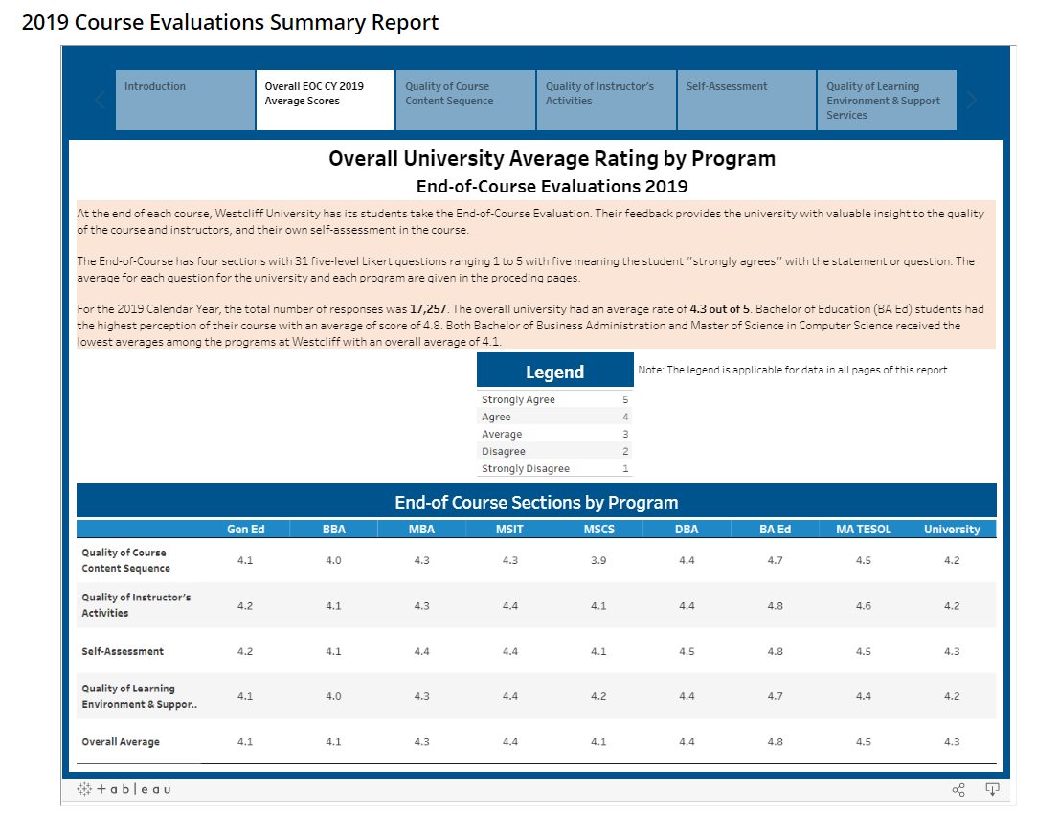
3c. Current Use of Student Survey Data

Slide 8
3d. Issues with Survey Data
Qualitative Data
Generalized
Likert scale
Quantitative Data
Unstructured
Complex
Better understanding student perception
Lacking of feedback
Technical capability
Notes:
Visal

Slide 9
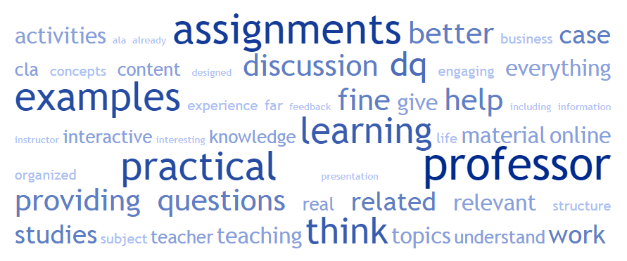
4a. Motivation for Text Analysis
Unstructured Data
Structured
Meaningful Data
Exclude blank responses, unspecified characters.
Identify possible outliers.
Categorize text data efficiently.
Perform text analysis
Notes:
Amy

Slide 10
4b. Motivation for Text Analysis
Types of text analysis examples:
Sentiment - determines whether content of the data is positive, negative, or neutral
Categorical -categorize content of the data based on specific identified categories.
Emotions - determines the content of the data based on emotions (sad, happy, etc.)
Cluster- grouping a set of data (keywords) in the clusters which are more similar to each other compared to other groups of clusters.
Notes:
Amy

Slide 11
5a. Using Google Add-in for Text Analysis
Notes:
Amy

Slide 12
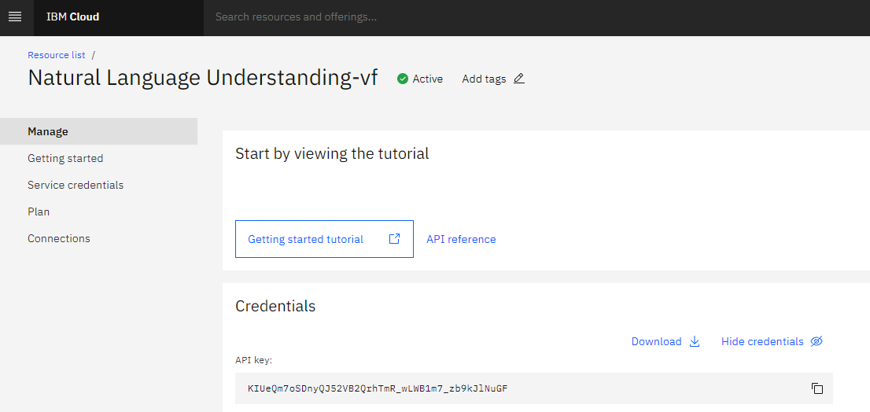
5b. Using Excel add-in for Text Analysis
Notes:
Amy

Slide 13
Run Sentiment Analysis by Excel Add-in
Notes:
Giang

Slide 14
Sentiment Results
Sentiment | Sentiment Score | Description
Positive | >0 | The underlying tone of the feedback is good and positive
Neutral | 0 | The feedback is neutral and general
Negative | <0 | The underlying tone of the feedback is not good and need attention

Slide 15
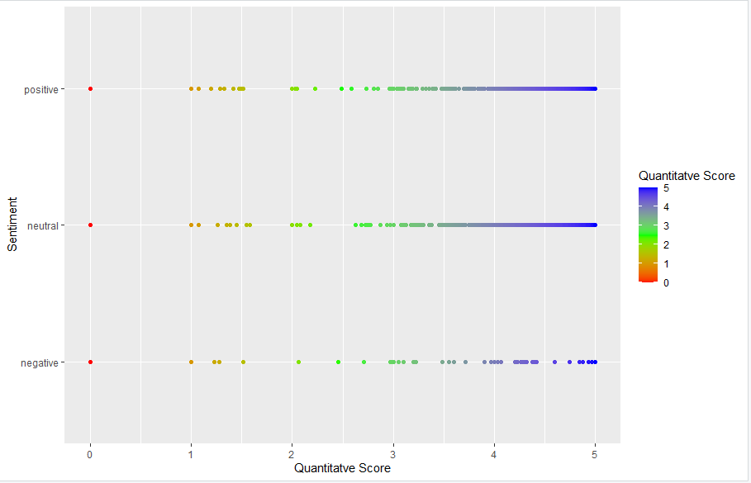
5c. Visualization
Scatter plot using R
X-axis: sentiment
Y-axis: avg quantitative
Focus group 1
Focus group 2
Notes:
Giang

Slide 16
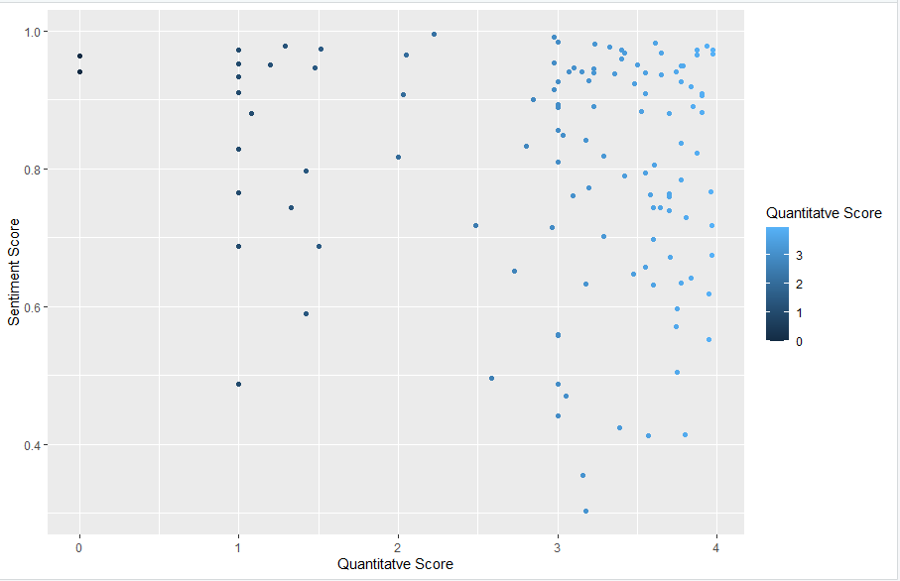
Focus Group 1: Positive Sentiment, but Low Average Quantitative Scores
Student feedback with conflict sentiment and quantitative score are furthered analyzed

Slide 17
Q & A
Thank you for participating in our session!
For more information, please email us at dir@westcliff.edu

