Slide 1
IR Juggling: Objectivity, Accountability, and the Fierce Urgency of Now
Terrence Willett, Mallory Newell, & Craig Hayward
CAIR 2020
11/20/20

Slide 2
Brief History of Institutional Research
CAIR began 1971 & incorporated 1988
RP Group north and south combined and incorporated in 1994
Partnership for Excellence (PFE) funding and accountability in 1998 began modern era of accountability for community colleges
The term “institutional effectiveness” first appears around 1984 in conjunction with accreditation standards
Head, R. B. (2011), The evolution of institutional effectiveness in the community college. New Directions for Community Colleges, 2011: 5-11. doi:10.1002/cc.432

Slide 3
Ethics codes of IR organizations
AIR: https://www.airweb.org/ir-data-professional-overview/statement-of-ethical-principles/principles
CAIR: Same as AIR
The Research and Planning Group (Draft): https://drive.google.com/file/d/1nsBTL0QlD10u9KyZR2EQSji_b2lk5pcD/view?usp=sharing
We acknowledge that the individuals whose information we use have rights, derived from both legal and ethical principles that can cross national borders.
Other organizations
AERA Code of Ethics: https://www.aera.net/Portals/38/docs/About_AERA/CodeOfEthics(1).pdf
USC’s Pullias Center for Higher Education: https://pullias.usc.edu/about/
Academic Senate for California Community Colleges: https://www.asccc.org/policies/codeofethics
Equal Opportunity - Ensure the right of all Executive Committee members, staff, volunteers, constituents, and Member Senates to appropriate and effective services without discrimination on the basis of race, ethnicity, gender/sex, sexual orientation, sexual identity, and expression (transsexual/transgender) disability status, religious and political affiliations, age, cultural background, socioeconomic status, academic and vocational disciplines, full- and part-time status, and the types of colleges that exist throughout the system, in accordance with all applicable legal and regulatory requirements.

Slide 4
Association of Institutional Research: AIR Ethics Statement
Excerpt of interest from current AIR ethics statement:
We recognize the consequences of our work. The analytic algorithms and applications we build and/or implement, as well as the policy decisions incorporating information we analyze and disseminate, impact people and situations.
We make intentional efforts to protect their information from misuse or use that could cause them harm.
Also of interest is that the current statement no longer includes the following from AIR’s prior statement of ethical principles:
We seek to be fair and transparent, providing objectivity and impartiality. AIR Statement of Ethical Principles (old)

Slide 5
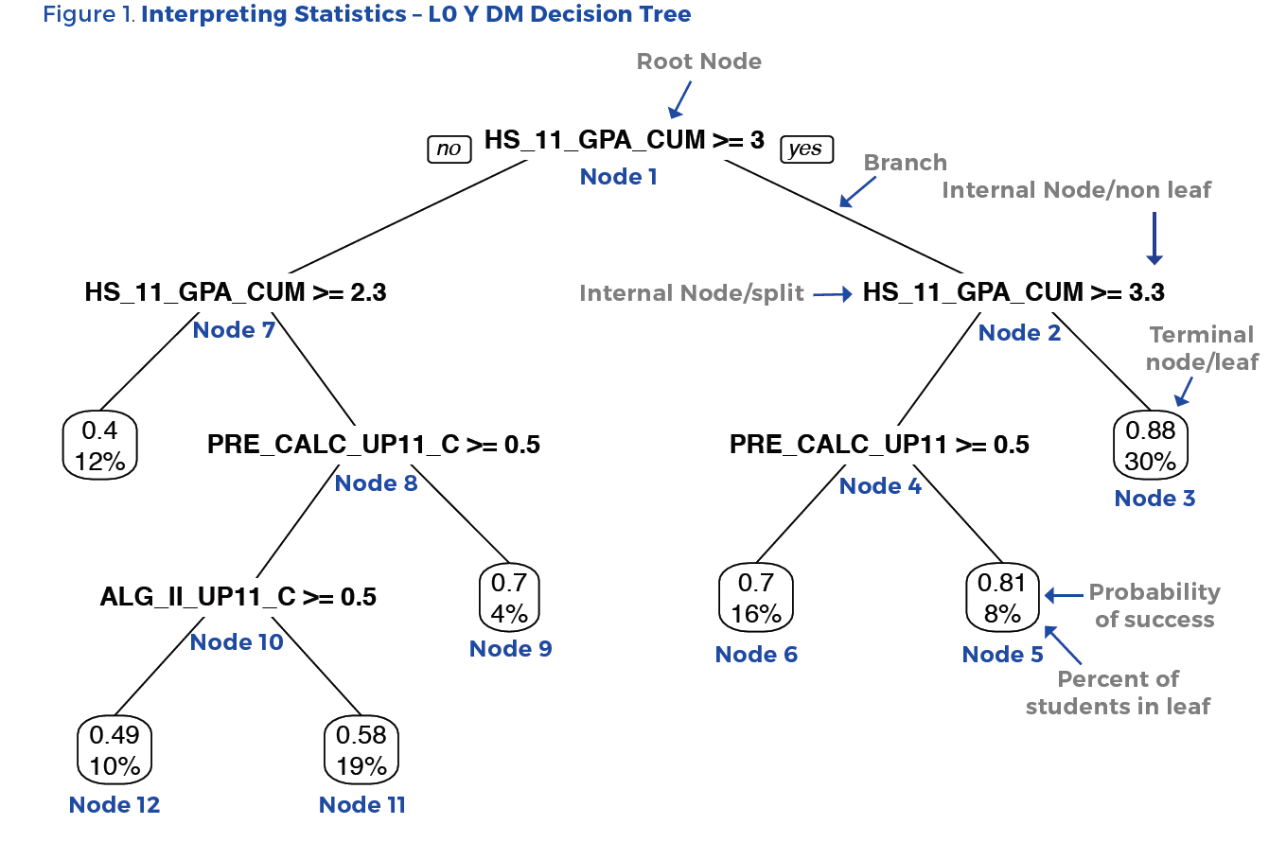
https://rpgroup.org/Portals/0/Documents/Projects/MultipleMeasures/DecisionRulesandAnalysisCode/Math-Decision-Trees-4_3_16.pdf

Slide 6
Enrollment in Transfer-Level English, Disaggregated by Ethnicity
Notes:
Terra
As displayed, access to transfer level English for the 4 racial/ethnic groups, African American, Asian, Hispanic and White have largely closed and are no greater than 4 percentage points. This is a huge departure from a system that largely placed African American and Hispanic students in below transfer level courses.
Total N’s:
African American = Fall 2015 = 9,676 to Fall 2019 = 9,186
Asian = Fall 2015 = 19,733 to Fall 2019 = 20, 737
Hispanic = Fall 2015 = 80,401 to Fall 2019 = 93,000
White = Fall 2015 = 41,277 to Fall 2019 = 36,080
White = Fall 2015 = 41,277 to Fall 2019 = 36,080

Slide 7
Discussion Questions
What is the role of IR/IE in the context of social justice and racial equity and holding colleges and personnel accountable for outcomes?
Have you reviewed ethics statements of IR/IE organizations?
Have you discussed ethics in your office? Should ethics statements be bold and include explicit statements about antiracism?
What is the role of faculty allies in advancing the work of IR/IE?

Slide 8
Please use the WHOVA Mobile App to rate this session. CAIR uses the session evaluations to determine the winners of the Best New Presenter, and Best Presenter awards each year.
Thank you!

