Slide 1
Hearing Our Students' Voices During COVID Commencement Planning
Kelly Wahl
Director of Student Achievement and Special Projects
Undergraduate Education

Slide 2
Learning Objectives of This Presentation
Identify student priorities through survey research
Recount one approach for executing a research project in response to an urgent need and communicate findings
Recognize the predictors of student participation in commencement celebration activities

Slide 4
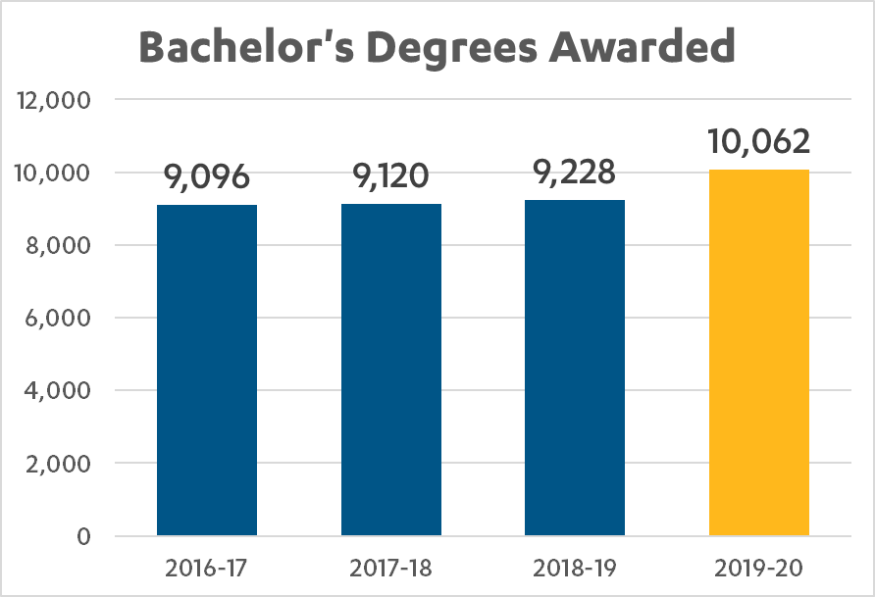

Slide 5
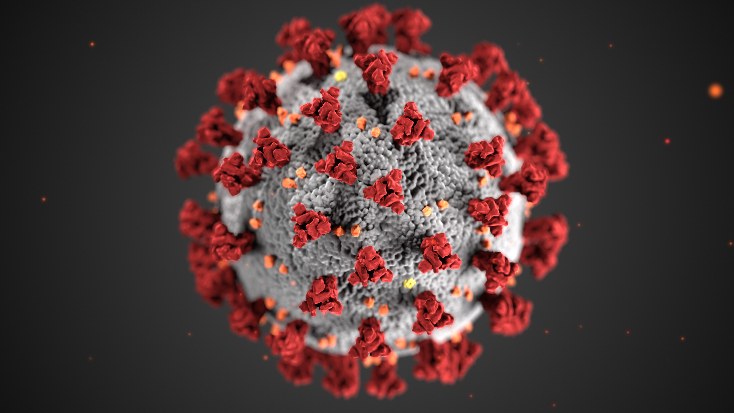
COVID-19
https://www.cdc.gov/media/subtopic/images.htm

Slide 6
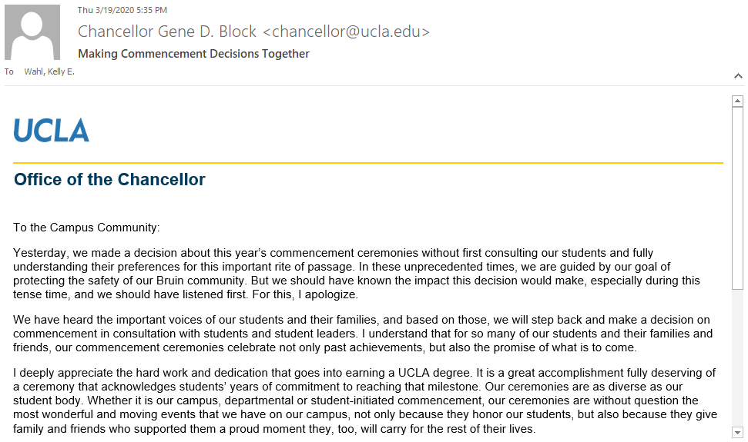
“We have heard the important voices of our students and their families, and based on those, we will step back and make a decision on commencement in consultation with students and student leaders.”

Slide 7
Which do you prefer?
A virtual ceremony in spring 2020 and a Pauley Pavilion ceremony in spring 2021 (if conditions are safe at that time for in-person gatherings).
14% (n=664)
A virtual ceremony in spring 2020 and an on-campus ceremony (location to be determined) sometime during 2020-21 (when conditions are safe for in-person gatherings).
84% (n=3,921)
A virtual ceremony in spring 2020 only.
2% (n=81)

Slide 8
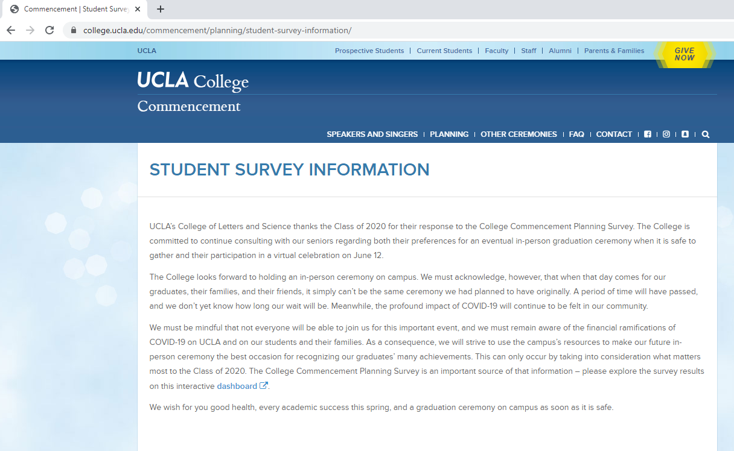
https://college.ucla.edu/commencement/planning/student-survey-information/

Slide 9
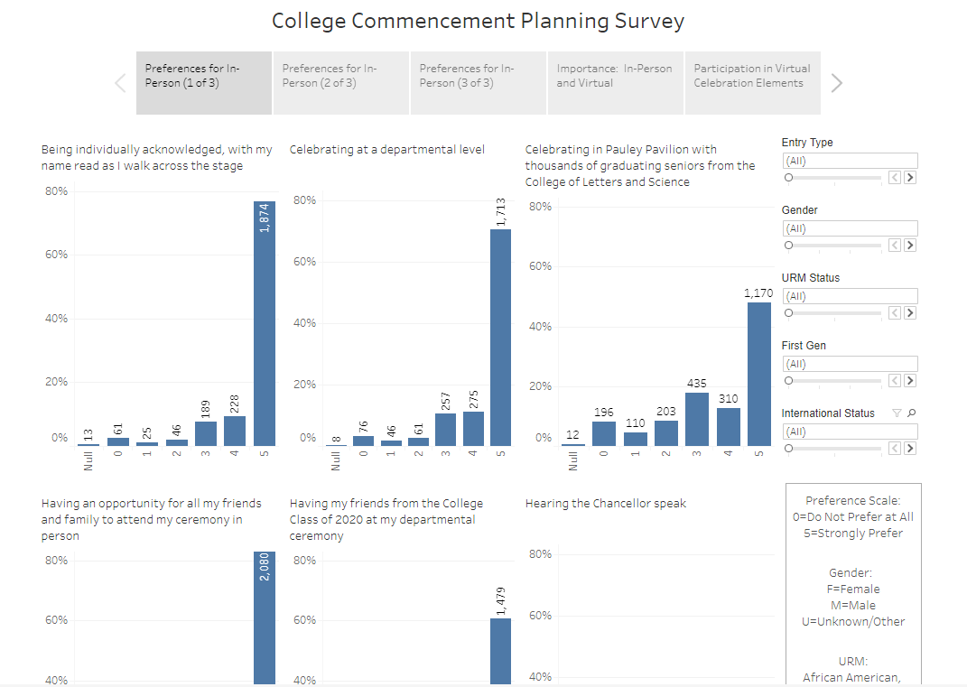

Slide 10
Graduating Student Slides

Slide 11
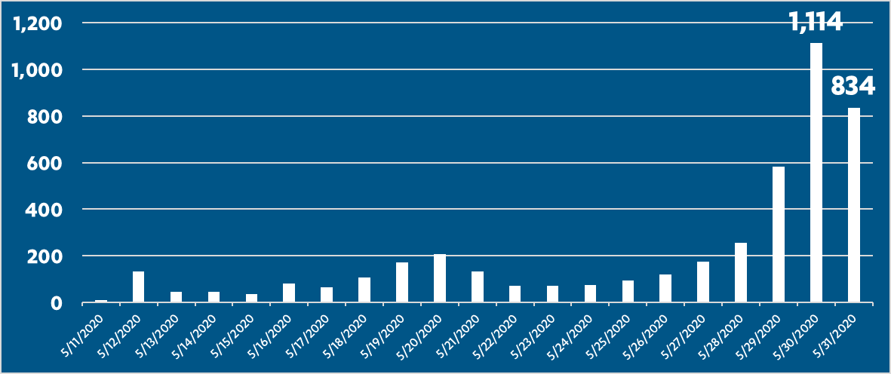
Some students waited until the last minute…

Slide 12
Of the students who said they didn’t want a virtual celebration, 61% submitted a slide anyway (compared to 78% of all others).
The most enthusiastic students wanted
to wait for the
right photo to include.
Submit early Submit in last 10 days
“I would definitely participate (in the slides).” (n=782) 40% 60%
Everyone else (n=1,585) 48% 52%
Submit early Submit in last 10 days
Do not want a virtual celebration at all (n=814) 53% 47%
Everyone else (n=1,553) 42% 58%
Submit on last day Submit before last day
Do not want a virtual celebration at all (n=814) 24% 76%
Everyone else (n=1,553) 31% 69%
(p <= 0.001 for all comparisons above)
Less enthusiastic students got the assignment out of the way sooner.

Slide 13
Prediction of Participation in the Slides
 | B | S.E. | Wald | df | Sig. | Exp(B) | 95% C.I.for EXP(B)
 |  |  |  |  |  |  | Lower | Upper
International | -0.272 | 0.122 | 4.942 | 1 | 0.026 | 0.762 | 0.599 | 0.968
Transfer | -0.274 | 0.101 | 7.358 | 1 | 0.007 | 0.760 | 0.624 | 0.927
First Gen | -0.475 | 0.099 | 22.751 | 1 | 0.000 | 0.622 | 0.512 | 0.756
Male | -0.554 | 0.105 | 28.017 | 1 | 0.000 | 0.574 | 0.468 | 0.705
Definitely Have Slide | 0.728 | 0.119 | 37.638 | 1 | 0.000 | 2.070 | 1.641 | 2.612
Don't Want Virtual | -0.484 | 0.103 | 21.921 | 1 | 0.000 | 0.616 | 0.503 | 0.755
Constant | 1.419 | 0.094 | 229.453 | 1 | 0.000 | 4.131
-24%
-24%
-38%
-43%
2 times
-38%
p<0.001, Nagelkerke R Square = .11

Slide 14
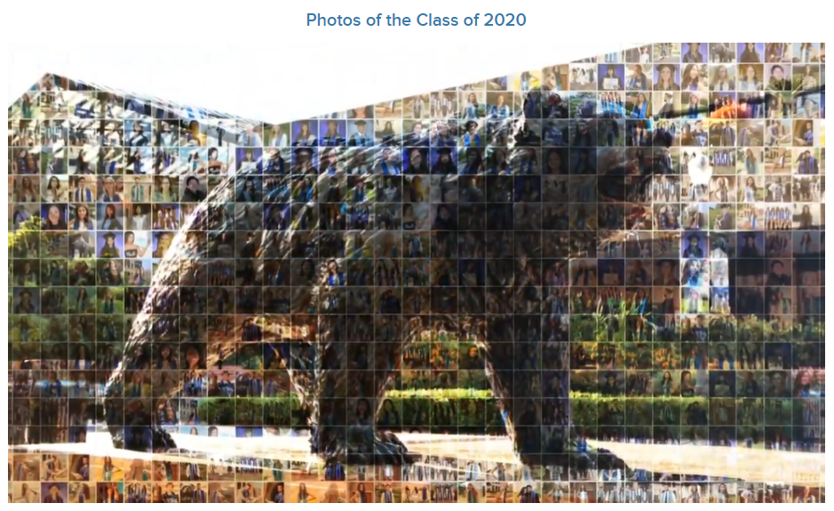
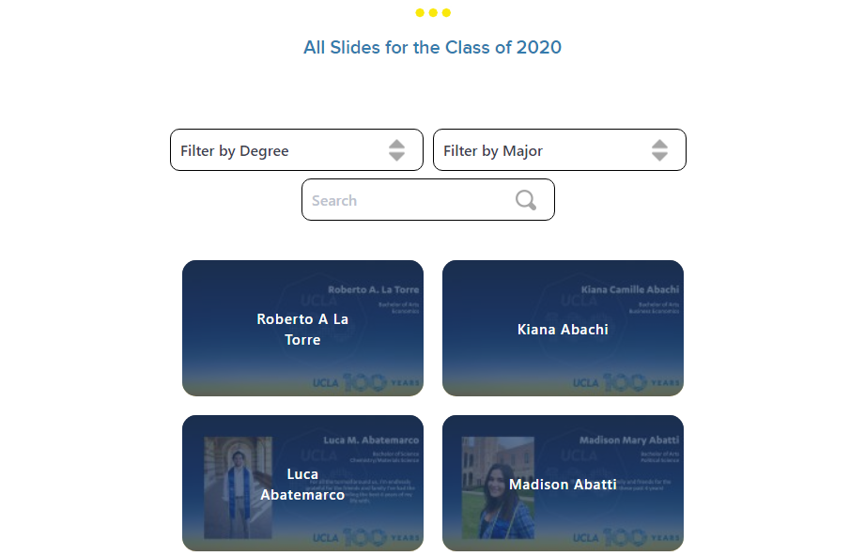
https://www.college.ucla.edu/commencement/

Slide 15
Thank you for joining me!
Please use the WHOVA Mobile App to rate this session. CAIR uses the session evaluations to determine the winners of the Best New Presenter and Best Presenter awards each year.
Kelly Wahl
kwahl@college.ucla.edu
Undergraduate Education

Slide 16
Please take a few moments to explore the UCLA College of Letters and Science Commencement 2020 website: https://www.college.ucla.edu/commencement I look forward to your questions!

