Slide 1
Leveraging Staff Insights for Enhanced Decision Support
Victoria Couch, CAIR 2020
Notes:
intro

Slide 2
Session outcomes
Participants will…
Explore how staff insights can be leveraged for decision support
Learn staff opinions related to policy and campus climate from the HERI 2020 Staff Climate Survey
Brainstorm how staff data can be used at their own institutions to assist with decision support

Slide 3
Why collect data from staff?
Key campus stakeholders (Alves et al, 2010)
Unique perspective that contributes to a more well-rounded understanding of campus matters (Mayhew et al, 2006)
Challenges of shared governance (Nadler et al, 2010)
Ethical considerations

Slide 4
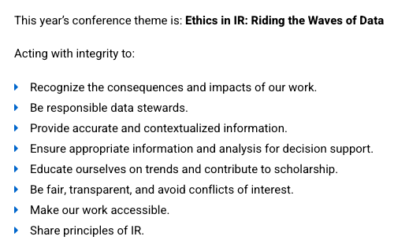
Ethical Considerations: Connection to Conference Theme
What are the consequences of implementing policies that affect staff without first consulting them?
What might institutional researchers miss by omitting staff data from decision support?

Slide 5
Prompt
How has your campus used staff data in the past?
<a href="https://www.vecteezy.com/free-vector/survey">Survey Vectors by Vecteezy</a>

Slide 6
HERI Staff Climate Survey Overview/Background
Notes:
HERI suite of surveys, longitudinal
HERI survey admin overview: paid survey etc
[1] assess climate for diversity from staff perspective [2] collects data in areas like experiences w/ discrimination, cross-racial interactions, and satisfaction with working conditions [3] allows for disaggregation by different social identities
New survey (currently on fifth admin), open-ended responses

Slide 7
Survey Sample/Demographics
N = 4,402
Data collection period: Oct. 2019 - May 2020
16 institutions
Community Colleges: 1
Public Universities: 1
Public Four-Year Universities: 5
Geographic Regions
New England (CT, ME, MA, NH, RI, VT): 1
Mid East (DE, DC, MD, NJ, NY, PA): 2
Private/Nonsectarian Four-Year Colleges: 3
Private Universities: 2
Catholic Four-Year Colleges: 2
Other Religious Four-Year Colleges: 2
Great Lakes (IL, IN, MI, OH, WI): 5
Far West (AK, CA, HI, NV, WA): 8
Notes:
Descriptives & open-ended responses (open-ended reinforce quant results)
response

Slide 8
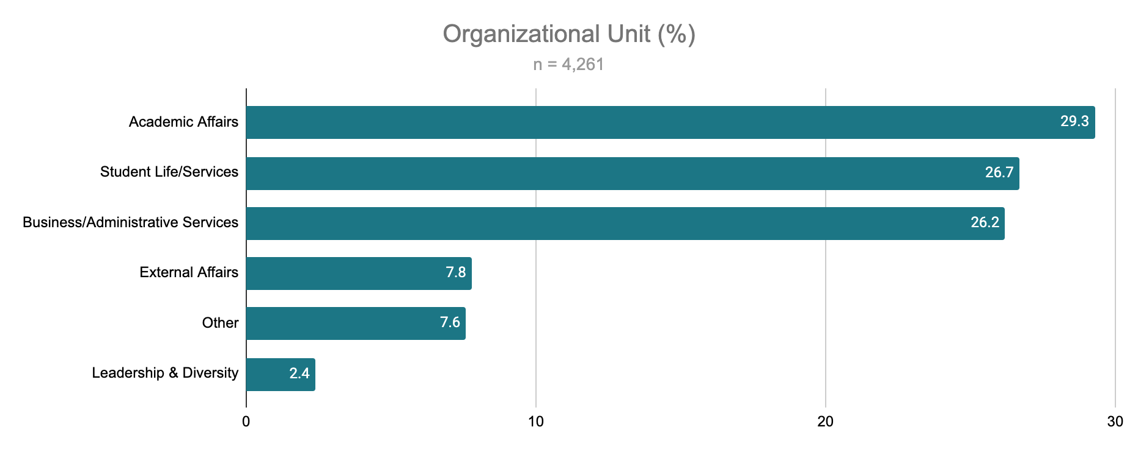
Notes:
Over 80% of respondents captured in first three units

Slide 9
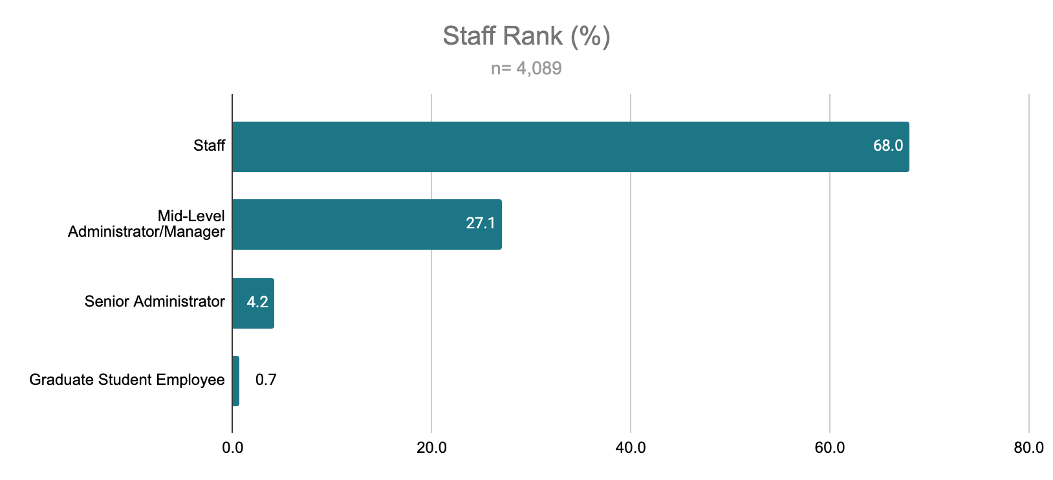
Notes:
94.1% full-time

Slide 10
Racial Group | % | N
Alaska Native/Native American | 0.2 | 8
Asian | 7.5 | 309
Black | 6.5 | 269
Latinx | 13.5 | 558
Multiracial | 8.3 | 342
Native Hawaiian/Pacific Islander | 0.3 | 14
White | 62.1 | 2,566
Other | 1.5 | 63
Gender Identity | % | N
Man | 30.9 | 1,268
Woman | 63.6 | 2,609
Non-binary | 0.5 | 22
Genderqueer/Gender Non-conforming | 0.3 | 14
Identity Not Listed | 4.7 | 192

Slide 11
Do staff feel their perspectives are valued and put to use?

Slide 12
Over half (52.5%) do not believe that staff concerns are considered when making policy
<a href="https://www.vecteezy.com/free-vector/people">People Vectors by Vecteezy</a>

Slide 13
Over one-third (36.5%) do not believe that their institution encourages staff to have a public voice
<a href="https://www.vecteezy.com/free-vector/mega-phone">Mega Phone Vectors by Vecteezy</a>

Slide 14
Open-ended Responses
“Staff do not have a voice at this institution. There is no consideration of staff in making policy.”
“Leadership ends up making decisions that affect all types of stakeholders in the campus community without taking the staff opinions into consideration.”
“I believe the University's governance structure does not provide a space for student affairs professionals to have an equal voice in the University.”
Notes:
Echo lit in this area, clear that substantial proportion of staff do not feel heard

Slide 15
Putting the Data to Work....

Slide 16
Connection to Current Events
Workplace safety
Climate for Black staff

Slide 17
Staff Concerns with Workplace Safety
Notes:
81.7% of responses collected prior to 3/11 when WHO declared pandemic

Slide 18
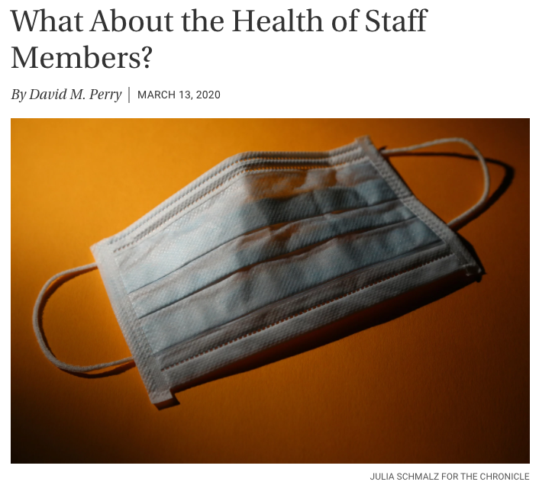
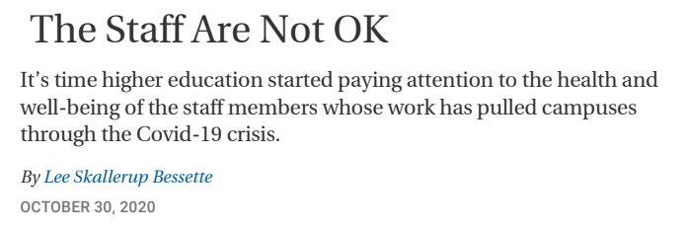
Recent Headlines

Slide 19
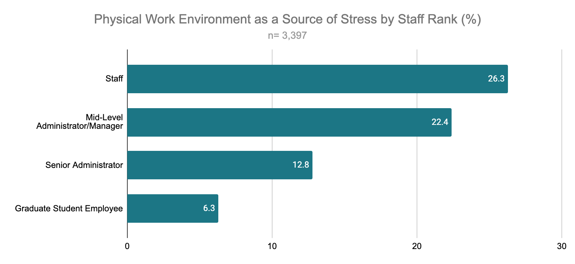
Total: 24.6% cite their physical work environment as a source of stress
Notes:
More than twice as many staff consider it a source of stress compared to senior admins

Slide 20
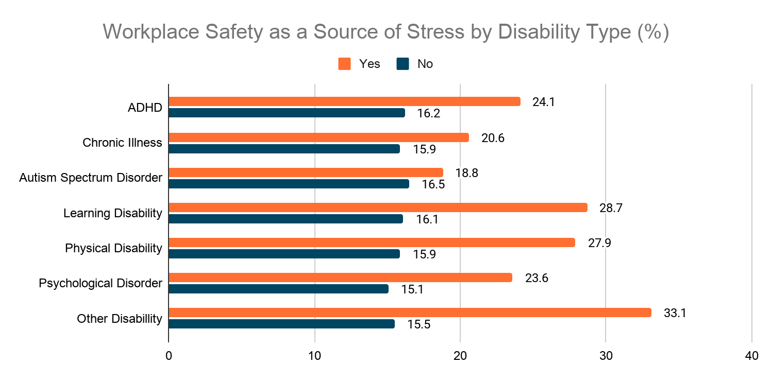
Total: 16.7% cite workplace safety as a source of stress
Notes:
All disability more concerned
Non disability between 15-16.5
Disabillity 18.8-33.1
Top 3: learning disability, physical dis, other dis

Slide 21
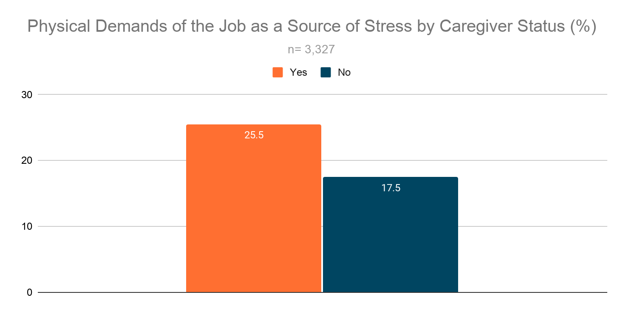
Total: 24.6% cite the physical demands of their job as a source of stress

Slide 22
Open-Ended Responses
“I feel that there was a delay in allowing all staff to work safely from home when the degree of threat of Covid-19 became apparent.”
“Senior Administration did not consider needs of staff's safety amid COVID-19 crisis”
“There seems to be a lot of scenarios wherein the information coming in is vague or deliberately withheld or the information is relayed to faculty faster when, in practice, it is the staff that are the most affected--on the front lines...”
Notes:
Early in pandemic

Slide 23
Summary
Staff Concerns with Workplace Safety
<a href="https://www.vecteezy.com/free-vector/medical-mask">Medical Mask Vectors by Vecteezy</a>
Notes:
Matters of workplace safety are stratified by staff rank, disability, caregiver status. These concerns likely heightened since pandemic
Staff highlight how their safety concerns were not built into university policy/communications
Link to how this would enhance decision support (stakeholders with especially pressing safety concerns who should be included/considered in policy formation)

Slide 24
Climate for Black Staff
Notes:
Summer protests

Slide 25
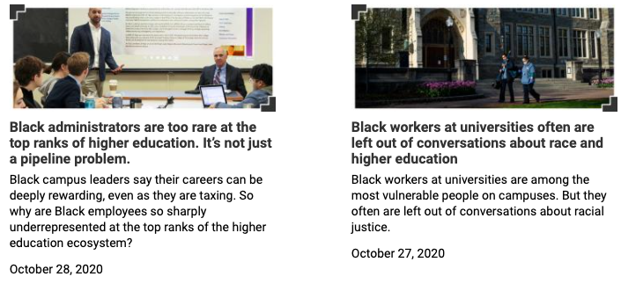
Recent Headlines

Slide 26
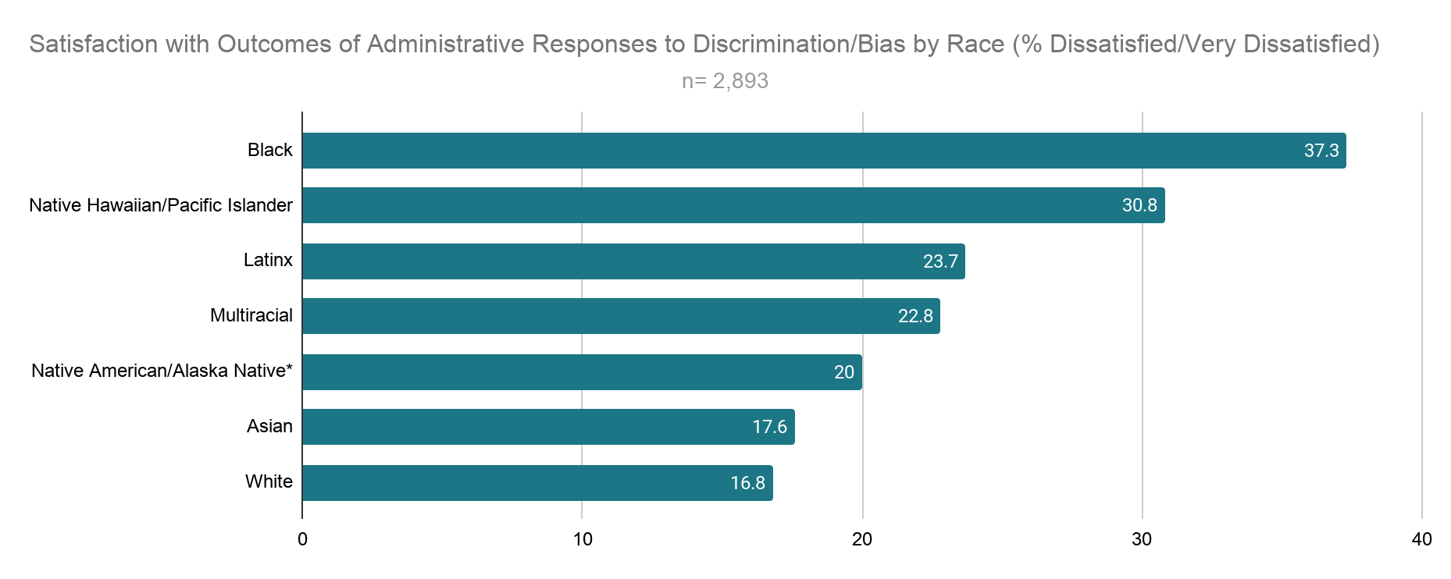
Total: 20.1% dissatisfied/very dissatisfied with outcomes of administrative responses to discrimination/bias
*n= 5
Notes:
17 pp higher than aggregate
7 pp than next group NH/PI (the only two groups in the 30s)
Group in 20s
Group in teens

Slide 27
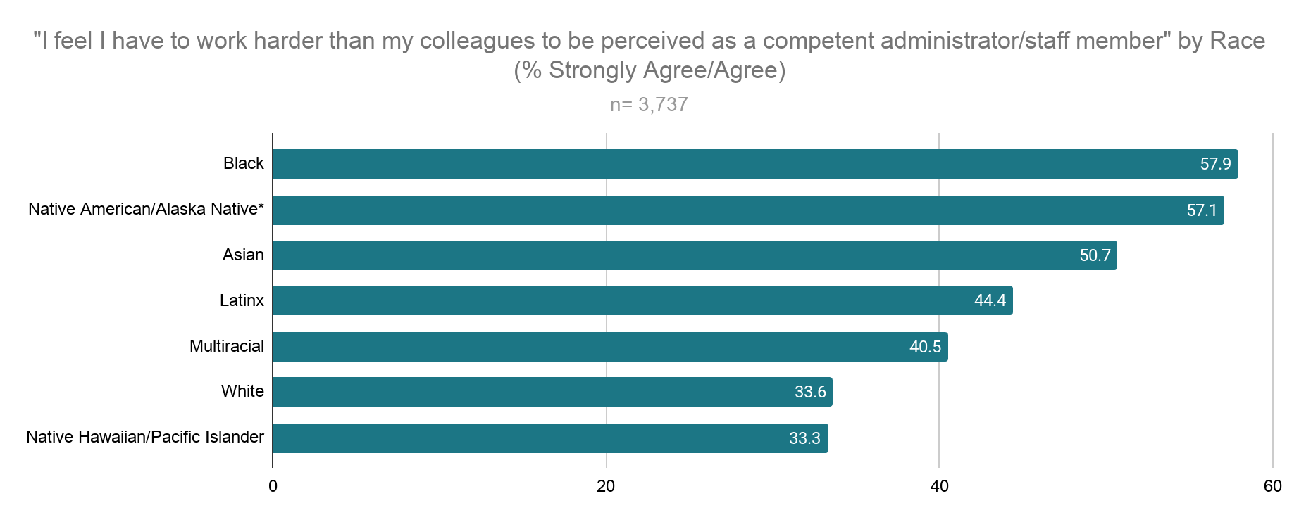
Total: 38.6% strongly agree/agree, “I feel I have to work harder than my colleagues to be perceived as a competent administrator/staff member.”
*n= 7
Notes:
20 pp difference from aggregate
Group in 50s
40s
30s

Slide 28
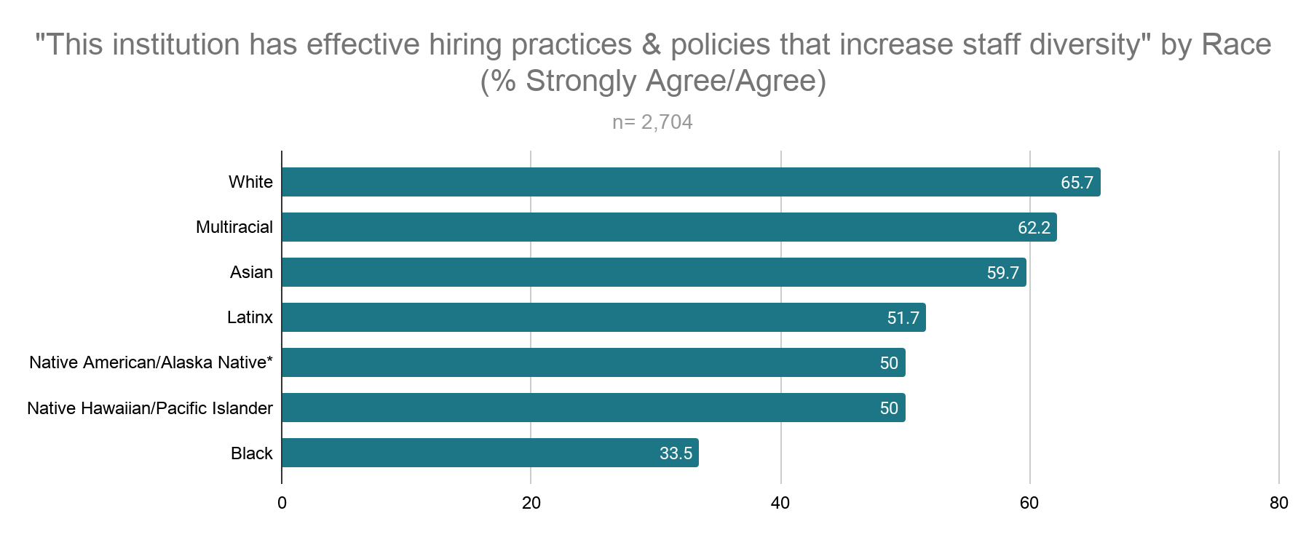
Total: 60.7% strongly agree/agree, “This institution has effective hiring practices & policies that increase staff diversity.”
*n= 6
Notes:
27 pp difference, almost twice, only group under half, biggest difference compared to other group of all items
Next closest group is almost 20 pp away
NH/PI, NA/AN, Latinx all close together
Asian, multiracial, white all high and close to one another

Slide 29
Open-Ended Responses
“We don't retain black staff & administrators.”
“On more than one occasion, I have witnessed qualified African American women passed over for promotions.”
“Having been on this campus for 35 years, the racial and ethnic diversity for the African American staff, faculty and student has not improved.”

Slide 30
Summary
Climate for Black Staff
<a href="https://www.vecteezy.com/free-vector/human">Human Vectors by Vecteezy</a>
Notes:
Consistently express the most urgent climate concerns
Concerns about hiring/promotional practices, compositional diversity
Link to how this would enhance decision support (more holistic plan for improving climate for all Black stakeholders on campus, implications for job satisfaction & retention)

Slide 31
Ethical Considerations: Connection to Conference Theme
What are the consequences of implementing policies that affect staff without first consulting them?
What might institutional researchers miss by omitting staff data from decision support?
Notes:
Stakeholders, unique perspective, shared gov
Q1 staff notice and are upset not to be included
Q2 miss out on complete info to create more comprehensive policies that account for the needs/concerns of all stakeholders, miss out on disparities (eg disabilities for workplace safety, climate for Black staff when developing climate plans for black students)

Slide 32
Prompt
What are endeavors on your own campus where staff data would enhance decision support?
<a href="https://www.vecteezy.com/free-vector/survey">Survey Vectors by Vecteezy</a>

Slide 33
Challenges of Collecting Staff Data
Capacity
Institutional Support
Climate surveys as, “...the solution to a “problem” with diversity instead of the catalyst for change” (Hurtado et al, 2008)
Building trust

Slide 34
Conclusion
<a href="https://www.vecteezy.com/free-vector/education">Education Vectors by Vecteezy</a>
Notes:
Majority of staff do not believe their perspectives are taken into account when crafting university policy
Collecting data from staff uncovers gaps in policy, pressing campus climate matters, disparities, etc
Has challenges but is an important step towards enhanced, ethical decision support

Slide 35
Q&A
Presenter contact: vecouch@ucla.edu
Please use the WHOVA Mobile App to rate this session. CAIR uses the session evaluations to determine the winners of the Best New Presenter, and Best Presenter awards each year.

