Slide 1
Pivot Tables as Change Agents: How to create and use them to improve IR presence on campus
Daniel Martinez, PhD, Director
Carlos Carballo, Emila Rahimic, Tessa Rohl
Research Analysts
November 21, 2014

Slide 2
What We Will Cover Today
What COD had when I arrived
Tables we developed
Student Equity
Success
FTES
How to create pivot tables
Alternatives to Pivots

Slide 3
Why use pivot tables?
Transparency/Accountability
Drill down
Slicers
Efficiency
Drill down (again!)
Grouping
Missing data
Updates
Memory

Slide 4
What COD had
One researcher
DATATEL
FTES Tool
Issues with Program Review
The Challenge:
Transparency, Accountability, Efficiency

Slide 5
New pivot tables
Student Equity
Success
FTES

Slide 6
Building a pivot table

Slide 7
Pivot pointers
Missing data
Grouping
Slicers
Calculated fields: in pivots or in tables
Create one pivot then copy
Tables
Tables – updates and slicers
Delivery

Slide 8
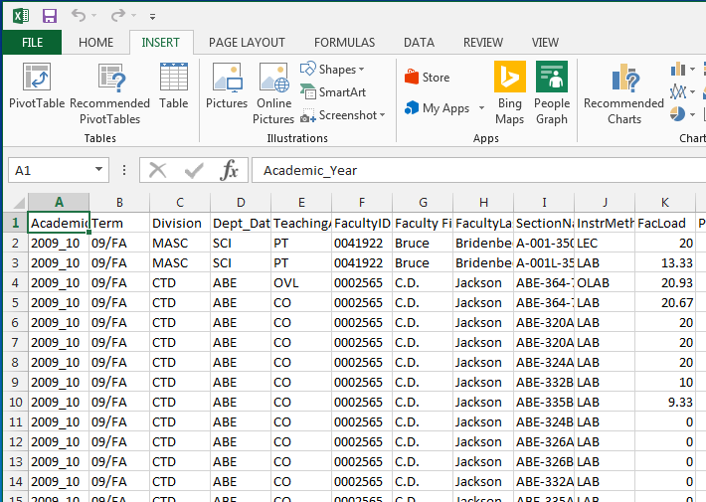
Turn your data into a table

Slide 9
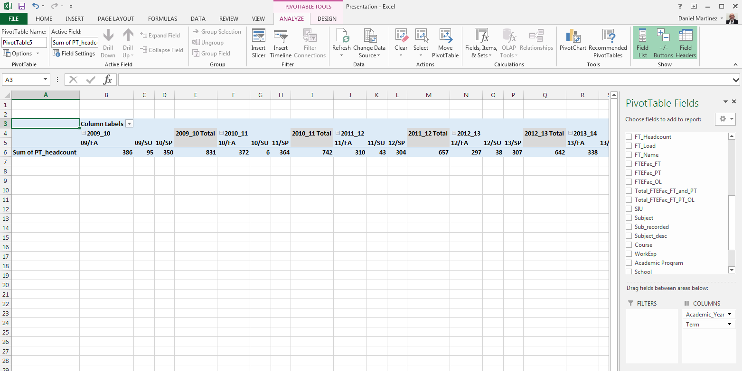
Variable and Pivot Table options

Slide 10
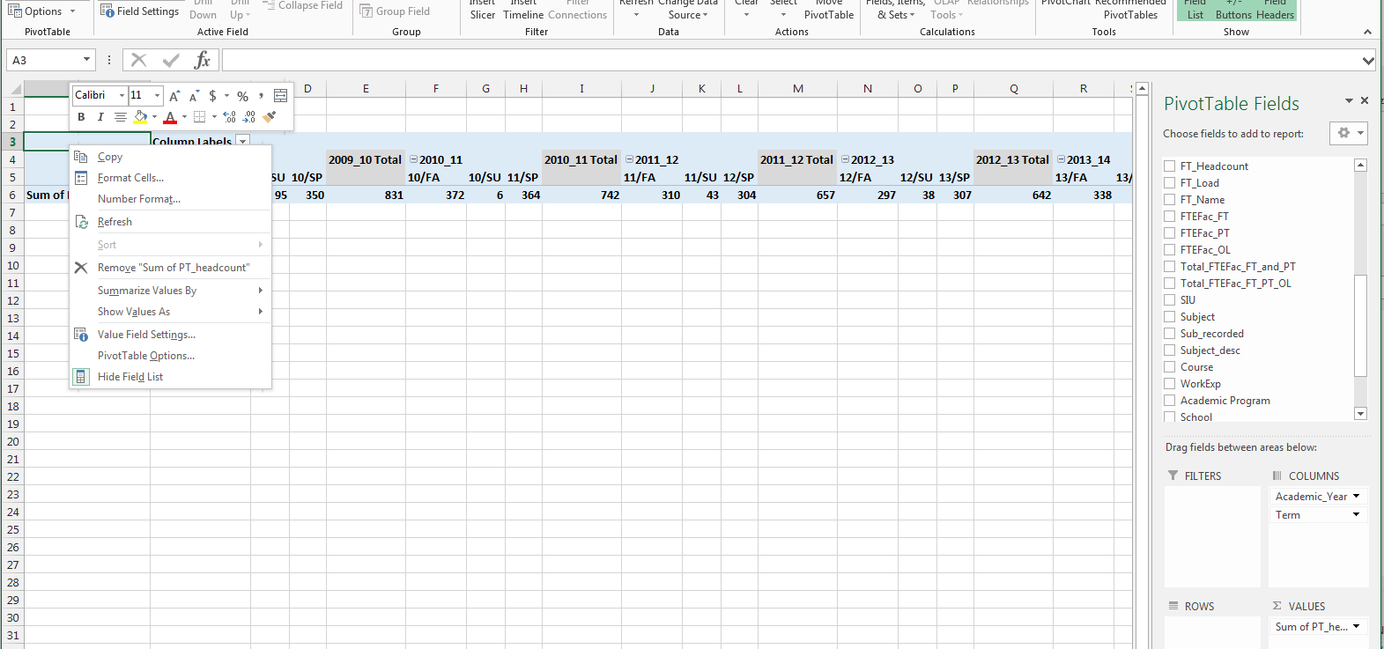
Variable and Pivot Table options
Change Grand Total for rows
Change Year totals

Slide 11
Variable and Pivot Table options
Change autofit on update to retain column widths
Change Grand Total for rows
Change Year totals

Slide 12
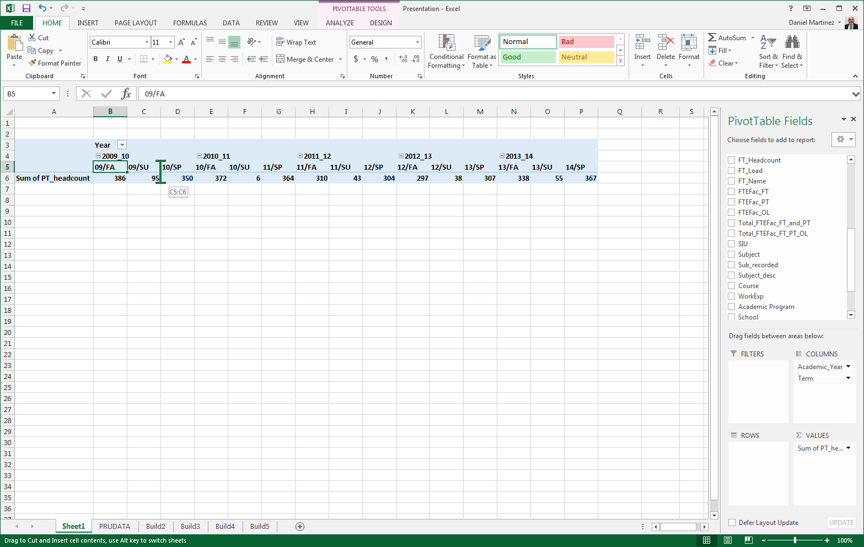
Click and drag to move columns

Slide 13
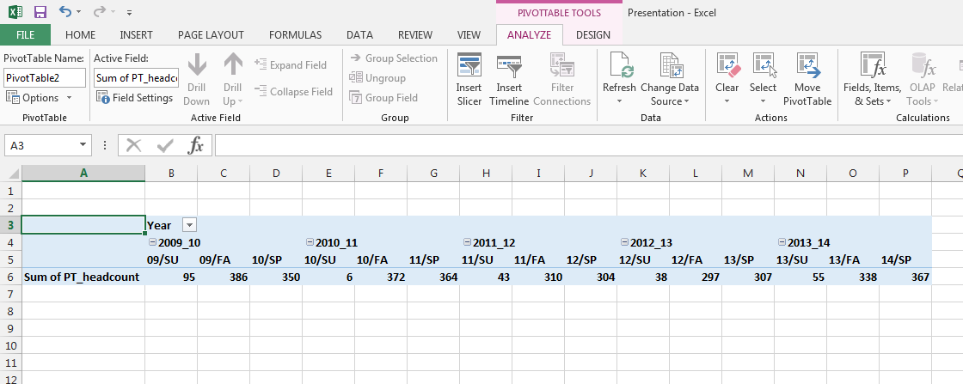
Add a slicer

Slide 14
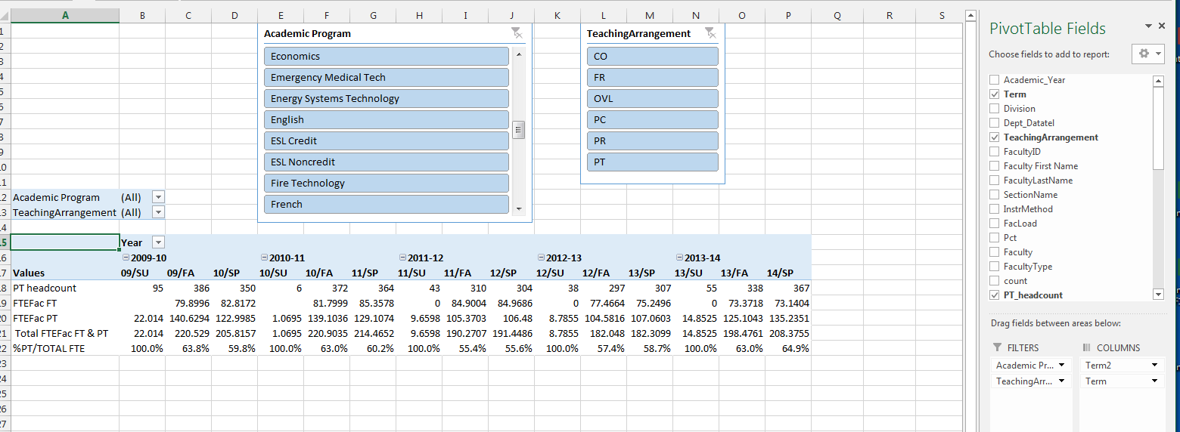
To drilldown with a slicer, add variable as a filter
Add filter here, same as slicer

Slide 15
For information about this presentation, please contact
Dr. Daniel Martinez
Director, Institutional Research
damartinez@collegeofthedesert.edu
760-776-7212

