Slide 1
Don’t Reinvent the Wheel: Informing Outcomes Assessment with Existing Survey Data
Holly Hoffman, Ph.D.
Research Analyst
University of San Diego

Slide 2
STRATEGIES TO MAXIMIZE SURVEY DATA USE
Look Beyond the Survey’s Original Purpose
Inform Efforts with Unusual Data Sources
Use Old Data to Answer New Questions
Report All the Information, but Quickly
Notes:
These are the four strategies we are currently using at USD to maximize the use of existing survey data.
Examples of how I used the strategies will be presented in the following slides.
I will not be presenting in depth details that would allow for the analyses to be directly replicated. Instead, I hope to provide ideas that will help you identify some new ways to incorporate existing survey data at your institution.

Slide 3
Look Beyond The original purpose
Example: First Destinations Survey Data
Correlate Career Center programming with
post-graduate outcomes
Notes:
Most institutions are required to collect data about what graduates are doing after they leave the institution and have a First Destinations survey.
The Career Center wanted to see if there was a relationship between their programming and post-graduation outcomes.
First, the Career Center tried to directly ask the graduates if the Career Center helped them to obtain a job post-graduation. They found that when graduates didn’t get a job quickly, they blamed the Career Center and when the graduates did get a job they said the Career Center didn’t help them to obtain a job.
Since this method didn’t work, we looked at the items that were already being asked on the First Destinations Survey to see if we could answer this question with existing data.

Slide 4
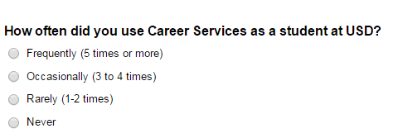
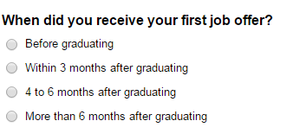
Career Destinations Survey Items
Notes:
These are the survey items that were used to determine if there was a relationship between Career Services programming and post-graduation outcomes.
The analysis looked at whether the frequency of use of Career Services or participating in an internship was correlated with post-graduation outcomes including annual salary or job offer timing.

Slide 5
Look beyond The original purpose
Example: Mapworks Factor Score Means
Identify areas of concern for first-year cohorts
Fall-to-fall retention predictors
Notes:
The original purpose of the Mapworks survey is to identify first-year students who are at risk of leaving the institution based on their factor scores.
We used the factor scores for two new purposes:
Allow Committee for Student Success to identify areas of concern for each new cohort
Fall-to-fall retention predictors

Slide 6
MAPWORKS RISK FACTORS
Commitment to the Institution
Self‐Assessment: Communication Skills
Self‐Assessment: Analytical Skills
Self‐Assessment: Self‐Discipline
Self‐Assessment: Time Management
Financial Means
Basic Academic Behaviors
Advanced Academic Behaviors
Academic Self‐Efficacy
Peer Connections
Homesickness: Separation
Homesickness: Distressed
Academic Integration
Social Integration
Satisfaction with Institution
Notes:
New Uses for Mapworks Risk Factors Data
Note: Results discussed below are fictitious and do not represent actual university data.
Allow Committee for Student Success to identify areas of concern for each new cohort:
For example, a trends analysis may show the factor mean scores for social integration had been decreasing across the years. This finding would results in a conversation about what current students’ needs are in terms of making connections and be involving in college.
Factor scores related to self assessment of academic skills (Communication Skills, Analytical Skills, and Basic and Advanced Academic Behaviors) can be triangulated with other academic profile information that had been collected for the cohort (SAT/ACT scores, high school GPA) etc. This triangulation provided information about the academic preparation of the cohort that could be used to identify the most needed student services.

Slide 7
MAPWORKS RISK FACTORS (cont.)
Commitment to the Institution
Self‐Assessment: Communication Skills
Self‐Assessment: Analytical Skills
Self‐Assessment: Self‐Discipline
Self‐Assessment: Time Management
Financial Means
Basic Academic Behaviors
Advanced Academic Behaviors
Academic Self‐Efficacy
Peer Connections
Homesickness: Separation
Homesickness: Distressed
Academic Integration
Social Integration
Satisfaction with Institution
Notes:
New Uses for Mapworks Risk Factors Data (continued)
Note: Results discussed below are fictitious and do not represent actual university data.
2) Fall-to-fall retention predictors:
Created a logistic regression model with fall-to-fall retention as the dependent variable (returners and non returners). The independent variables included the Mapworks risk factor scores and some demographic variables.
This analysis might result in non-surprising findings such as: students with higher scores on the basic academic and social integration factors are more likely to return in the following fall.
Or it might result in a surprising result: Non-returners rated their communications skills higher than returners. A possible explanation for this relationship may be students overestimated their writing and reading skills and their confidence in succeeding at college was challenged when their self-assessment of communication skills did not match the skill level required to perform well at the college level.

Slide 8
Inform Efforts with Unusual Data Sources
Example: Demographics section of third-party surveys
Hours worked per week
Financial means/financial concerns
Support anecdotal findings from withdrawal interviews
Provide supplemental information for LGBTQ student need study
Notes:
To use this strategy it is important to look beyond just reporting survey results as a whole and instead identify individual items or groups of items that can be used in ongoing outcomes assessment efforts across campus.

Slide 9
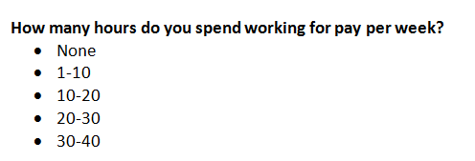
Survey Items
Notes:
Examples: Inform efforts with unusual data sources:
Avoid conducting an additional survey:
Many areas around campus were interested in how much students worked per week. For example: Academic areas/faculty might want this information for curricular reasons and Student Affairs would want to know so they could plan student activities.
Instead of conducting a new survey, this information was pulled from existing survey data including the Mapworks survey for first-year students, the Diverse Learning Environment survey for sophomores and juniors and the Graduating Senior survey for seniors.
2) Supplement anecdotal evidence with quantitative evidence:
The Center for Student Success had anecdotal evidence from exit interviews that some students enroll at the institution with an intention to transfer to another school. Mapworks has items asking whether students intended to transfer when they first arrived at the institution. This provided quantitative evidence to go with the anecdotal findings.

Slide 10
SURVEY ITEMS (cont.)
Notes:
Examples: Inform efforts with unusual data sources (continued)
Obtain information on sensitive topics:
A committee who wanted to assess the needs of students who identify as LGBTQ was trying to find out the best way to collect information about students’ sexual orientation without violating privacy. The Diverse Learning Environments survey and the NSSE ask related questions in the demographics section. This information could be used to provide the committee with an estimate about the percentage of students who identify as LGBTQ or transgender at the institution.
4) Add a personal element to quantitative data:
Many department on campus are concerned with whether students have the ability to finance their education. Quantitative information from Financial Aid can show numeric information including loan amounts, percentages of students who have financial need etc. but survey data can show how the students feel personally. Survey data from questions about the students’ concern with their ability to finance their college education can be used in conjunction with financial aid data.

Slide 11
USE old data to answer new questions
Example: Withdrawal Survey Results
Expand on standard frequency report
Identify reasons for student groups of interest
Notes:
Many institutional surveys have been in the field for several years and have a large amount of data that can be used to answer emerging questions from faculty and administration.
Process for Using Old Data
1) Look at the current reports being produced
2) Look at how they are being used by stakeholders
3) Evaluate whether current needs are being met and if there are any new questions to be answered

Slide 12
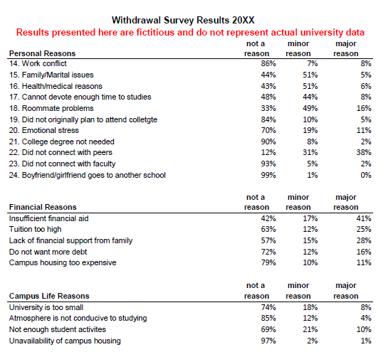
Old Report Format Used to Disseminate Survey Results
Notes:
Example: Using Withdrawal Survey data to inform Fall-to-Fall Retention efforts
Using Old Data to Answer New Questions Process: Withdrawal Survey example
Look at current reports:
Many institutions have a withdrawal survey that contains a laundry list of withdrawal reasons and it is difficult to produce reports that present the information in a succinct manner.
For example, the format displayed above was used to present Withdrawal Survey results for at least the past 10 years. As you can see, it is very difficult to obtain information from this report.
2) See how the reports are being used by stakeholders:
At meetings, the director of the student success center would say “These are the same reasons that have been coming up every year.” We are not learning anything new.” Then questions would emerge about the reasons for leaving for specific student groups: first generation, transfers., etc.

Slide 13
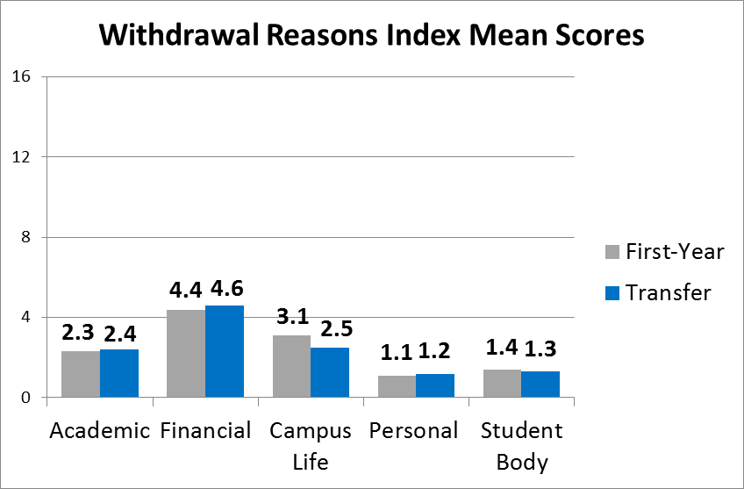
New Report Format
Results presented here are fictitious and do not represent actual university data
Notes:
Using Old Data to Answer New Questions Process: Withdrawal Survey Example cont.
3) Answer the new questions: Run an efficient statistical analysis comparing which of 36 reasons for leaving are most cited by student groups of interest
Withdrawal survey items are categorical: Not a reason, minor reason, major reason
Solution:
Use past data to create index variables for categories of withdrawal reasons (e.g. Academic, Financial, etc.)
Assign a score for each response 0=Not a Reason, 1=Minor Reason, 2=Major Reason
Tally score for each category for each student
Calculate category means for each student group of interest (See above graph)
The index variable analysis provides a quick visualization of what is going on:
1) Can immediately see which types of reasons were cited more by which groups. Then additional analyses can be run on individual withdrawal reasons.
2) Also, you can see how reasons for withdrawal are spread out across categories for each student group of interest.

Slide 14
USE old data to answer new questions
New question: Why do transfer students leave the institution?
Transfer students report that campus life and student body reasons contribute to their decision to withdraw less often than first-year students.
Results presented here are fictitious and do not represent actual university data.
Notes:
With the withdrawal reasons index mean scores, we could easily answer the new questions that had emerged about why different student groups leave the institution.
All of the information from the Withdrawal Survey can be distilled into statements like the example above.

Slide 15
Report all the information, but quickly
Example: Graduating Senior Survey Results
Year-to-Year Comparison
Comparison by College
Notes:
USD has moved from providing frequency reports for survey results to more innovative and visually appealing methods.

Slide 16
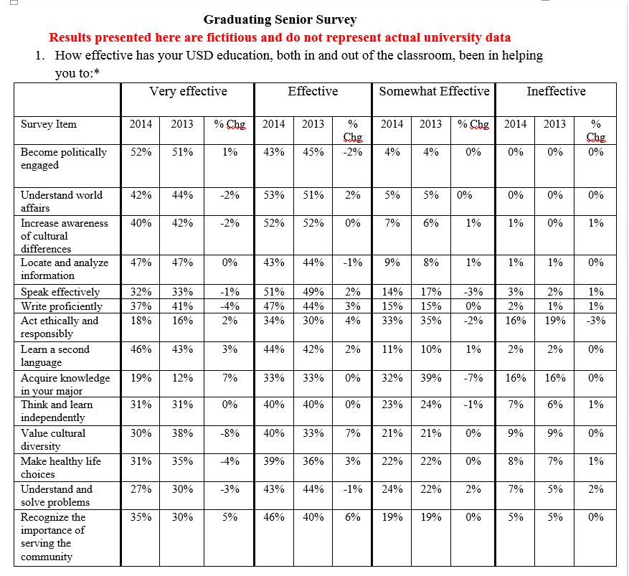
Old Report Format
Notes:
Old reporting strategy: Answer every single question that the audience might have about the survey data (as shown in the example of an old report above)
As you can see, it is difficult to gain any information easily about trends across the two years.

Slide 17
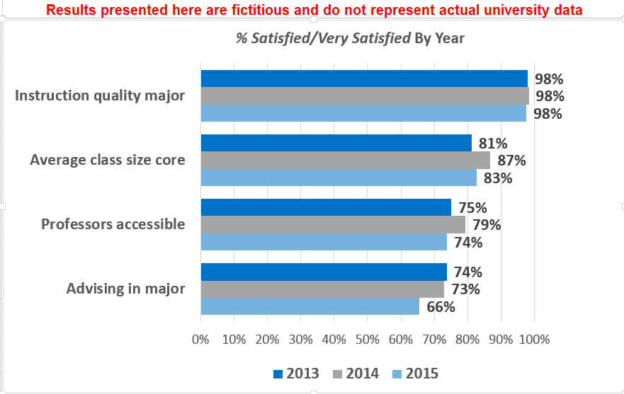
New Report Format
Notes:
New strategies (as shown in report format pictured above):
Put the most important information front and center
Find ways to present large amounts of information in a small space
Make additional information accessible but out of the way/not distracting
Challenge: Business faculty who use the report above print out hard copies to take to meetings in black and white
Challenge: Sometimes the people who received the report wanted to see the details on some of the items (e.g. wanting to see the frequencies for all response options (Very dissatisfied, dissatisfied, satisfied, very satisfied) for a particular item
Solution: Put tables with all frequencies, means, and N’s for all items in appendix of report.

Slide 18
Report all the information, but quickly
Example: Diverse Learning Environments
Results of a statistical analysis
Notes:
In the past, we created APA format reports about the statistical analyses we conducted in our office. However, our audiences tended to not respond well to the long paragraphs about the representativeness of the data, methodology, etc. and the reports were rarely used.
At our institution, infographics were not well received by administrators and faculty because they wanted to know more about the analysis, representativeness of sample, statistical significance, etc.

Slide 19
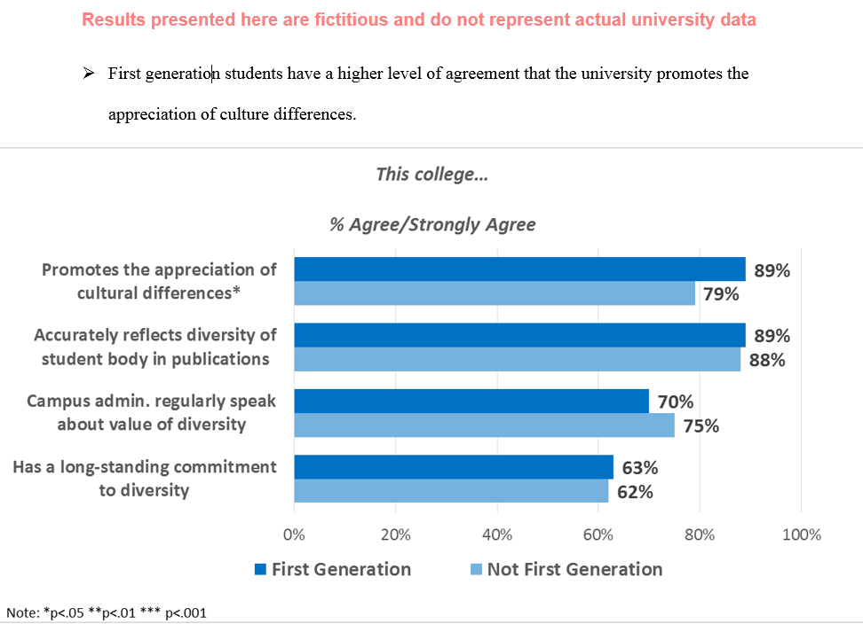
New Report Format
Notes:
Our challenge: Present results of a statistical analysis in a way that is both accessible to non-research audiences, but includes information academic audiences would want to know (e.g. how the analysis was conducted, limitations, etc.)
Solution: We created a report format (as shown above in an example from the Diverse Learning Environments Survey) that presents
Only significant findings in bullet points
Bar graphs showing only levels of agreement for the items
All other pertinent information about the analysis in footnotes or the appendix.
This report format is a happy medium between infographics and standard APA format reports.

