Slide 1
CAIR Presentation
November 5, 2015
Graduate Alumni Outcomes
Alana Olschwang and Jeanette Baez

Slide 2
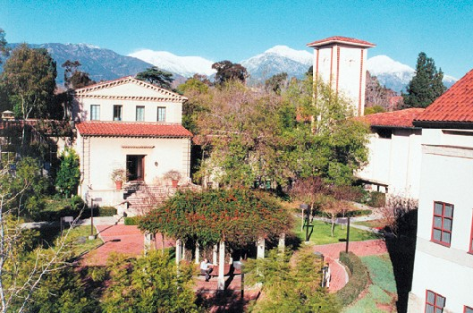
Fast Facts
Graduate Only
Claremont Colleges Consortium
2200 students
1/3 Part Time
1/3 Doctoral Studies
18% International
19% ethnic minority
53% female
130 Core Faculty
90th Anniversary

Slide 3
Pressure to track outcomes

Slide 4
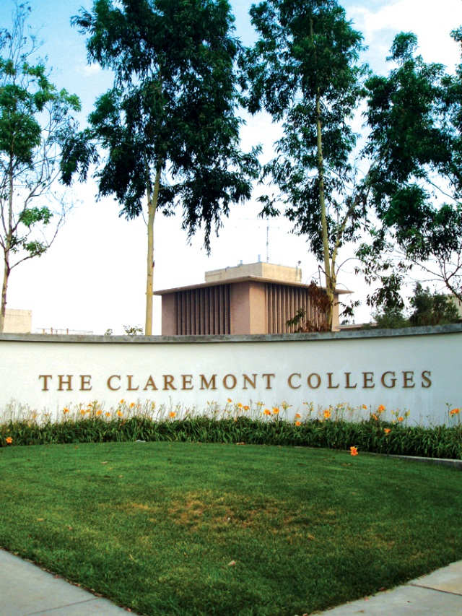
Focused Topics for Today:
BASIC EMPLOYMENT STATISTICS
What jobs are our graduates securing?
How much money are they making?
How is the ROI perceived?
SATISFACTION and LEARNING
In what areas are students most/least satisfied?
In what areas did students learn the most?
MULTIPLE AUDIENCES
Recruitment of new students
Program review and accreditation
Building and Branding

Slide 5
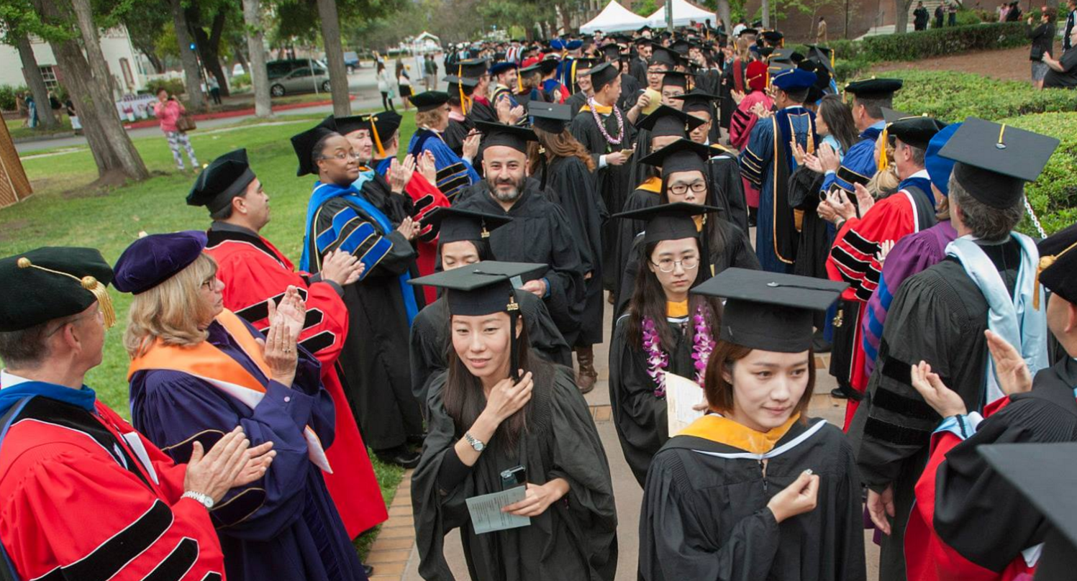
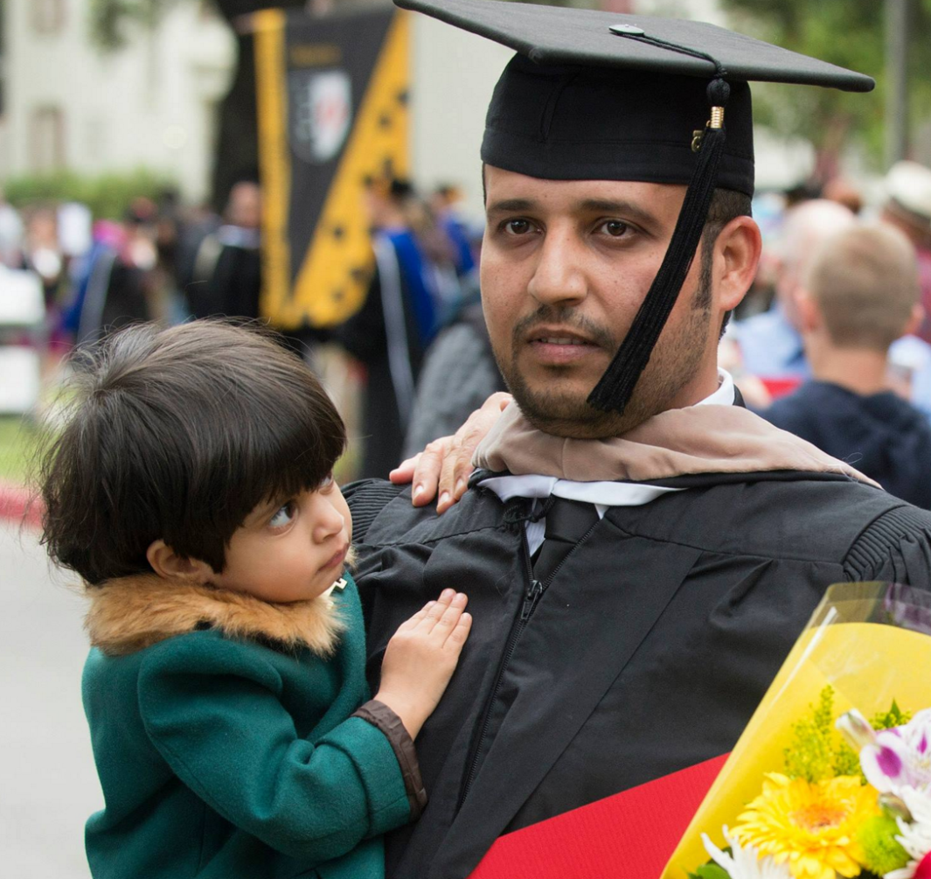
Where do alumni go?
How much do they make?
How strong is the ROI?

Slide 6
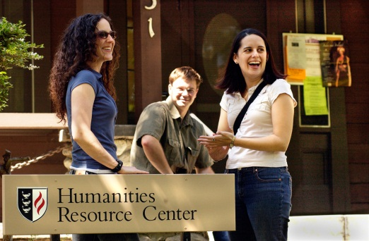
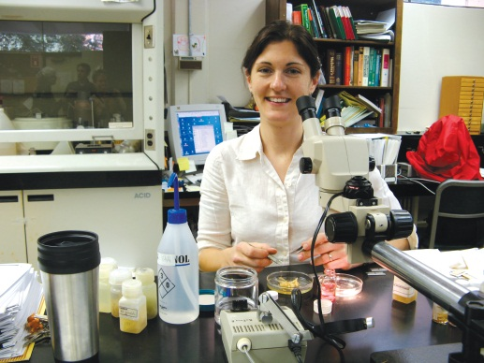
Campus sources for alumni data…
GOAL: END THE ‘SHADOW SYSTEMS’
Fragmented Collection Methods
Program Review
Student Liaison
Alumni relations
Media coverage
Office ‘Drop In’ paper form
Exit survey(s)
Rankings Projects

Slide 7
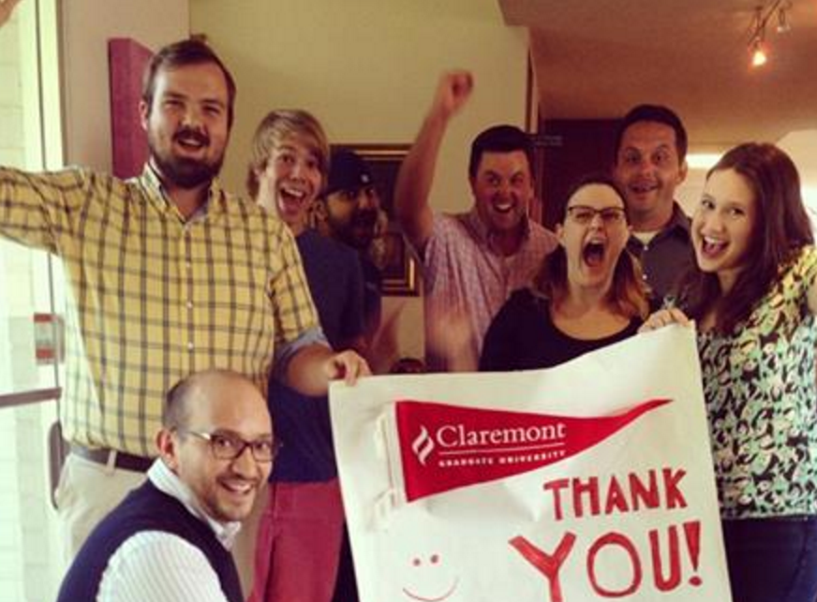
It takes a village to build a database

Slide 8
Campus sources for alumni data…
BUILDING THE DATABASE PIECE BY PIECE…
Source | Added ‘n’
LinkedIn Purchase | 4000
Alumni Survey | 384
Career Development Office | 326
Advancement Annual Fund | 175
Online Teaching Community | 70
International Student Office | About 50
Program Offices (ENG, PSYCH, etc) | About 50

Slide 9
The Alumni Task Force
IR’s KEY LEADERSHIP ROLE
Beyond ‘Show me the data’
Strategize
Develop standards
Establish trust
Train in analysis
Clarify roles
Set timelines
Reminders
Convene

Slide 10
Employment: LinkedIN
Cost: $500 ($0.12/individual profile)
Return: 6913 cases
Cleaned Return: 4,000
Fields: Name
URL
Location
Industry
Education History (major, degree, start/end dates)
Employment History (start, end dates)
Employment Status (current, past)

Slide 11
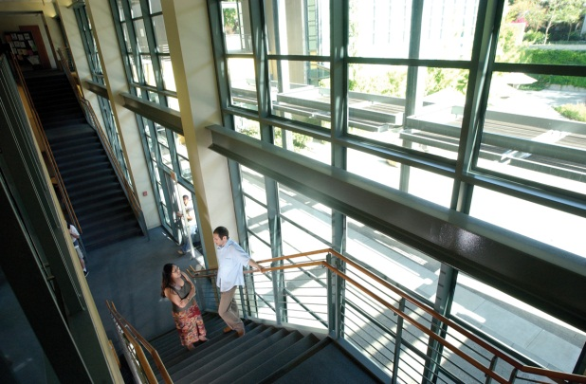
Clean, Merge Data, and Code
LinkedIn data was cleaned against the degrees conferred file.
Code was written in R, matching the key words in job titles
to the top level industry in BLS SOC code hierarchy.
Many alumni hold multiple jobs concurrently
(job titles > number of students)
https://www.r-project.org/

Slide 12
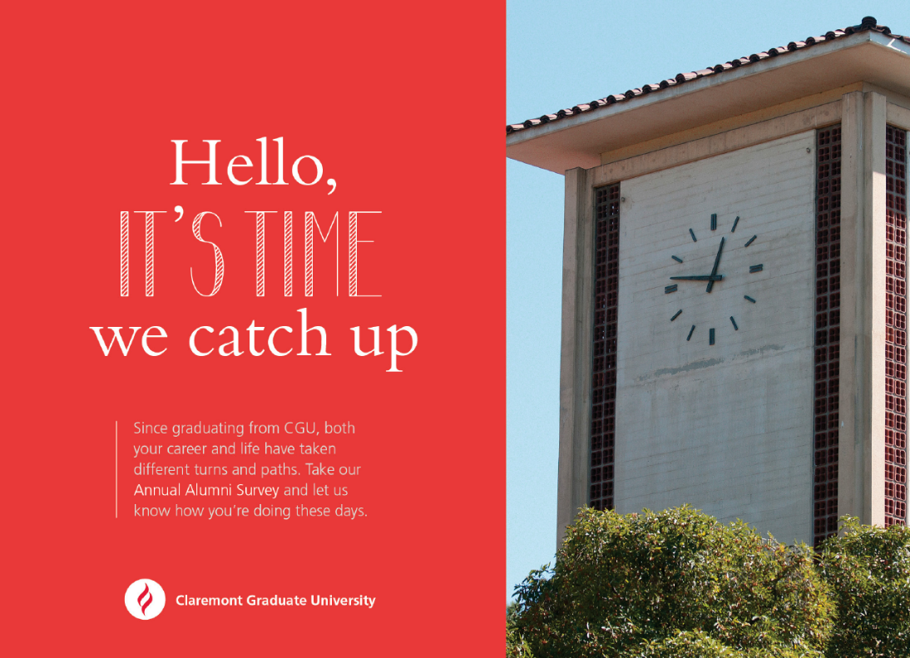
Alumni Survey 2015
Update Alumni Contact Information
Cost: $2000
Survey Distribution
New information for almost 400 alumni
Electronic/postcard reminder: 24% return
Full paper survey: 5% return

Slide 13
Alumni Survey 2015
80% reported feeling satisfied in their current job
78% reported overall satisfaction with their program at CGU
488 new employment facts added
Flag achievements for follow up

Slide 14
Alumni Survey 2015
The graduate experience at CGU enhanced knowledge, skills,
and abilities in the following ways
…Top 5…
Acquire New Knowledge
Synthesize ideas from multiple sources
Think analytically
Apply research practices
Address problems from multiple perspectives

Slide 15
Alumni Survey 2015 Information Science & Technology
Sample Job Titles Sample Employers
CIS Manager or Researcher
Computer Network Admin
Systems Design Engineer
Risk Analyst
Professor and Dean
Industry: Amazon, Microsoft, ESRI
Costco, Kaiser Permanente
JPL, Boeing, Raytheon, CalTEch
TaylorMade-Adidas, WESTAT
Academic: LMU, Cal Poly Pomona, Biola, Cal Lutheran, Worchester

Slide 16
Compare Nationally - PhD
Request data file free of charge
Future Plans | CGU |  | National
Signed contract/definite commitment for postdoc or other work | 67% |  | 69%
Seeking position but no specific prospects | 24% |  | 31%
Employer Type (TOP 3) | CGU | National
Academe | 62% | 50%
Industry or business (for profit) | 14% | 26%
Not for profit organization | 7% | 6%
http://www.sedsurvey.org/Pages/home.aspx

Slide 17
Employment Tracker: Salary for Alumni in California
Alumni File: 8,650 cases
Cost: $ 3,300
Return:
# Years Out | Master's | PhD
1 | 61% | 55%
3 | 44% | 38%
5 | 17% | 25%
Marc Stockton
EDD Applied Research Unit
Labor Market Information Division
(916) 651-5901
Marc.Stockton@edd.ca.gov
http://www.labormarketinfo.edd.ca.gov/

Slide 18
Employment Tracker: Salary for Alumni in California EDD Data
1 Year out 3 Years out 5 Years out

Slide 19
Employment Tracker: Salary for Alumni in California EDD Data
Next Step: Match with incoming student salary to analyze ROI

Slide 20
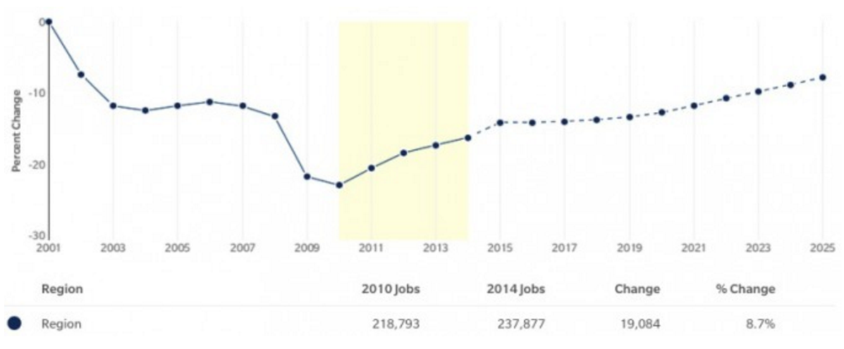
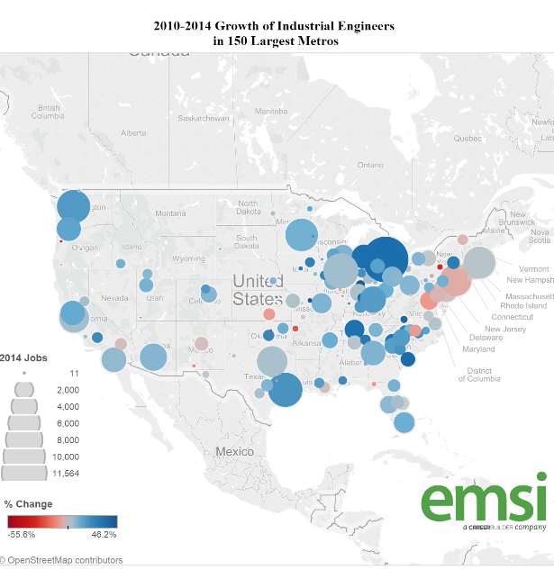
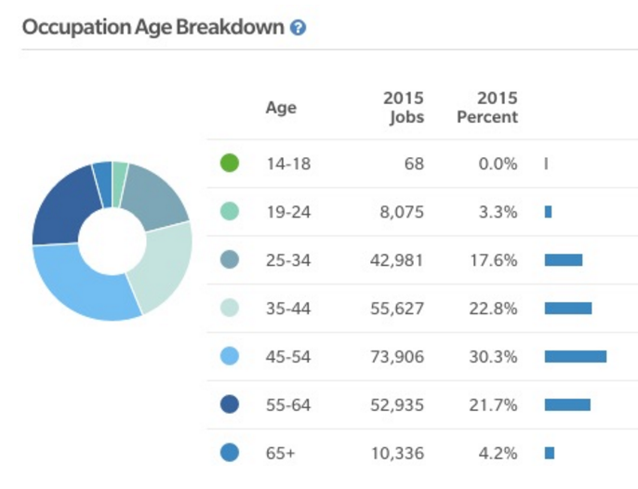
Salary & Market: Other Options…
ANALYST
CAREER COACH
ECONOMIC MODELING
http://www.economicmodeling.com/2015/10/27/does-the-us-have-an-industrial-engineers-shortage/

Slide 21
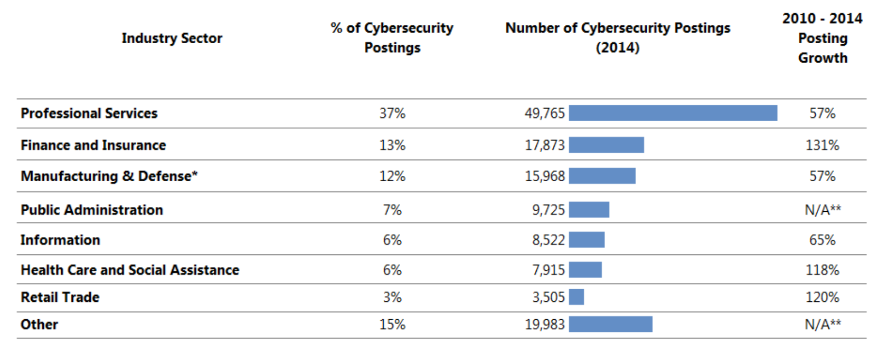
Salary & Market: Other Options…
http://burning-glass.com/wp-content/uploads/Cybersecurity_Jobs_Report_2015.pdf/

Slide 22
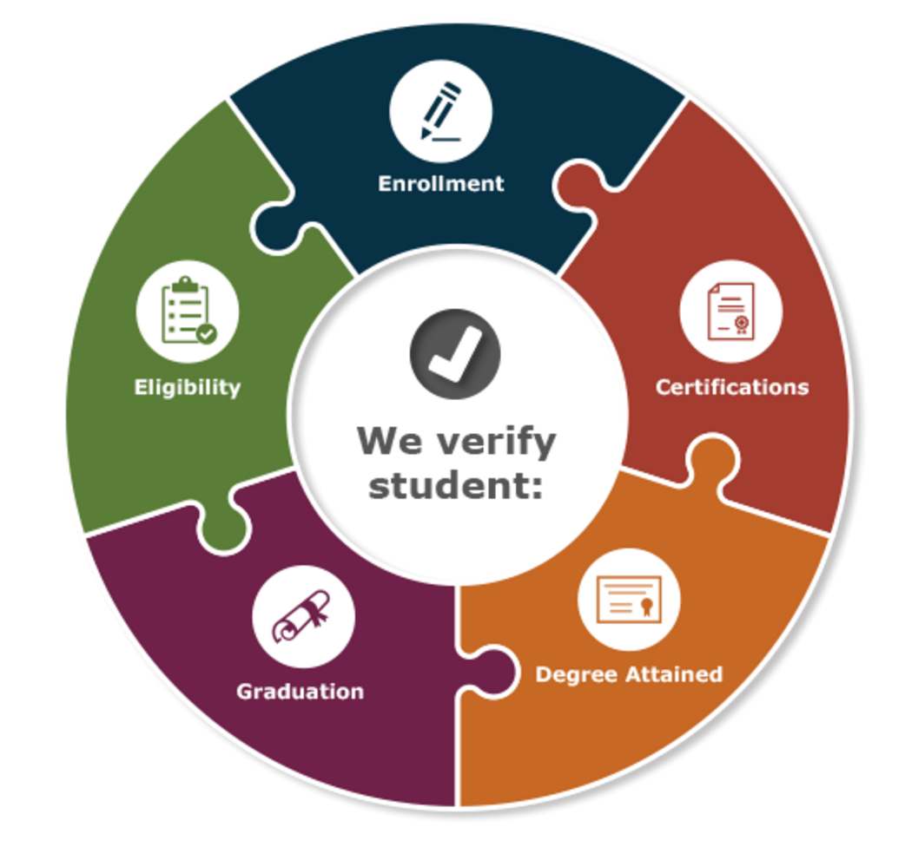
Student Outcome: More Education
Where do CGU master’s degree alumni go for continued education?
http://www.studentclearinghouse.org/

Slide 23
Standards: What to collect & When
University Guidelines: NACE
First Destinations Survey at Graduation & 6-9 Months out
Employment
job titles, job type, hiring employer information, and aggregate salary data
Service programs/Volunteer opportunities
Further academic study
Military service
Accreditation Standards/Program Review
Destinations Survey at Graduation & 3 Months out
Offers, acceptances, bonus, industry
Learning Outcomes Achieved
ROI

Slide 24
Standards for PhD: What to collect & When
Initiative
Process: Partner with national organizations & experts
Funding: Sloan, NSF, Mellon
Purpose: Develop Survey Instrument
Data Collection Standards & Guidelines
Long term outcomes
Inform curricular improvements
Expected Release: 12/2015
http://cgsnet.org/understanding-career-pathways

Slide 25
***CULTURE CHANGE***
New Student Orientation
As students enter the 90th year of CGU history
What have other students achieved?
Will CGU find me ‘placement’?
How long does my program take?
I have so much time…
Make an appointment with
Career Development
ASAP!

Slide 26
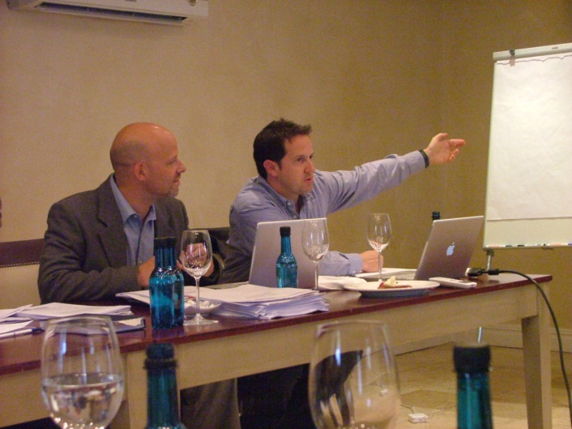
DATA ACTIVITIES
Incoming Student Profile and Plan
Future Plans and Destinations Survey
At Graduation
Follow Up – 6 months out
Follow Up – Underemployment
Follow Up – Online Workshops
Programs follow up with calls and outreach
Workshop and Visit ‘Check In’
Alumni Profiles
Alumni Summary Reports by Program and Degree

Slide 27
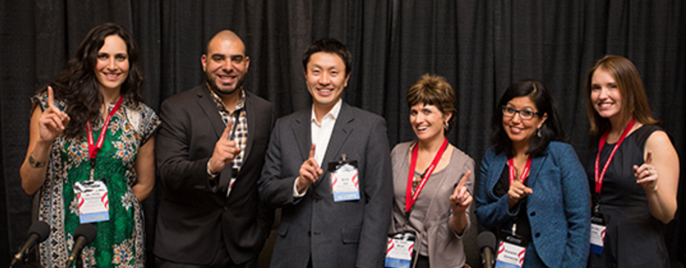
Alumni Relations
Events
Engagement opportunities
Professional development workshops

Slide 28
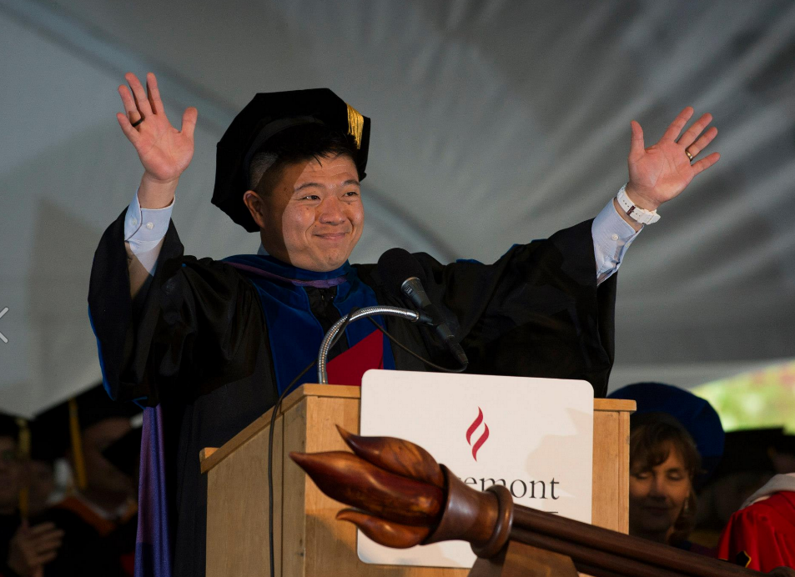
Distinguished Alumni
SPOTLIGHTS & FREQUENCY
C-Suite
Academic Leadership
Awards, Honors, Achievements
Fulfilling CGU’s promise:
In the world to change the world
How many college presidents, deans, provosts?
How many CEO, CFO, CIO?
How many years to achieve leadership roles?
How did CGU help them get there?
Robert Bunker (Research Advisor to FBI and others)
Thomas Hsieh (Distinguished Alumni Service Award)

Slide 29
Next set of questions to answer
EMPLOYMENT TRAJECTORIES
What do career tracks look like (academic and alt-ac)? Trajectories?
How many achieve tenure and senior level positions?
Where are alumni (GIS interactive mapping) located? See eAIR Tech Tip 12/9/2014
SATISFACTION
How do satisfaction ratings compare to the enrolled and exit surveys?
How are alumni making use of their degree?
How do alumni recommend their program change to best prepare future alumni?
LASTING IMPACT
Which faculty significantly influenced alumni careers and how?
How are the outcomes different by degree? By program? Over time?
In what ways do alumni want to be engaged with CGU now?

Slide 30
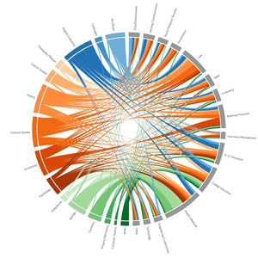
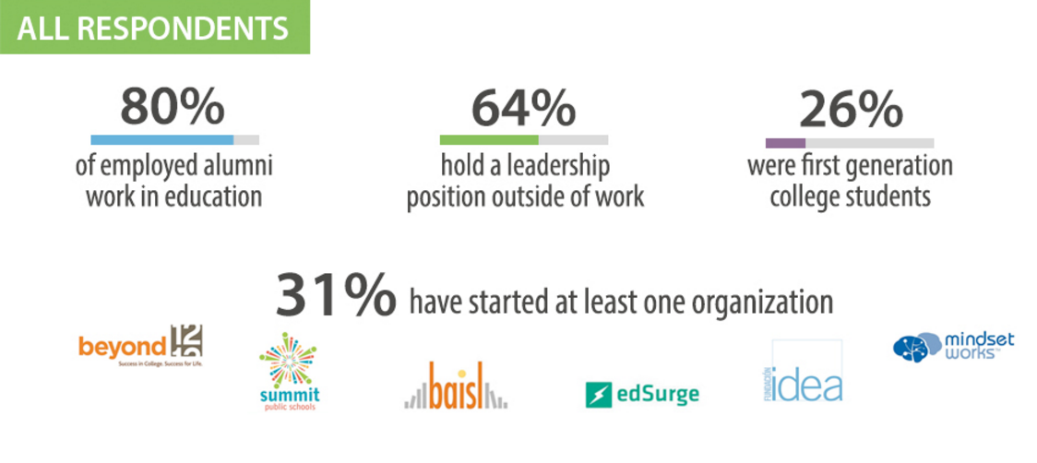
Infographics – telling the story
Stanford Alumni Dashboard
- edcareers.Stanford.edu
- http://web.stanford.edu/dept/pres-provost/irds/phdjobs
Arts National Alumni Report (SNAAP)
– see discussion in eAIR, March 2015
Williams

Slide 31
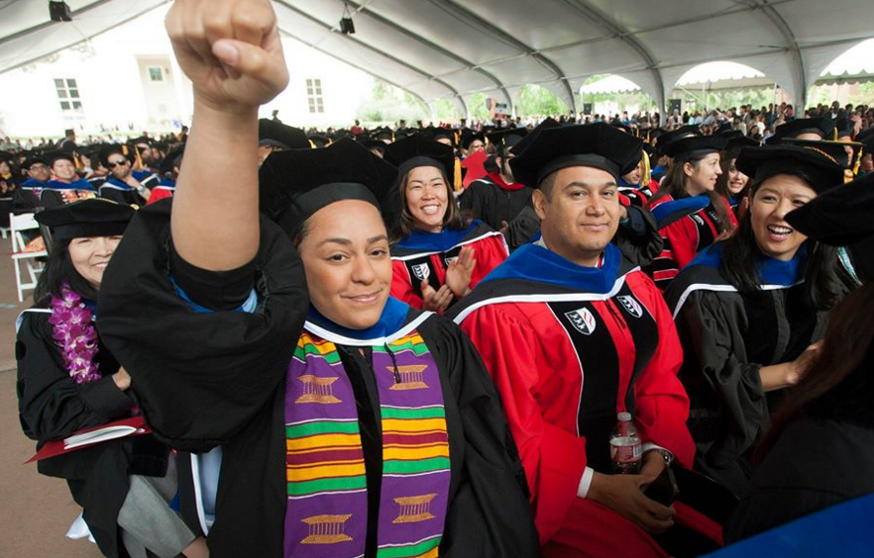
Thank you for your time & attention
Alana Olschwang
Director, Institutional Effectiveness
alana.olschwang@cgu.edu
(909) 607-8135
Please let me know how you are tracking alumni, how you work across your campus, to collect these data, and how you are using this information to attract new students, tell your story to faculty and donors, and improve programs and student experiences!

