Slide 1
Opportunities & Challenges Afforded Under Qualitative Equity Inquiry
Brad Trimble, Ph.D.

Slide 2
Who’s here today?
University of California?
California State University?
California Community Colleges?
Private Colleges & Universities?
Entities other than higher education institutions?

Slide 3
In what capacity does qualitative research exist at your educational institution?

Slide 4
Why qualitative research at Sierra College?
SSSP & Equity Funding from CCCCO
Sierra College is re-envisioning how to best serve students.
We have the statistical data and know which groups are struggling, but beyond basic anecdote we can’t explain why.

Slide 5
Student Success & Support Program (SSSP) and Student Equity Funding
Since January 2014: Governor Brown and the California State Legislature have invested $155,000,000 to enhance local and statewide student equity initiatives at California community colleges.
The goal and vision of this equity funding is to improve campus-level programs to enable community colleges to close student achievement gaps, by reforming policies and practices that ultimately reduce inequities for underrepresented student groups on campuses.

Slide 6
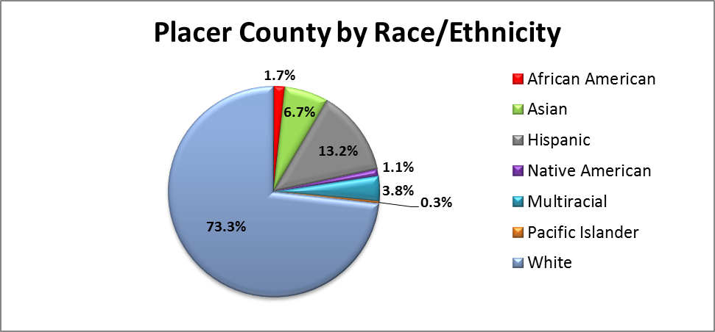
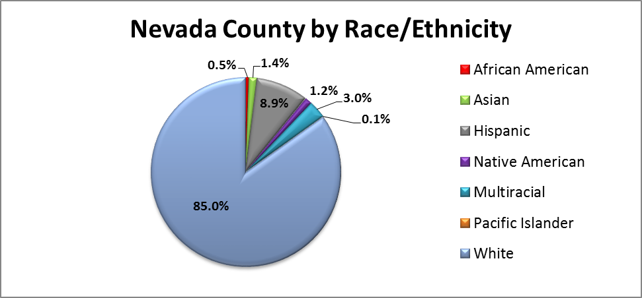

Slide 7
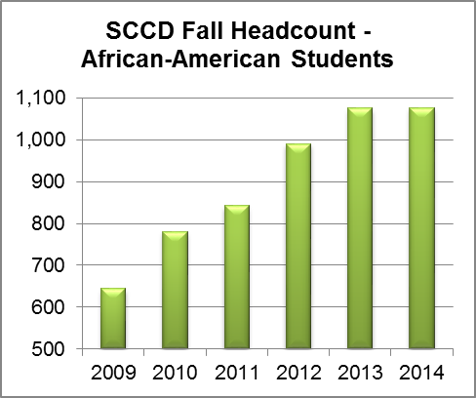
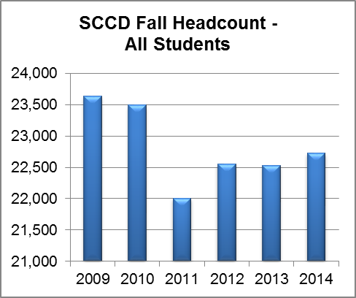

Slide 8
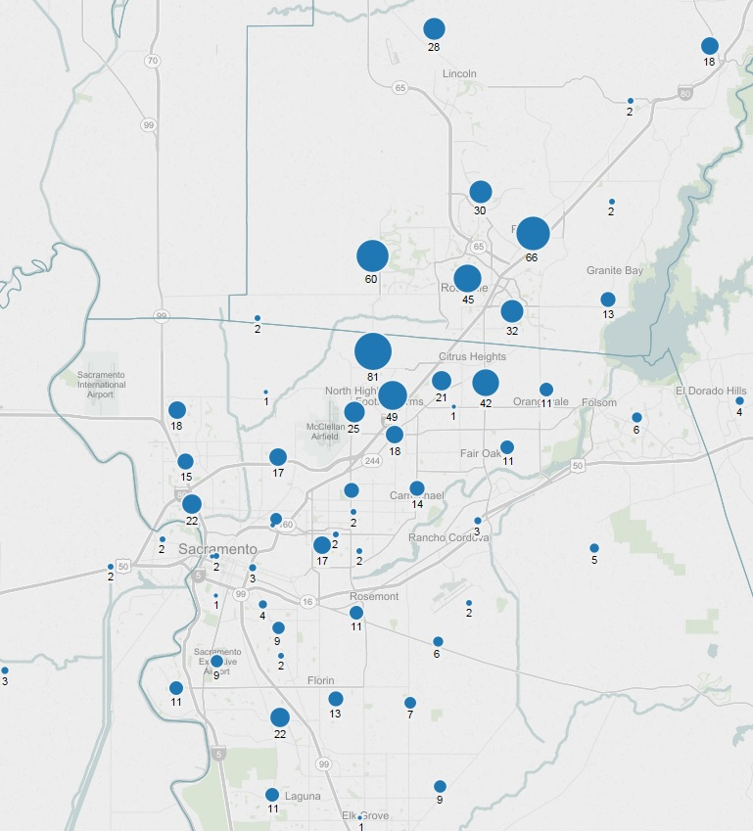

Slide 9
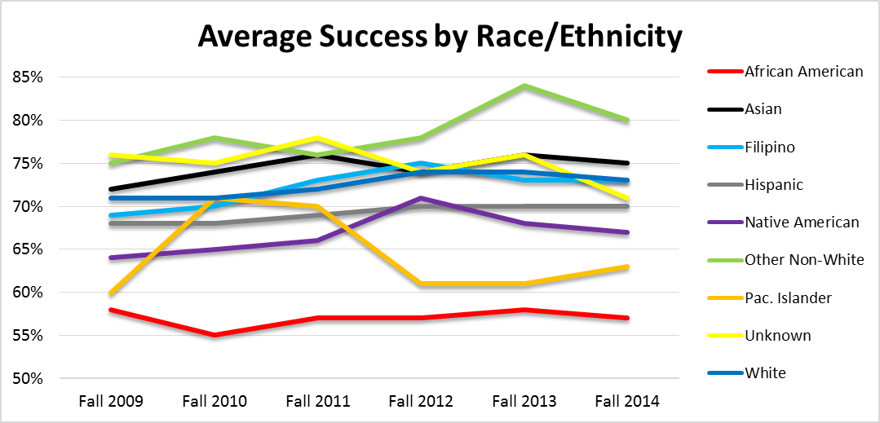

Slide 10
LTT Faculty Researcher for Equity & Student Success
Consults with the Equity Advisory Committee, standing committees of Academic Senate, faculty and administration to develop research to support educational equity and student success.
Conducts qualitative research studies.
Evaluates the effectiveness of curricula, programs and services to enhance student equity and success.
Other duties as assigned.

Slide 11
More Questions:
Why is my position faculty rather than classified?
Why is my position long-term temporary rather than tenure-track, and how might this affect the research?
What opportunities and challenges does my position afford?

Slide 12
Spring 2015 Qualitative Equity Research Projects
African-American Student Focus Groups
LGBTIQ Faculty Focus Group
Non-Native Speaker Student Focus Group
Leaver Survey
Campus Climate Survey

Slide 13
Fall 2015 Qualitative Equity Research Projects
LGBTIQ Student Focus Groups
Native American Student & Community Focus Groups
Hispanic/Latino Student Focus Groups
ESL Student Focus Groups
Former-Foster Youth Student Focus Group

Slide 14
Beyond Traditional Research
All-in approach
Institutionalize the equity mindset
Empower all campus stakeholders
Stand in opposition to inequitable practice
Promote civility and collectivism

Slide 15
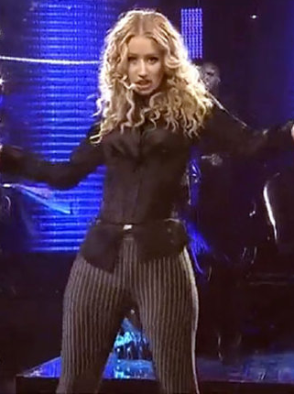

Slide 16
LGBTIQ Faculty Voice
“While I don’t believe that there is any explicit and intentional disregard for LGBTIQ issues, events and space, I do believe that the unrecognized heterosexism and cisgenderism imbued throughout the equity work on campus is undeniable.”
“The claim that our students need to be protected from being recognized as LGBTIQ acknowledges that the campus is not a safe space to be open and honest. LGBTIQ students are in a double-bind here. We’re unwilling to track their academic performance based on privacy concerns, so consequently, there’s no data to justify services for them.”

Slide 17
LGBTIQ Faculty Voice
“There’s a notion out there that anyone who doesn’t follow gender expectations on campus is fair game for ridicule.”
“Recently a transgender female student expressing female went into a women’s restroom on campus. While occupying the restroom a female Sierra College staffer confronted her and said, ‘Oh you’re not supposed to be in here, you’re supposed to be in the men’s room.’ The student then responded that she was a trans-woman. The staffer’s response was, ‘Well, maybe you should wear some kind of badge to designate’.”

Slide 18
African-American Student Voice
47-Year-Old Female Umoja Student: “I think my experience here has been a little different because I'm an engineering major. I went to one class and the professor was like, "Ummm you're in the wrong class." I said, "No…I'm not." I think because it's engineering, and they're not used to seeing Black people, they make these assumptions. I can always count on certain counselors here to remind me that engineering is hard, and that I can still change my mind and choose another major. They’ve suggested that I choose a career path in social work.”

Slide 19
African-American Student Voice
21-Year-Old Male Student-Athlete: “I feel like the counselors for athletics don’t really let you do what you want to do here. They just push social science, social science, social science.”
25-Year-Old Female Student: “I finally met a good counselor today.”
19-Year-Old Female Student: “Counseling makes it difficult here.”
18-Year-Old Male Umoja Student: “Something that's made things more difficult here is definitely the counselors. I hate the counselors here. There's actually only like three counselors that I'll go see. The other counselors are horrible.”

Slide 20
What have we accomplished?
MIS Resolution of California AB 620 from ASCCC to refine the LGBTIQ data collection via CCCApply and provide colleges with access to their students’ LGBTIQ data collected on the admission application.
Shifting faculty and student perceptions of institutional research at Sierra College.
An unmatched level of depth and understanding about the Sierra College student experience.

Slide 21
Questions?

Slide 22
Thank you! btrimble@sierracollege.edu

