Slide 1
A nationwide US student survey

Slide 2
The context

Slide 3
The challenge
Reward colleges that educate students better, not just
Those that do research
Those that are the most selective – “colleges that educate better students”
Source: Sysomos

Slide 4
3Ps of the learning process – Biggs, Gibbs et al
Presage
Process
Product
Student factors
Prior knowledge
Ability
Motivation
Learning focused activities
Learning outcomes
Skills
Facts
Involvement
Teaching Context
Objectives
Assessment
Climate/ethos
Teaching procedures

Slide 5
Resources
Engagement
Outcomes
Environment
Teaching Context
Objectives
Assessment
Climate/ethos
Teaching procedures
Student factors
Prior knowledge
Ability
Motivation
Teaching Context
Objectives
Assessment
Climate/ethos
Teaching procedures
Presage
Learning focused activities
Process
Learning outcomes
Skills
Facts
Involvement
Product

Slide 6
The survey goal
Understand the picture of student learning activity at US colleges
How learning occurs
What is being learned
End satisfaction and perceived value
Student context
Source: Sysomos

Slide 7
The survey

Slide 8
The big picture
Motivation
Impact on career
Satisfaction, value, NPS
Interaction & learning

Slide 9
Questionnaire content
Motivation to study for degree
  Job opportunities
  Contribute to academic literature
  Learn more about a subject
  Have a good time
  Meet diverse new people
Interaction
  Faculty interaction
  Collaborative learning
Higher Order Learning
  Practical application
  Reflection / connection
  Critical thinking
  Challenging classes
Social engagement
Perceived career impact
Value for money
Satisfaction measures
  Choose again
  Recommend
  Computed “Net Promoter Score” (NPS)
PLUS: Free text comments

Slide 10

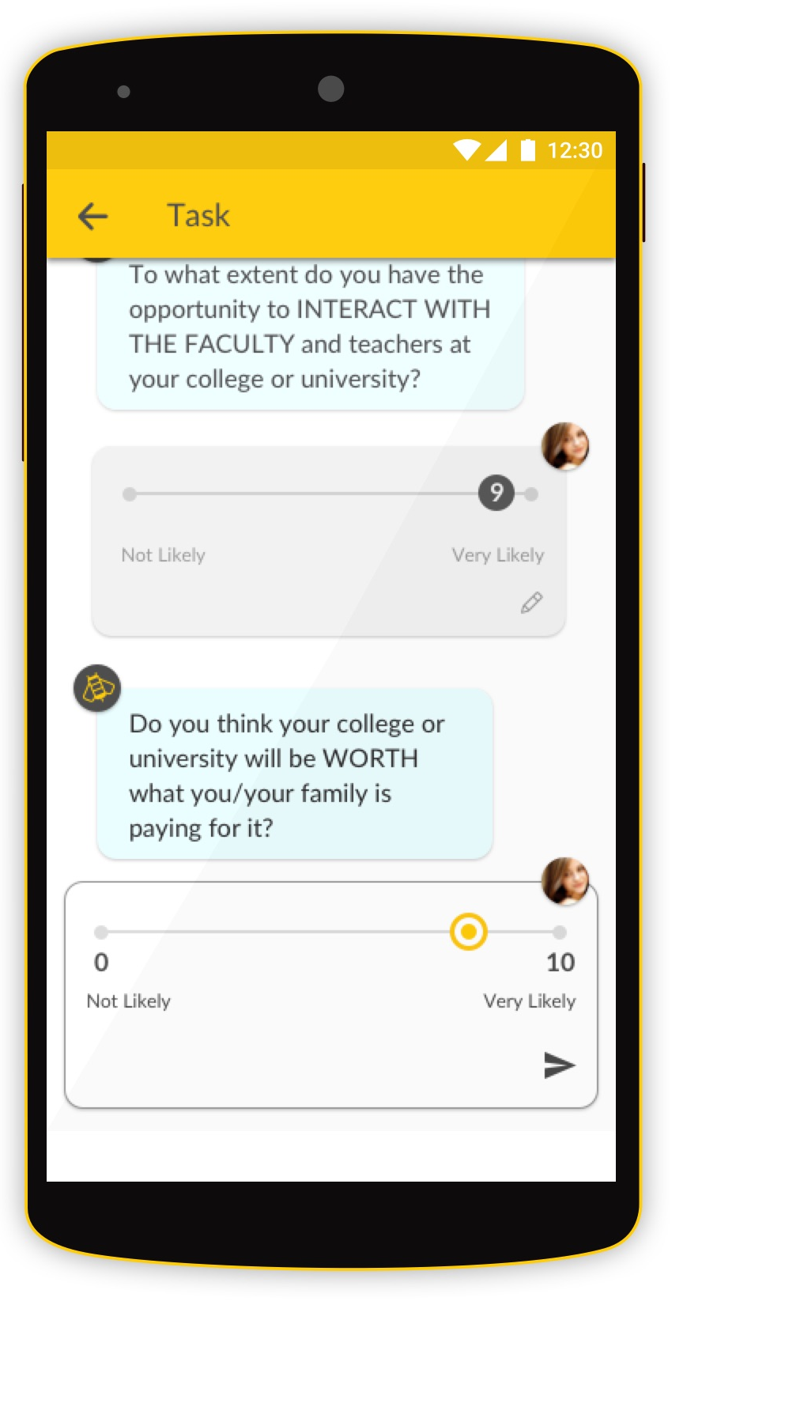
Execution
Current students in taught courses
Around 1,300 colleges targeted
Focused samples
Engagement managed by established market research organizations
The result: 100,000 students in over 1,111 colleges

Slide 11
The data

Slide 12
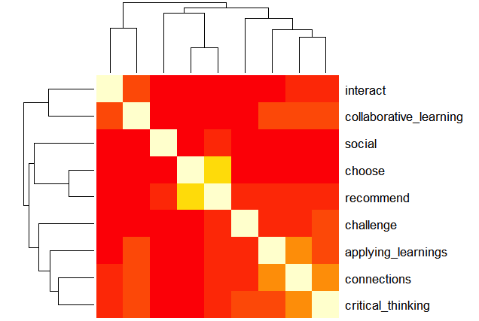
Benchmark measures
  Faculty interaction
  Collaborative learning
  Recommendation
  Choose again
  Practical application
  Reflection / connection
  Critical thinking
  Challenging classes

Slide 13
Dimensions for analysis
Region/State
Institution
Institutional characteristics
  Carnegie class
  IPEDs data
  CSC data
  Ranking in other rankings
In some instances…campus
Degree attributes
  Level of study
  When entered
  At what level entered
  Subject of focus
  Delivery method
Student attributes
  Gender
  Location of origin
  (in state / OOS / int’l)
  Nationality
  Year of birth

Slide 14
National-level observations

Slide 15
Analysis
By funding type (sector)
By Carnegie classification
By student segment
Drivers?

Slide 16
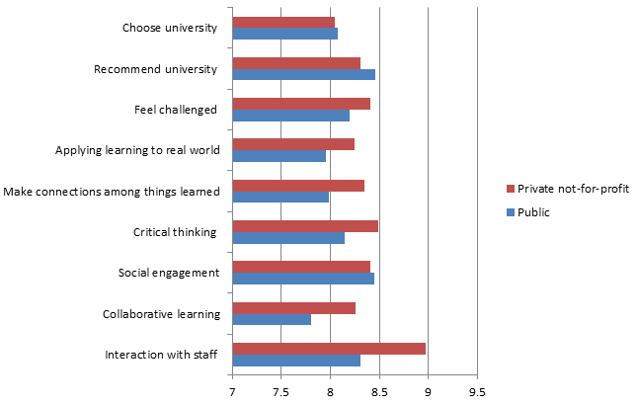
Funding type

Slide 17
Funding type

Slide 18
Funding type

Slide 19
Funding type

Slide 20
Funding type

Slide 21
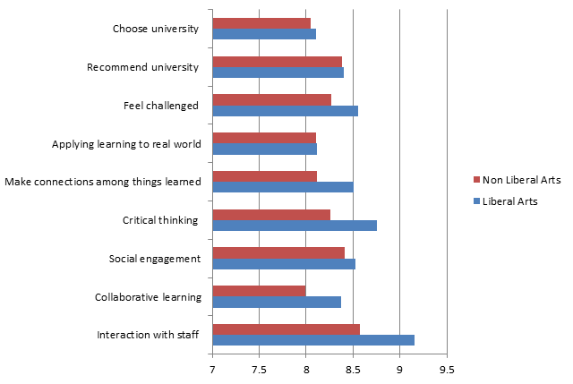
Carnegie class
Notes:
National Liberal Arts Colleges (CCBASIC 21) are those that don’t fit the above categories but with over 50% of bachelor degrees and over 50% of those in the Arts & Sciences

Slide 22
Carnegie class
Notes:
National Liberal Arts Colleges (CCBASIC 21) are those that don’t fit the above categories but with over 50% of bachelor degrees and over 50% of those in the Arts & Sciences

Slide 23
Carnegie class
Notes:
National Liberal Arts Colleges (CCBASIC 21) are those that don’t fit the above categories but with over 50% of bachelor degrees and over 50% of those in the Arts & Sciences

Slide 24
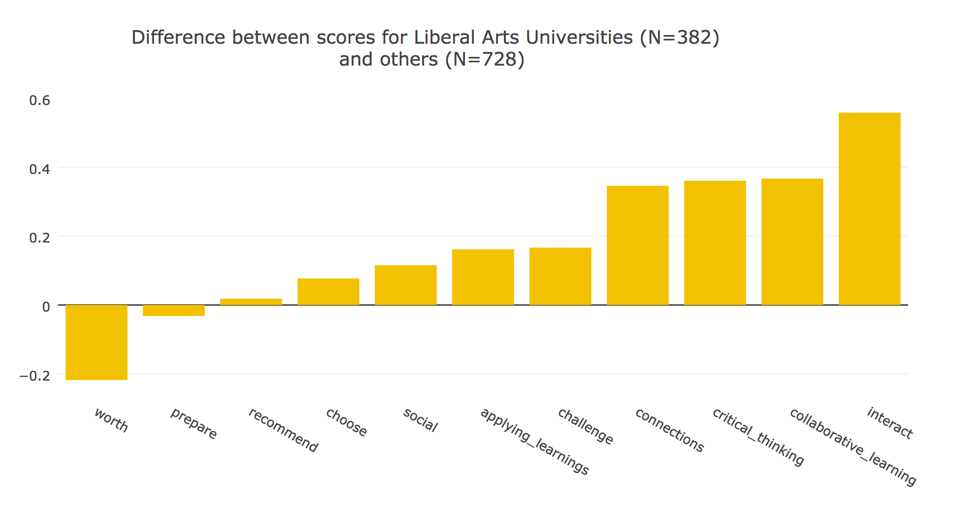
Notes:
i.e. for the negative (left-hand-side, only 2) cases, Liberal Arts unis performed less well than the rest of the US, and better for the questions on the right.

Slide 25
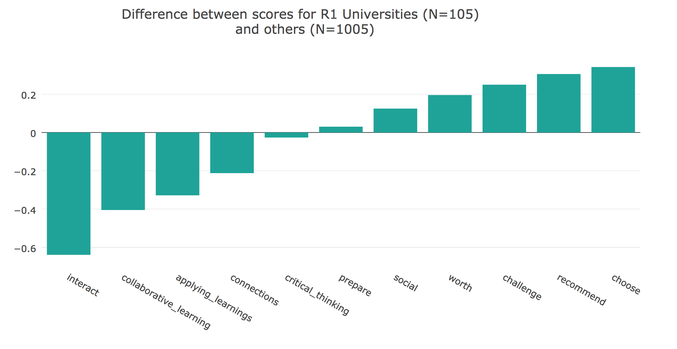

Slide 26
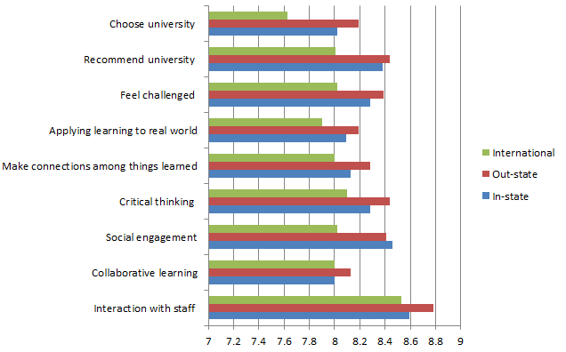
Origin of students
Notes:
National Liberal Arts Colleges (CCBASIC 21) are those that don’t fit the above categories but with over 50% of bachelor degrees and over 50% of those in the Arts & Sciences

Slide 27
Origin of students
Notes:
National Liberal Arts Colleges (CCBASIC 21) are those that don’t fit the above categories but with over 50% of bachelor degrees and over 50% of those in the Arts & Sciences

Slide 28
Origin of students
Notes:
National Liberal Arts Colleges (CCBASIC 21) are those that don’t fit the above categories but with over 50% of bachelor degrees and over 50% of those in the Arts & Sciences

Slide 29
Benchmark measures
  Faculty interaction
  Collaborative learning
  Recommendation
  Choose again
  …..Social engagement
  Practical application
  Reflection / connection
  Critical thinking
  Challenging classes

Slide 30
Delivery method

Slide 31
Delivery method

Slide 32
Delivery method

Slide 33
Delivery method

Slide 34
Multi-campus example – diagnosis within the institution
Multiple campuses, one only online
Significant variance by campus in all benchmark measures
Learning engagement measures stronger for ONLINE
ONLINE also more likely to say college is worth what they’re paying for it

Slide 35
Conclusions

Slide 36
Summary
Interesting disconnect between indicators of interaction and learning and recommendation scores, and even more with ‘worth’ scores
  Case of Public vs. Private NFP – on average lower faculty interactions and higher order learning in public universities vs. private NFP surveyed
  Case of Liberal Arts Colleges – advantage in terms of higher order learning but not in recommendation or perception of worth
Across institutions social engagement most closely correlated with desire to recommend

Slide 37
For consideration
What are we trying to achieve? Learning skills, knowledge, social engagement, value, overall happiness?
If average achievement on these dimensions differs by sector, is this right? What would be the short-term and long-term impacts of shifting resources?
What is the impact of your students’ desire to recommend your university on word-of-mouth referrals – at home, out of state, and overseas?
What is the enrolment and tuition/alumni funding impact of raising NPS?

Slide 38
Where next?
More questions to explore about HE system – across national / state dataset
Tools to benchmark data
Use of data or measures independently e.g. NPS score
Participation next year
Feedback: madeleine.evans@timeshighereducation.com

Slide 39

Thank you
Thank you
Feedback to madeleine.evans@timeshighereducation.com
@timeshighered

