Slide 1
Institutional Research 101: Assessment, Accreditation and Roles in Institutional Research
Western University of Health Sciences
Institutional Research and Effectiveness
Juan Ramirez, Ph.D.
Satoko Siegel, Ph.D.
En-Hsien Liu, Ed.D.
Neil Patel, Ph.D.

Slide 2
Presentation Outline
 | Outline
1 | Introduction
2 | Political and Social Component
3 | Management
4 | Informational Component
5 | Consultation and Expertise
6 | Take Home Messages
7 | Question and Answer
Notes:
Transition from Neil to Juan.

Slide 3
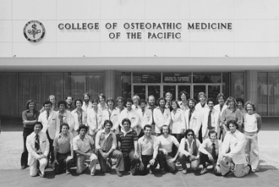
Western University of Health Sciences
9 Colleges
18 Programs
14 Degrees offered
1 Post Masters
certificate

Slide 4
Western University of Health Sciences
Accreditation
WSCUC
Professional accreditors
Our students
3,876 students.
13,376 alumni.
Average age: 28
60.3% Female
Ethnicity/Race
40.8% White
33.4% Asian
10.6% Hispanic/Latino
2.5% African American
Student FTE to Faculty FTE Ratio: 12.8 to 1
Humanism

Slide 5
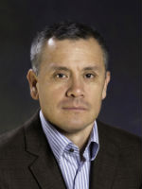
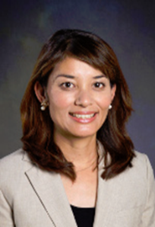
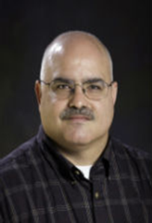
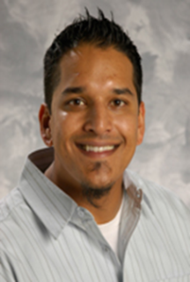
Institutional Research and Effectiveness: informs University decision-making by providing accurate, timely, and appropriate data and analysis.
Director
Research Analysts
Senior Assessment Analyst
Assessment Coordinator
Programmer Analyst
Operations Coordinator

Slide 6
 | Outline
1 | Introduction
2 | Political and Social Component
3 | Management
4 | Informational Component
5 | Consultation and Expertise
6 | Take Home Messages
7 | Question and Answer

Slide 7
What is your role?

Slide 8
Defining You
Nope, absolutely not me.
There are those few fleeting moments when I think about it.
Somewhat like me.
I breath it, I live it, yep, definitely me.
I strive to be the leader on accreditation at of my institution.
I have access to the right people to get things done.
I am prepared to lead important committees related to accreditation.
I prefer to stay behind the scenes and out of the way.
I have strong facilitation skills that I use often.
I am an expert on student learning outcomes assessment.
Customer support is extremely important to me.
I am technically proficient.
I can play any role on a committee.

Slide 9
Type of Roles
Support
Providing data to decision makers
Providing “technical” support
Supporting committees
Managing processes (e.g., program review)
Member
Help identify and define problem
Research, analyze, and interpret data
Help implement solution
Lead
Chair committee
Lead a taskforce
Lead on an issue

Slide 10
Committees
Committees (and subcommittees)
Reaffirmation Steering Committee (lead)
Program Review Committee (lead, support)
Assessment Committee (lead, support)
Faculty Senate Committees (support)
Subcommittees/Committee Taskforce (member)

Slide 11
Getting Out There
Assessment Workshops
Faculty curriculum committees
Assessment Learning Community
Support Services Learning Community

Slide 12
 | Outline
1 | Introduction
2 | Political and Social Component
3 | Management
4 | Informational Component
5 | Consultation and Expertise
6 | Take Home Messages
7 | Question and Answer
Notes:
Transition from Juan to Satoko
Similar to how Juan describes our role within the organization, Satoko will describe how we manage the work flow within the organization

Slide 13
Management
Accreditation
Committees
Support
Assessment
Data
Information
Website
Surveys
Program review
Reporting tool
Intranet
Focus groups

Slide 14
How IRE supports
WesternU program Review Process

Slide 15
WesternU Program Review
Academic programs
10 professional degrees
4 research degrees
Interprofessional education
Co-curricular Programs
8 programs

Slide 16
WesternU Program Review Process
Professional degrees
Research degrees, IPE
Co-curricular Programs
 | Milestone
1 | Planning and Preparation
2 | Research
3 | Self-study
4 | External Review
5 | Internal Review
6 | Annual Follow-up
Professional Accreditation
WesternU
WesternU
WesternU

Slide 17
IRE Support for Program Review Process
 | Milestone | IRE Support
1 | Planning and Preparation | Kickoff meeting Program review training workshop
2 | Research | Standard data and reports Potential external reviewers
3 | Self-study | Phone conference with external reviewers Self-study and supporting documents
4 | External Review | External site visit (lodging support) Draft team report Final team report honorarium, reimbursement
5 | Internal Review | Action plans to Academic Affairs Academic Affairs recommendation to provost
6 | Annual Follow-up | August Trustees Report

Slide 18
 | Outline
1 | Introduction
2 | Political and Social Component
3 | Management
4 | Informational Component
5 | Consultation and Expertise
6 | Take Home Messages
7 | Question and Answer
Notes:
Transition from Satoko to En-Hsien
In addition to supporting program review, we also assist and help guide our University accreditation

Slide 19
Informational
Data reporting
External
IPEDs
WSCUC Reporting
Guidebooks such as Petersons
Dashboard – Academic Outcomes site
Internal
The Board of Trustee (BOT) reports
Ad hoc survey/service requests.
Data sources:
Banner – institutional database

Slide 20
Other Data Sources: Surveys
Examples of the surveys we do regularly:
Administer 8 surveys to all WesternU students on an annual basis:
Two major ones: First Year Student and Graduating Student surveys. Both surveys cover Program Learning Outcomes, Employment information, student climate.
Alumni surveys
Evaluations for faculty.
Satisfaction surveys for academic and non-academic support units.
IRE customer satisfaction survey; Financial Aid office satisfaction survey.
Surveys to help with the program review and accreditation process.

Slide 21
Example of how the IRE Office supports the accreditation process: Review under WSCUC Standards worksheet

Slide 22
Example: Review under WSCUC standards worksheet
Collected evidence for the worksheet.
Identified over 100 individuals which included the President, Provost, students, personnel in academic and non-academic support units to help us to complete the self-assess worksheet.
Created 21 surveys.
Managed and administered the surveys.
Collected, merged and analyzed the data.
Created 4 reports by 4 standards.
Reported the results back to the WSCUC Steering committee which was chaired by our director to guide the conversation and planning.

Slide 23
 | Outline
1 | Introduction
2 | Political and Social Component
3 | Management
4 | Informational Component
5 | Consultation and Expertise
6 | Take Home Messages
7 | Question and Answer

Slide 24
Consultation/Expertise
Common questions people ask…
How do I ask this?
What should I do?
What am I looking for?
Can you give me a p value?
Common services we provide…
Survey construction
Methods
Assessment
Statistics

Slide 25
Assessment Learning Community (ALC)
Vision: Help place a spotlight on faculty who strive to improve student success
Goal: Help faculty pursue their ideas while they still meet their work load demands
Methodology:
Meet once a month for 2 hours (lunch provided!)
Discuss ideas, methodologies, statistics, IRB, patent laws, publications
Learning community participates as a mock participants
Support one another
Tangible goal: Poster presentation
Nontangible goals: Faculty recognition and IRE visibility

Slide 26
Support Service Learning Community (SSLC)
Initial vision: Help create a spotlight on staff who strive to improve student success
Additional vision:
Create a vehicle of communication
Methodology: Same as before, but with one addition…
Discussion of how their work can help support accreditation
Tangible goal: Poster presentation and useable data
Nontangible goals: Staff recognition, IRE visibility and…
Increased University communication

Slide 27
 | Outline
1 | Introduction
2 | Political and Social Component
3 | Management
4 | Informational Component
5 | Consultation and Expertise
6 | Take Home Messages
7 | Question and Answer

Slide 28
Take home message
Culture of assessment
Successful accreditation
Trust
It’s about trusting yourself to put yourself out there for people to trust you– this helps create effectiveness.
Knowledge
Knowing the different roles that you can play, and how you can fill your role.
Awareness
Being aware of what individuals and programs/colleges are doing.
Communication
Communication is a key for management.

Slide 29
 | Outline
1 | Introduction
2 | Political and Social Component
3 | Management
4 | Informational Component
5 | Consultation and Expertise
6 | Take Home Messages
7 | Question and Answer

Slide 30
Thank you!

