Slide 1
Emma Deraze, Data Scientist
Times Higher Education
CAIR 2017 – Thursday Nov 9th

Slide 2
A FEW WORDS ABOUT WHO WE ARE…

Slide 3
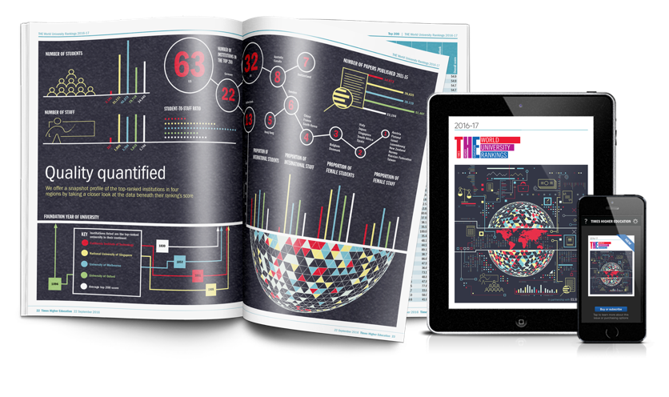
1971
First issue of supplement
World University Rankings launched
THE becomes standalone publication independent of The Times
THE relaunched in magazine format
World University Rankings production moved to Thomson Reuters
World University Rankings brought in-house
US College Rankings launched
2004
2005
2008
2010
Times Higher Education
2015
2016

Slide 4
2017
1971
2004

Slide 5
The World University Ranking
Universities submit their data
Research focus

Slide 6
The challenges for the US College rankings
Moving away from research focus towards teaching focus

Slide 7
The challenges for the US College rankings
Moving away from research focus and towards teaching focus
Reward colleges that educate students better, not just those that are the most selective – “colleges that educate better students”

Slide 8
The challenges for the US College rankings
Moving away from research focus and towards teaching focus
Reward colleges that educate students better, not just those that are the most selective – “colleges that educate better students”
Avoid metrics that enable perverse incentives:

Slide 9
A new approach to understanding US colleges
Entry criteria
Title IV Colleges
Over 1000 students
Public and Private (non-for-profit)
No more than 20% distance learning
→ 1276 considered institutions
8000+ colleges
1276
Data available
+
sufficient survey responses
→ 1056 ranked institutions
1056

Slide 10
Overlap between the World University Rankings and US College Rankings
World Research Mission
1,102
US Teaching Mission
1,054
158

Slide 11
The first fully audited rankings
“The most widely respected global ranking”
Louise Richardson, vice chancellor University of Oxford
The calculations of the THE World University Rankings and the WSJ/THE College Rankings have been independently audited by professional services firm PricewaterhouseCoopers (PwC).

Slide 12
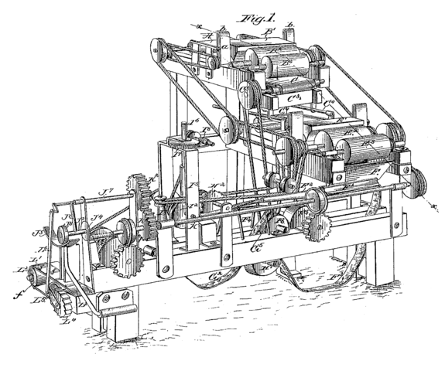
THE METHODOLOGY

Slide 13
3Ps of the learning process – Biggs, Gibbs et al
Presage
Process
Product
Student factors
Prior knowledge
Ability
Motivation
Learning focused activities
Learning outcomes
Skills
Facts
Involvement
Teaching Context
Objectives
Assessment
Climate/ethos
Teaching procedures

Slide 14
Resources
Engagement
Outcomes
Environment
Teaching Context
Objectives
Assessment
Climate/ethos
Teaching procedures
Student factors
Prior knowledge
Ability
Motivation
Teaching Context
Objectives
Assessment
Climate/ethos
Teaching procedures
Presage
Learning focused activities
Process
Learning outcomes
Skills
Facts
Involvement
Product

Slide 15
WSJ/THE College Rankings Methodology
Public data
6 Sources
15 Metrics
4 Pillars
1 Rank
Focus on teaching and learning experience

Slide 16
Does it have the right resources? Resources
What might a student ask? | What can answer the question? (our metric) | 30 %
How well funded is my college? Will my college have money to teach me? | Finance per student (instructional expenses) | 11 %
Will my college have enough staff to teach me? How likely is it that the class sizes are small? | Faculty (teaching staff) per student | 11 %
Does my college have strength in research to support its teaching? Is the teaching research informed? | Publications per faculty (papers, abstracts, book chapters…) | 8 %

Slide 17
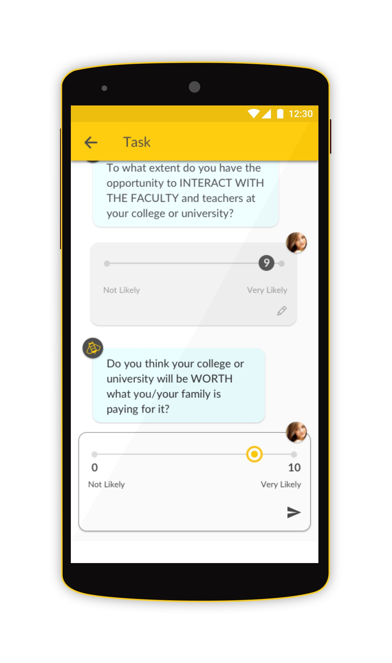
Times Higher Education US Student Survey
Current students in taught courses
1,300 colleges targeted
Focused samples
Engagement managed by established market research organizations
Data from two years
The result: 209,000 students surveyed
To participate, email usrankings@timeshighereducation.com

Slide 18
Does it engage its students? Engagement
What might a student ask? | What can answer the question? (our metric) | 20 %
Will my learning be engaging? How engaged are the existing students? | Student engagement (challenge, critical thinking, making connections, applying learnings) | 7 %
Are the students satisfied with their experience? | Student recommendation | 6 %
Will I have good interactions with faculty and peers? | Student interaction (with staff + collaborative learning) | 4 %
Will I have wide opportunities? | Subject breadth (# CIP codes with accredited programs) | 3 %

Slide 19
Does it produce good results? Outcomes
What might a student ask? | What can answer the question? | 40 %
Does my college succeed in getting people through the program? | Graduation rate | 11 %
Will my salary be higher if I go here? | Graduate salary, VA | 12 %
Will I be able to repay any loans I take out? | Loan default rates, VA | 7 %
How strong is the college's reputation nationally? | Academic (teaching) reputation | 10 %

Slide 20
Does it have a supportive environment? Environment
What might a student ask? | What can answer the question? | 10 %
Will I meet people from other countries? | International student % | 2 %
Does the college support students from other backgrounds? | Student inclusion (1st generation and Pell Grant) | 2 %
Will I meet people from other backgrounds? | Student diversity (ethnic groups breakdown) | 3 %
Will I meet people from other backgrounds? | Faculty diversity (ethnic groups breakdown) | 3 %

Slide 21
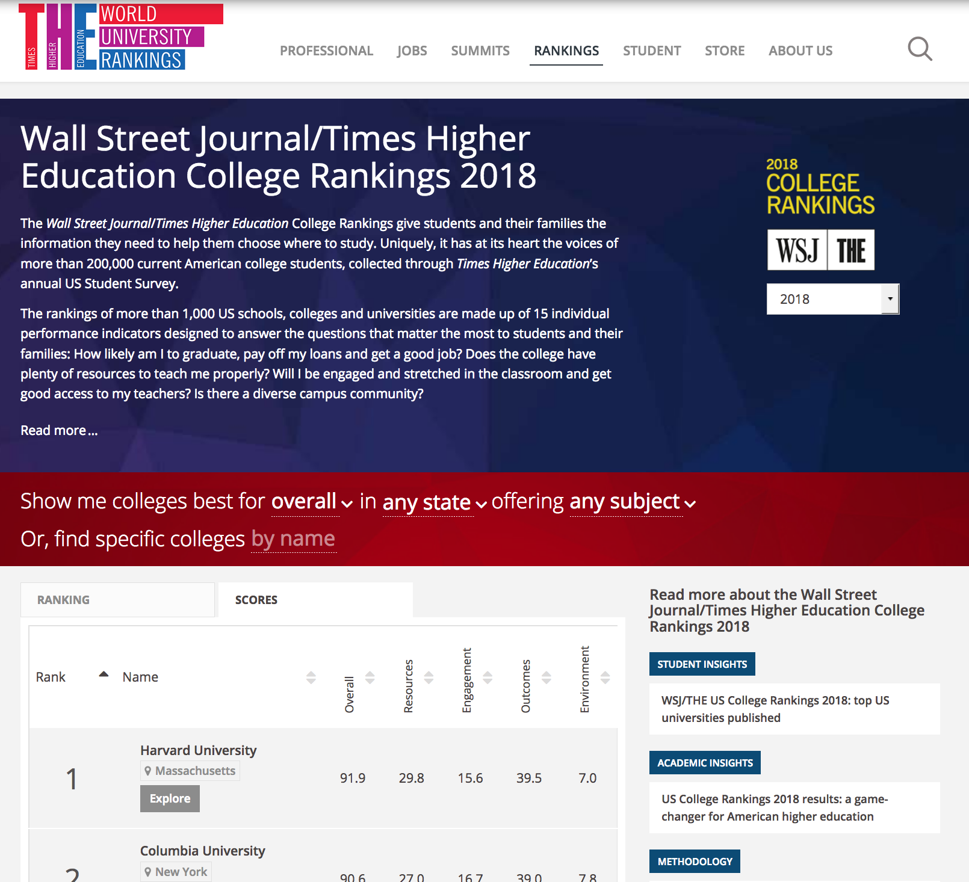
THE RESULTS of the ranking

Slide 22
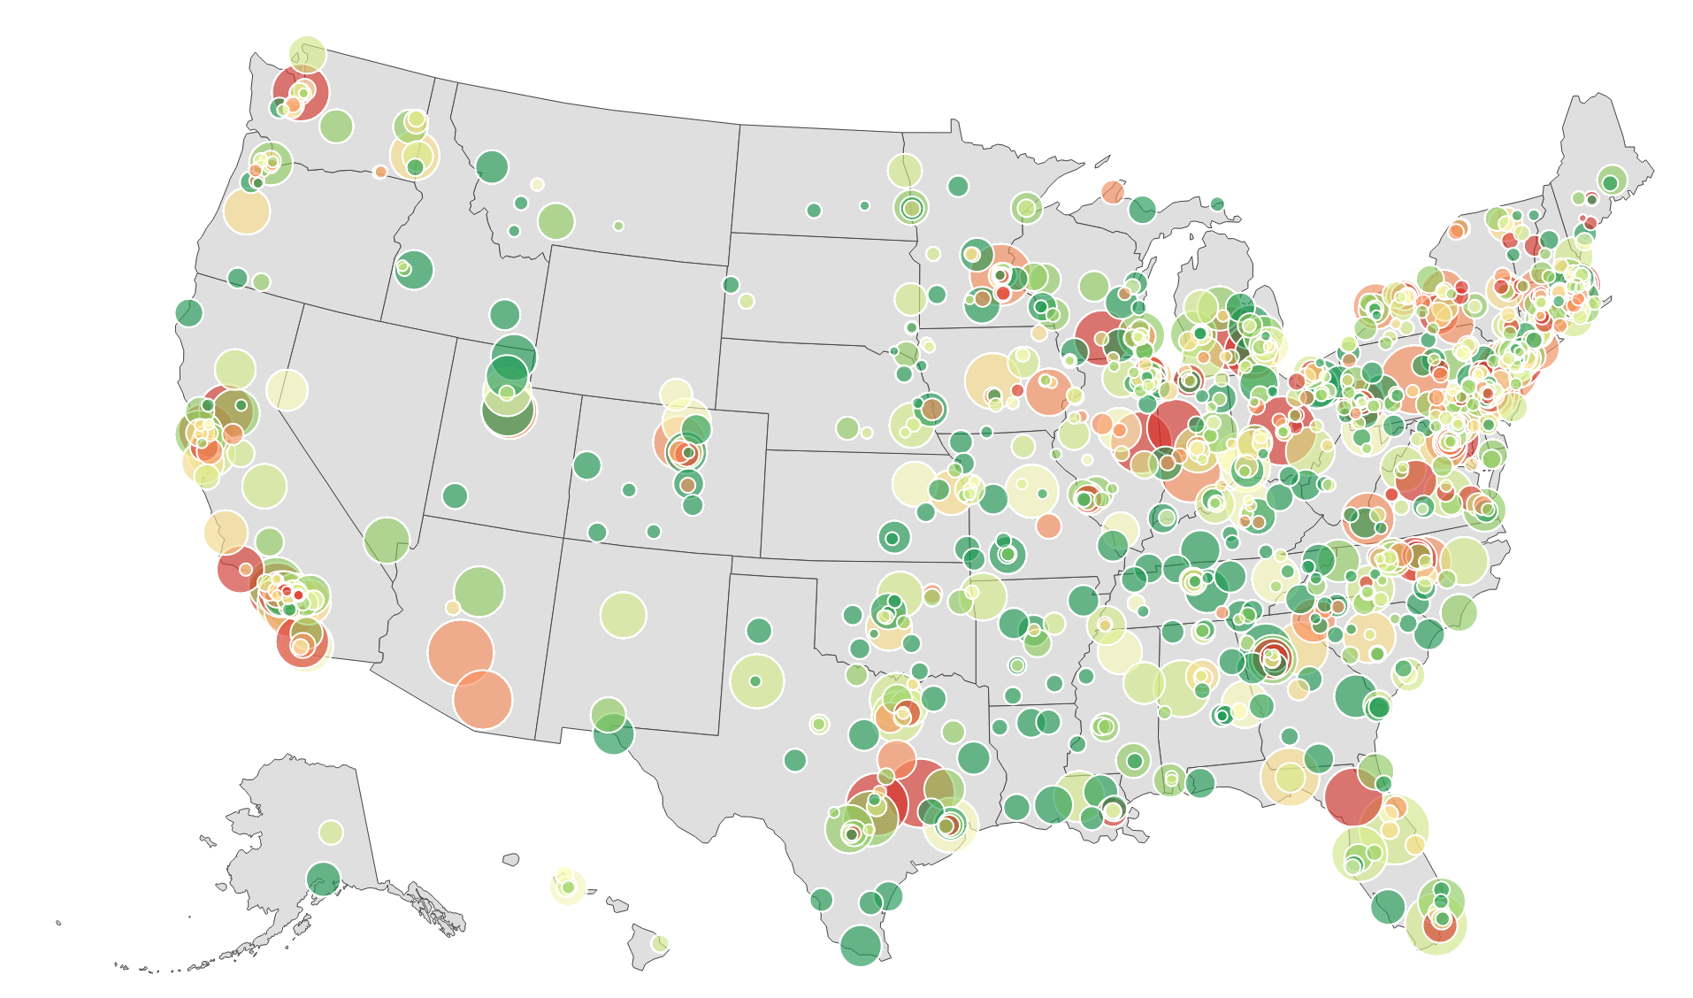
1056 institutions ranked

Slide 23
Top 10 institutions overall
1 | Harvard University
2 | Columbia University
=3 | MIT
=3 | Stanford University
5 | Duke University
6 | Yale University
7 | California Institute of Technology
8 | University of Pennsylvania
9 | Princeton University
10 | Cornell University

Slide 24
Top 10 California institutions
US CA
=3 | 1 | Stanford University
7 | 2 | California Institute of Technology
15 | 3 | University of Southern California
24 | 4 | University of California, Los Angeles
26 | 5 | Pomona College
35 | 6 | Claremont McKenna College
40 | 7 | University of California, Berkeley
46 | 8 | University of California, Davis
47 | 9 | University of California, San Diego
91 | 10 | Occidental College

Slide 25
What can we learn about STUDENT SUCCESS?

Slide 26
Correlation and clustering amongst all metrics
ENVIRONMENT pillar
OUTCOMES pillar
RESOURCES pillar
ENGAGEMENT pillar

Slide 27
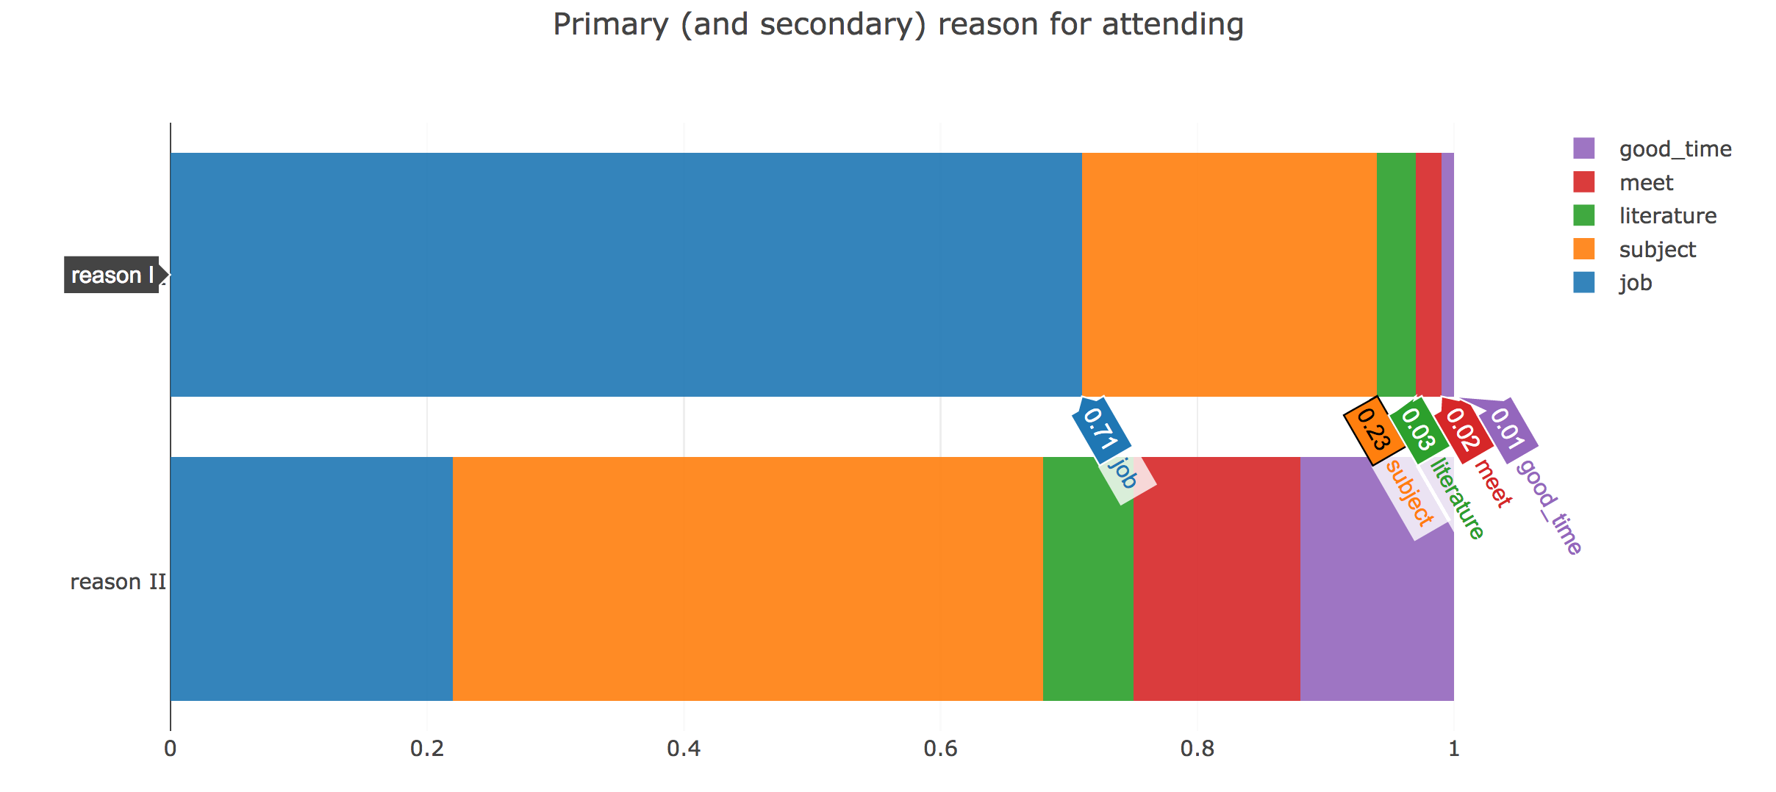
Lesson 1: Students are coming to College for good reasons…

Slide 28
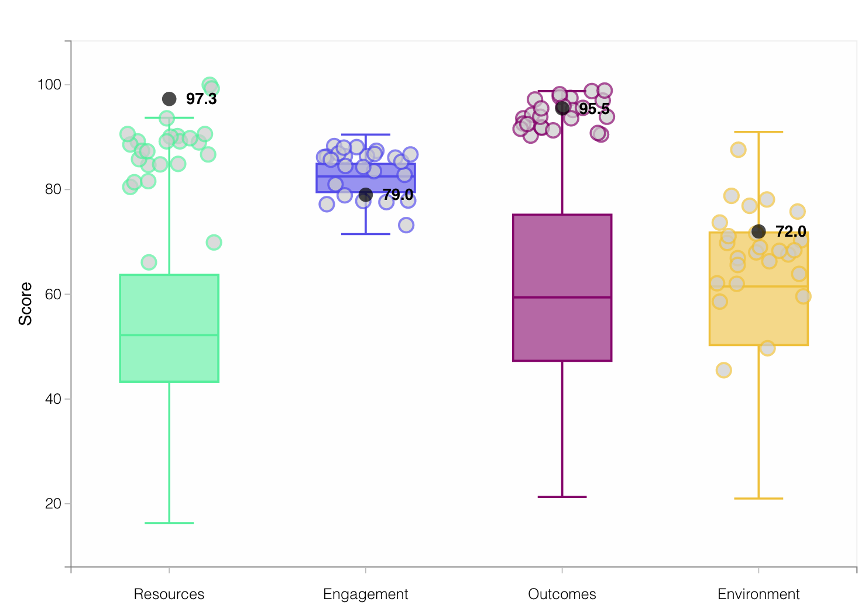
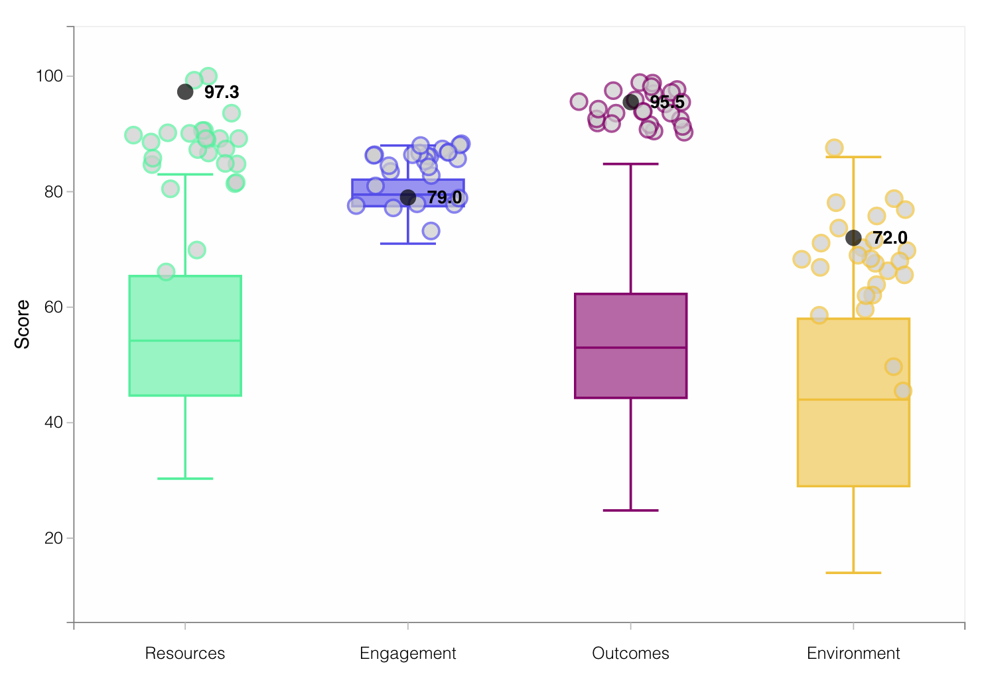
Lesson 2: Traditional Research Universities are strong across the piece
Research
Liberal Arts Colleges

Slide 29
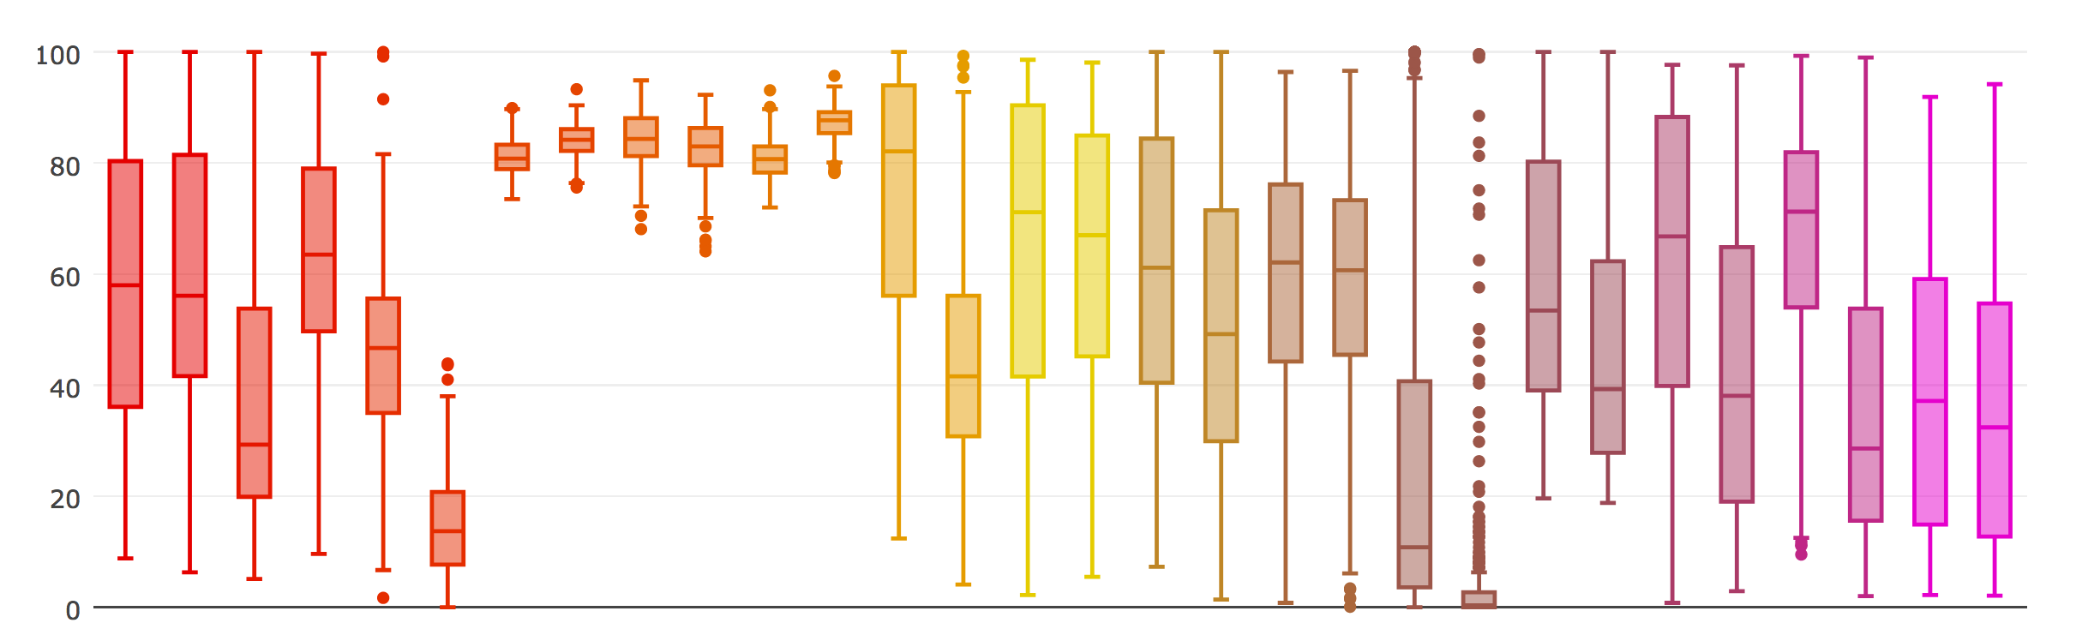
Research universities (R123) vs. Liberal Arts Colleges
engagement
stu. diversity
stu. inclusion
papers / fac
recommend
fac / student
interaction
fac diversity
subject breadth
salary (va)
graduation rate
aca. reputation
finance / student
loan default (va)
international stu.

Slide 30
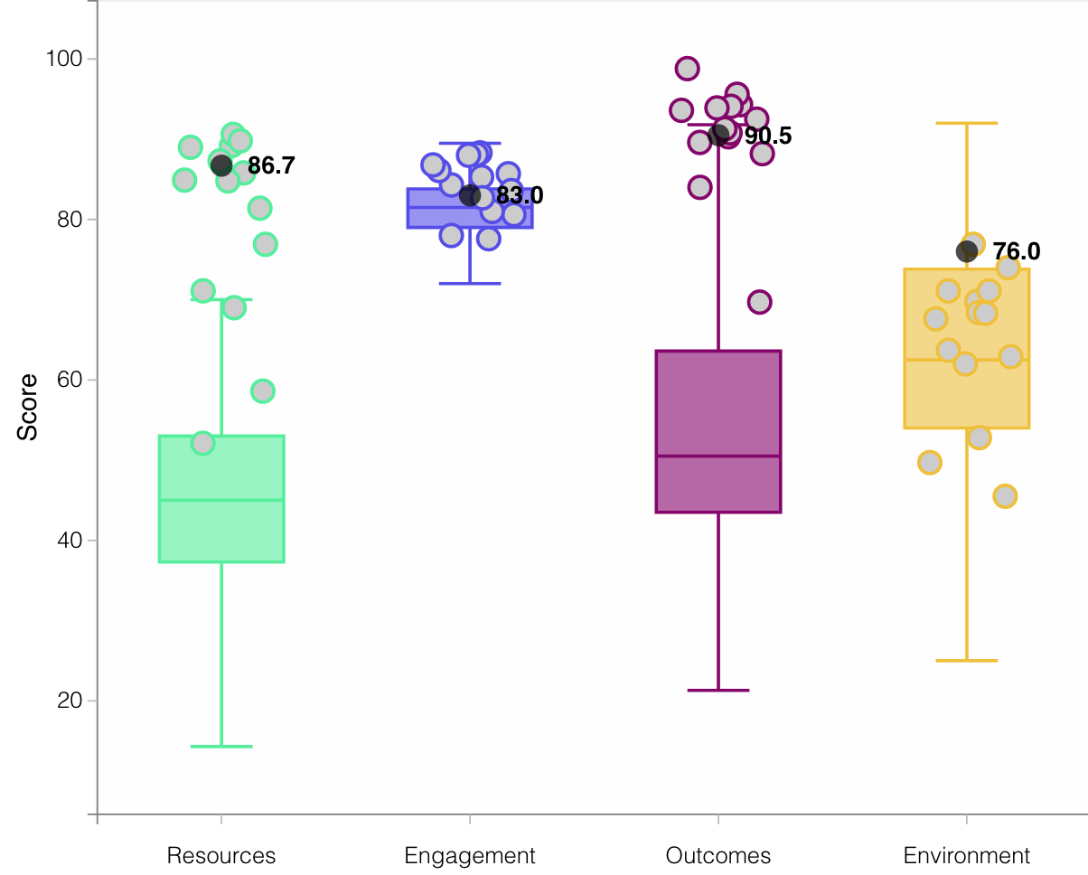
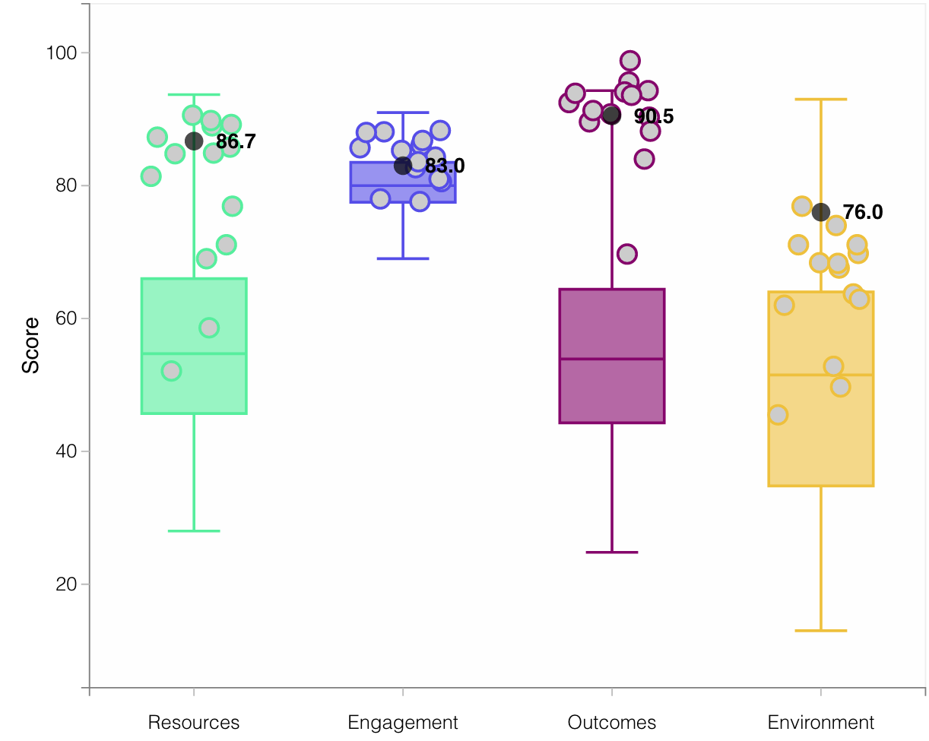
Lesson 3: Public Colleges face a difficult future
Public
Private

Slide 31
Public universities vs. Private universities
engagement
stu. diversity
stu. inclusion
papers / fac
recommend
fac / student
interaction
fac diversity
subject breadth
salary (va)
graduation rate
aca. reputation
finance / student
loan default (va)
international stu.

Slide 32
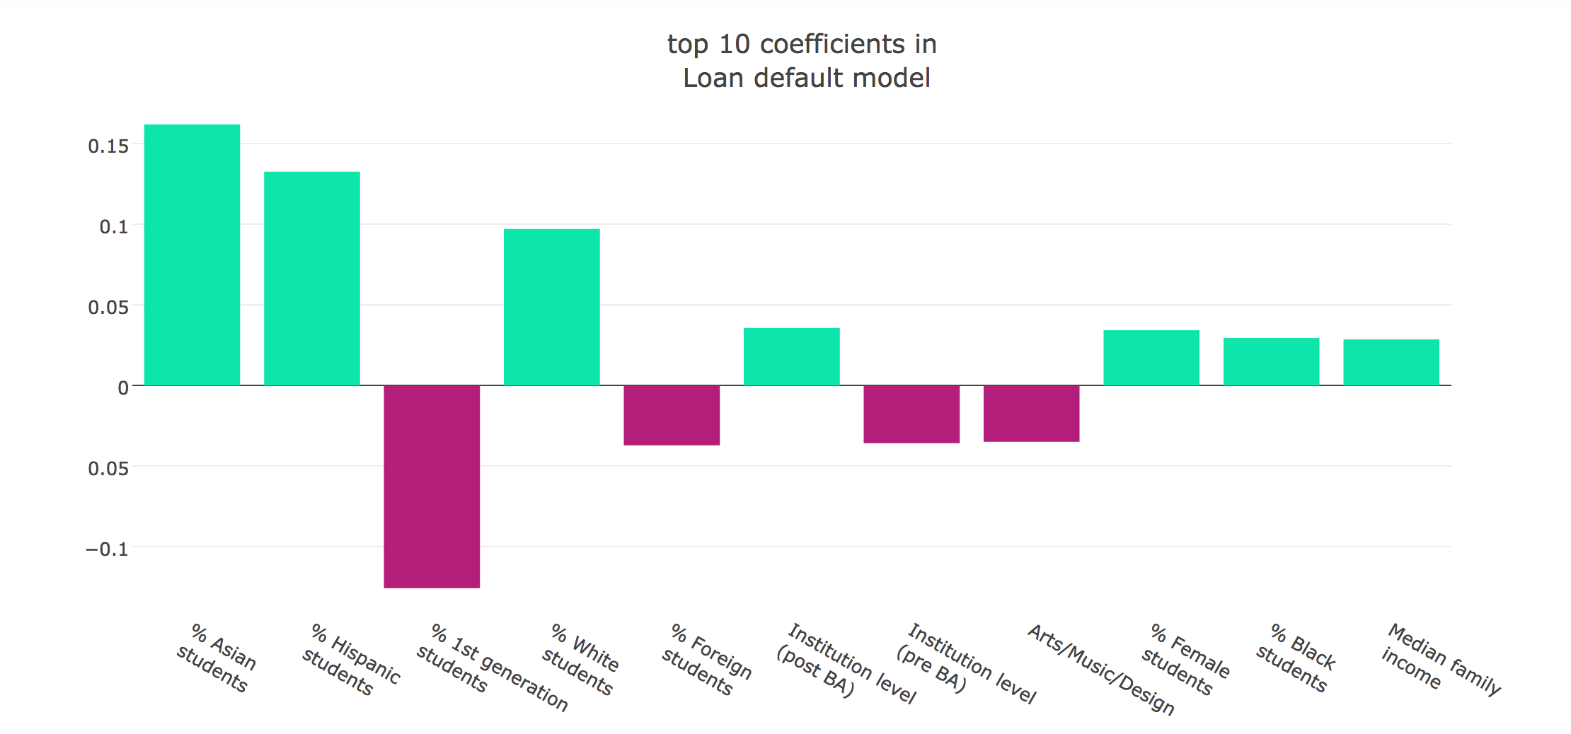
Lesson 4: Social mobility is under threat
Loan repayment:
who is not in default after 3 years

Slide 33
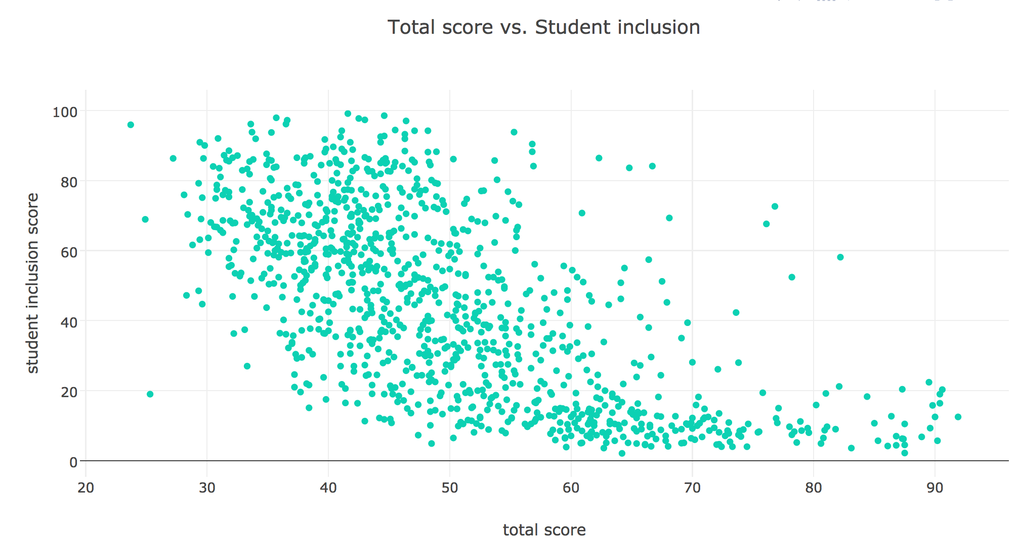
The challenge of student inclusion

Slide 34
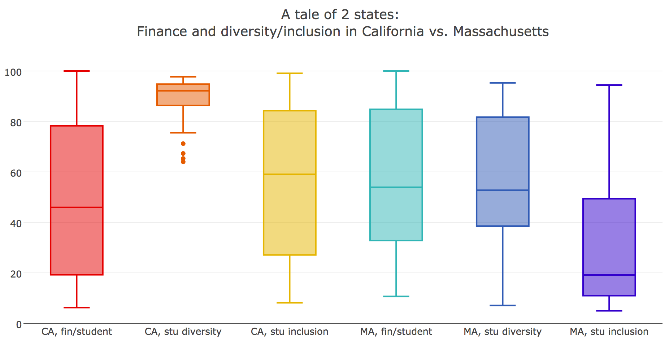
CA: 44% public
MA: 23% public

Slide 35
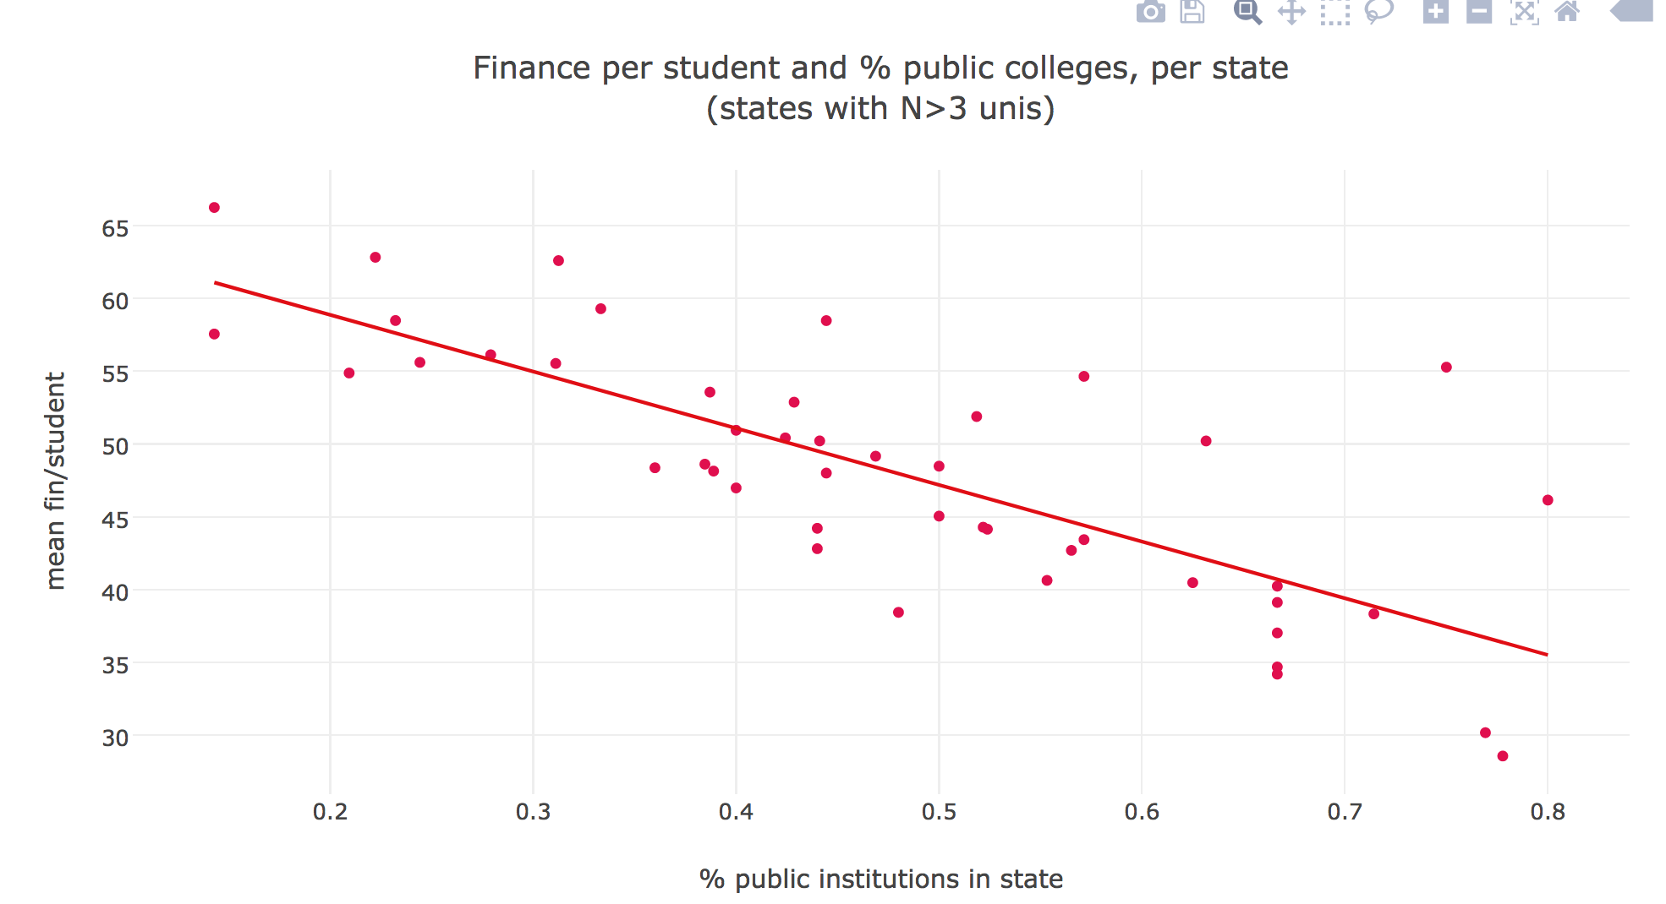

Slide 36
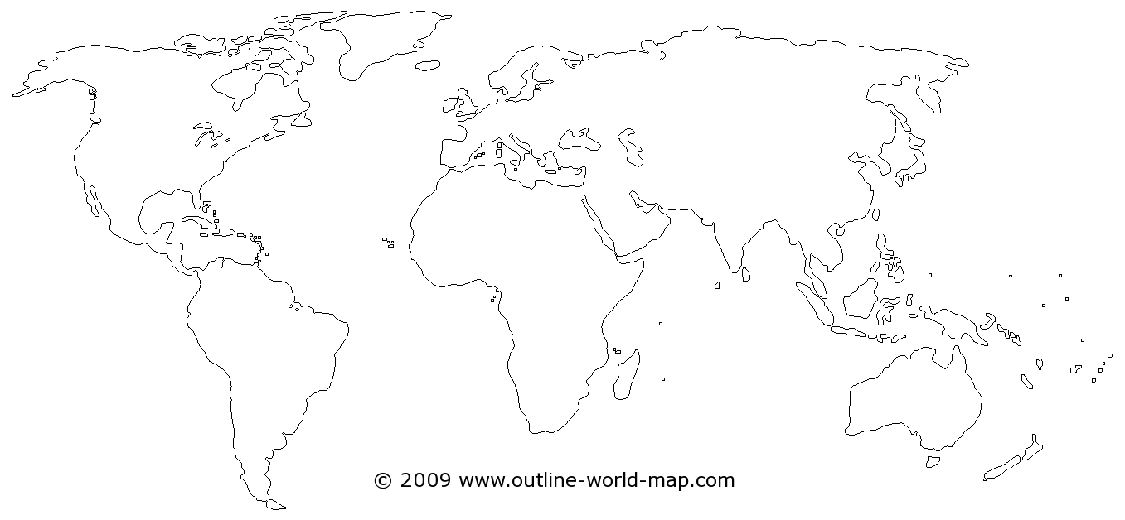
Other teaching rankings across the world…

Slide 37
Japanese University Ranking
Launched March 2017
Second edition March 2018

Slide 38
European Teaching Rankings
Launch June 2018

Slide 39
Thank you!
Questions?
Our rankings:
https://www.timeshighereducation.com/rankings/
Contact the THE US ranking team at:
usrankings@timeshighereducation.com
data@timeshighereducation.com

