Slide 1
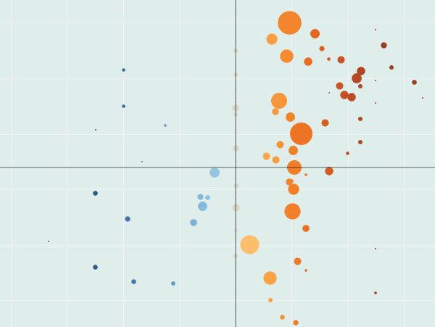
Dashboards for Indirect Student Learning Outcomes Assessment
Erika Jackson, UC Davis
Kelly Wahl, UCLA

Slide 2
Learning Outcomes for this Presentation
Identify the strengths and drawbacks of using indirect methods of learning outcomes assessment
Configure the data for reporting and construct the dashboard in Tableau
And the mystery learning outcome:
?????

Slide 3
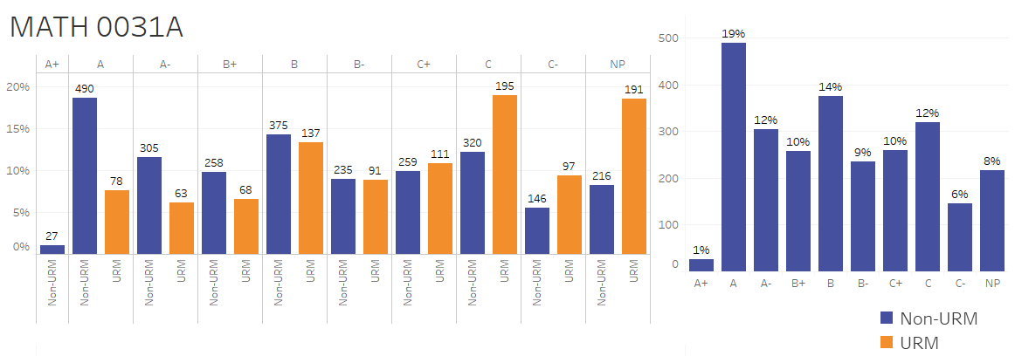
Indirect Learning Outcomes Assessment
Self-Reported Skills Level
Letter Grades in Courses
Grade Point Average
Retention/Persistence
Degree Completion
Time to Degree
Career Outcomes
Many of these are reported on dashboards already
Survey data
Grades in courses
Time to Degree
Graduation Rates

Slide 4
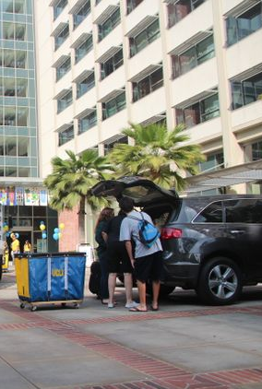
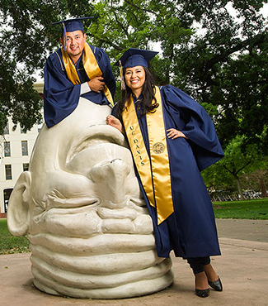
Two Campuses, Two Angles
Formative Assessment of Outcomes: Early Career Gains
Summative Assessment of Outcomes: Success at Graduation

Slide 5
UCLA: Early Career Gains
An analysis of the WSCUC Graduation Rate Dashboard data:
Not passing particular courses was associated with not completing a UCLA degree.
With a six-year graduation rate of 91%, UCLA strives to close the gap between its four-year rate (74%) and its five-year rate (90%).
Self-reported skill levels are collected with the UCUES Survey.
How can we fit these pieces together?

Slide 6
The Scenario Studied
Focus on entering cohort in Fall 2011
Use entering and current quantitative skills level items from UCUES administered in Spring 2012
Include only frosh entrants (24% of undergraduates are transfer entrants)
Extract first-year grades by course subject to create subject GPAs
Attach time-to-degree data, specifically: elapsed years from entry
Fall 2011 cohort is on the brink of its six-year completion

Slide 7
Here’s what the data file looks like:
One record per student per course, with grade points earned
(Select only first three terms of fall 2011 frosh cohort.)
One record per student who completed, with elapsed years for completion
AGGREGATE INTO
One record per student per subject with average grade points earned
UCUES responses to entry and current items: Quantitative
Skills
(Compute the delta.)
One record, per student, per subject, with self-ratings attached (and improvement calculated), with time-to-degree attached if completion has occurred.
stud_no | subject | ave_gps | pre_skill | post_skill | improvement | regular_years_elapsed
1 | LIFESCI | 3.300 | 5 | 5 | 0
1 | MATH | 4.000 | 5 | 5 | 0
1 | PSYCH | 3.000 | 5 | 5 | 0
2 | CHICANO | 3.300 | 3 | 4 | 1 | 4.333333
2 | MUSIC | 3.657 | 3 | 4 | 1 | 4.333333
2 | PHYSCI | 2.700 | 3 | 4 | 1 | 4.333333

Slide 8
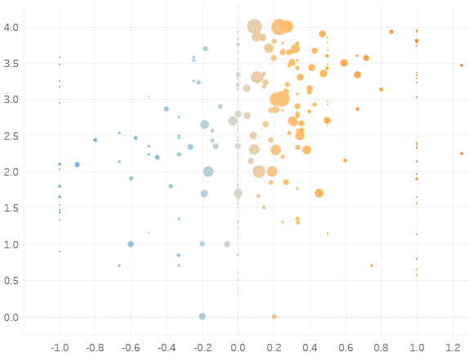
The Tableau Build:
What is mark type?
Circle
What are columns (x-axis)?
AVG(Improvement), Continuous, Measure
What are rows (y-axis)?
Subject GPA, Continuous, Dimension
What is detail?
Subject
What is color?
AVG(Improvement), Continuous, Measure
What is size?
SUM(Number of Records), Continuous, Measure

Slide 9
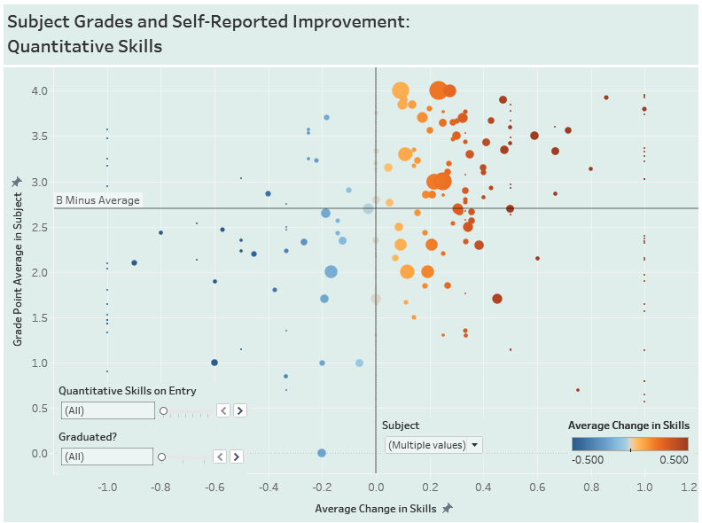

Slide 10
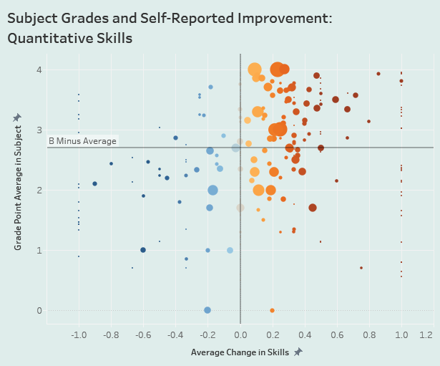
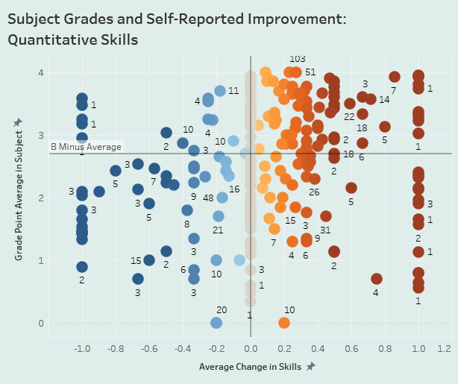
Original scatterplot
Obliterate size dimension and label the dots

Slide 11
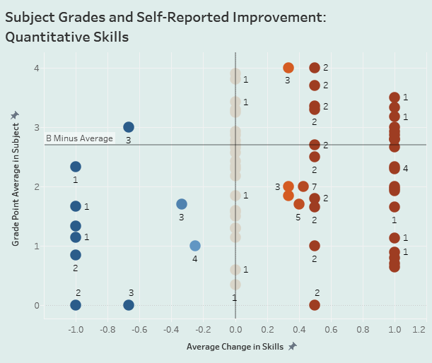
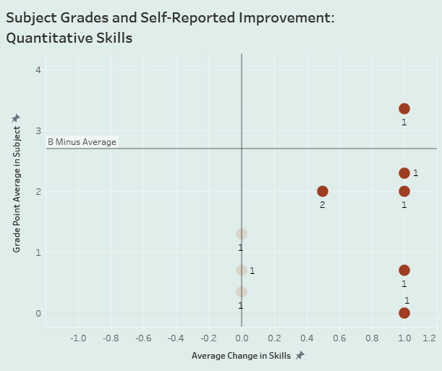
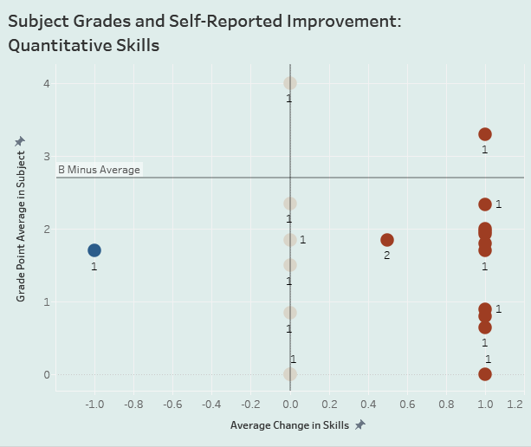
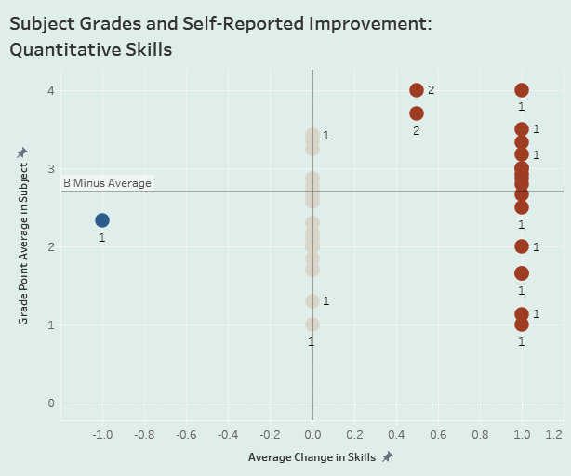
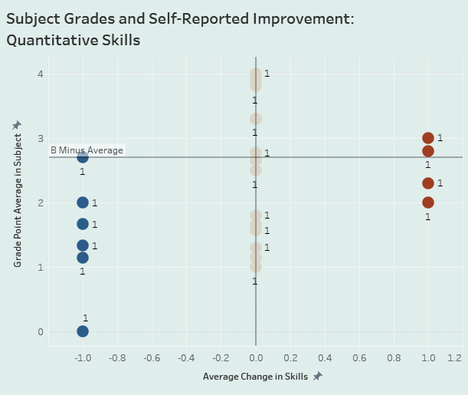
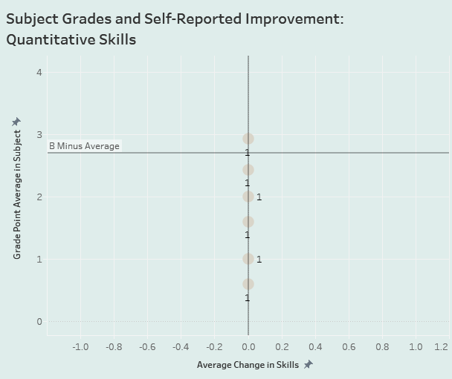
Quantitative Skills on Entry – Not Graduating
All Not Graduating
Poor
Fair
Good
Very Good
Excellent

Slide 12
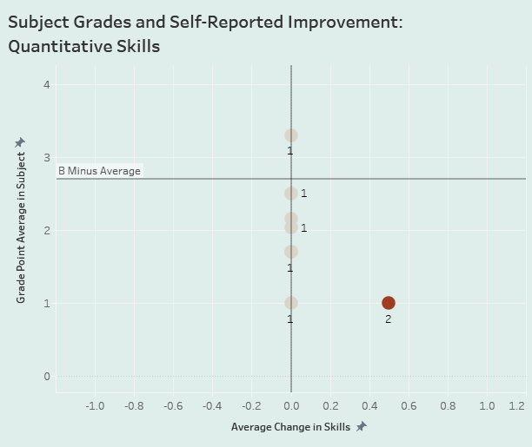
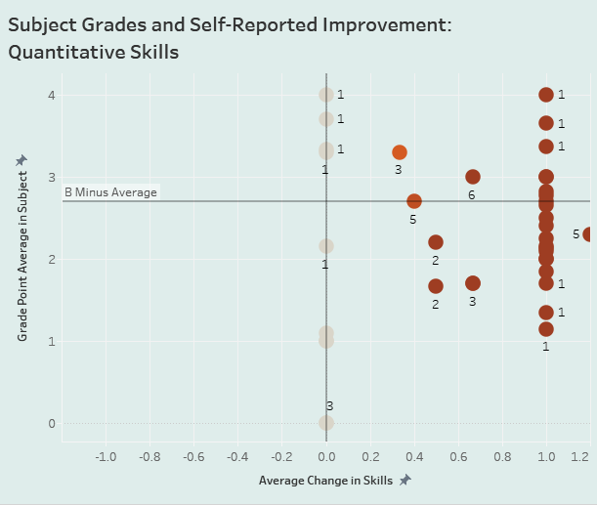
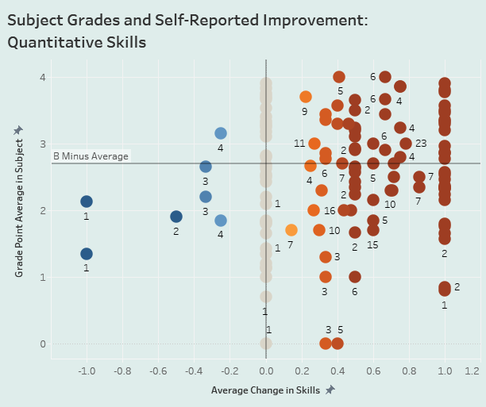
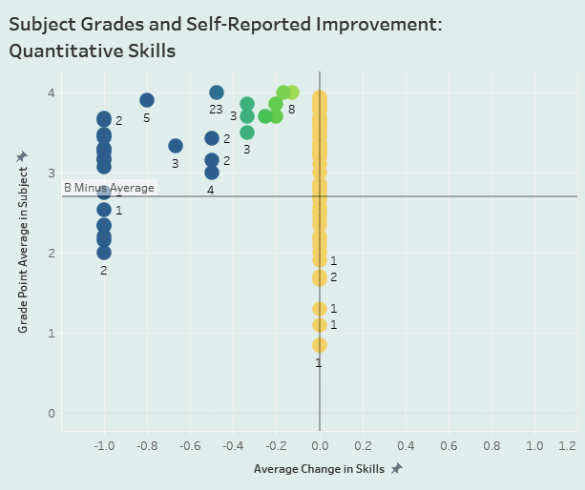
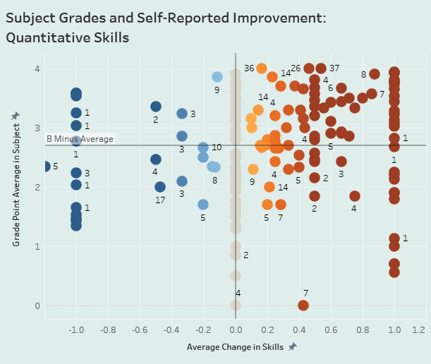
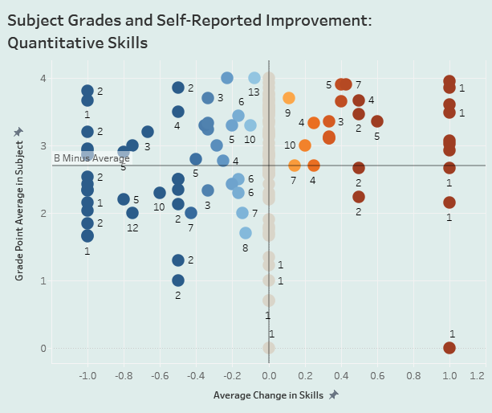
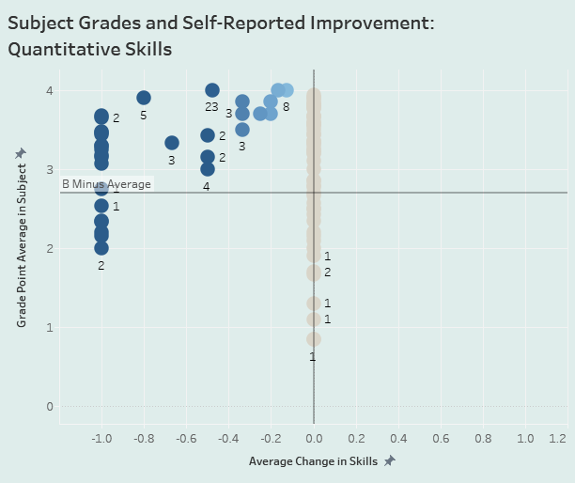
Quantitative Skills on Entry – Graduating
Very Poor
Poor
Fair
Good
Very Good
Excellent

Slide 13
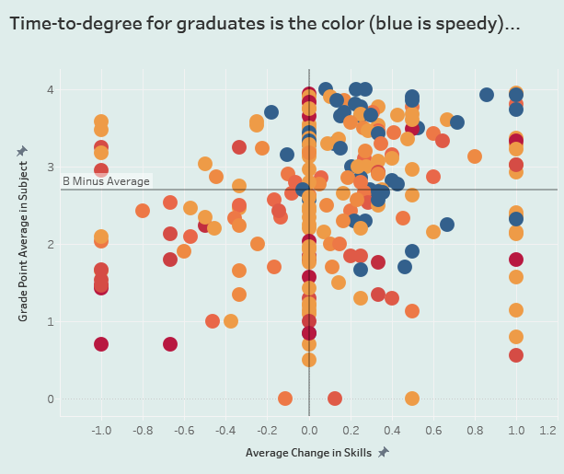

Slide 14
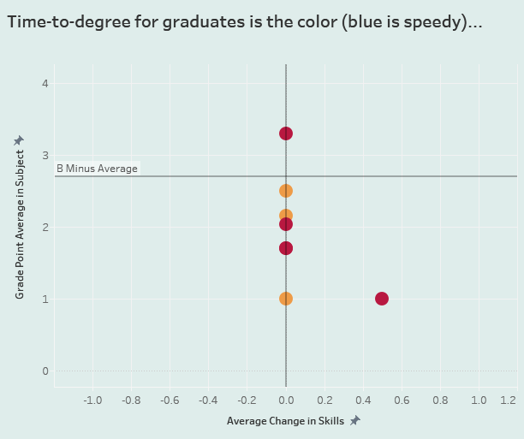
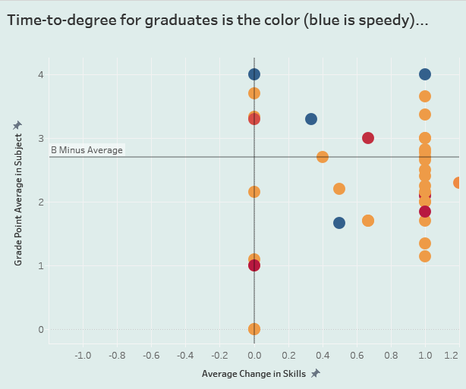
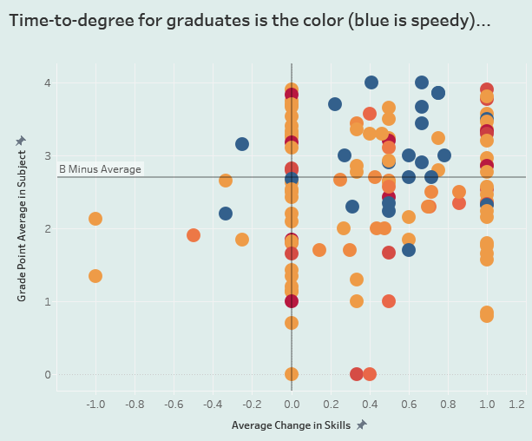
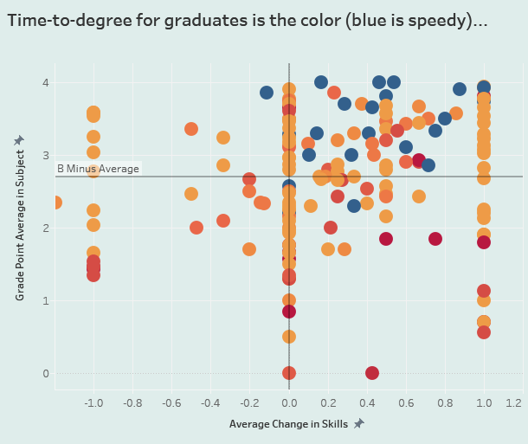
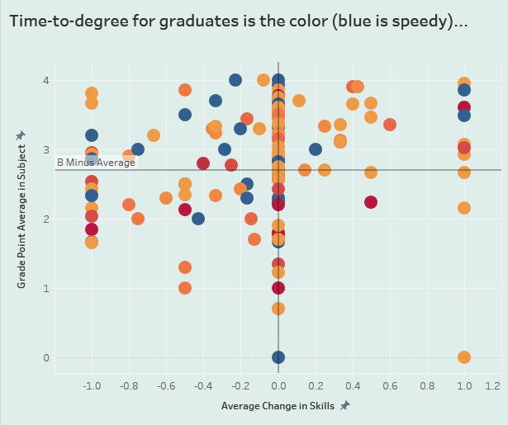
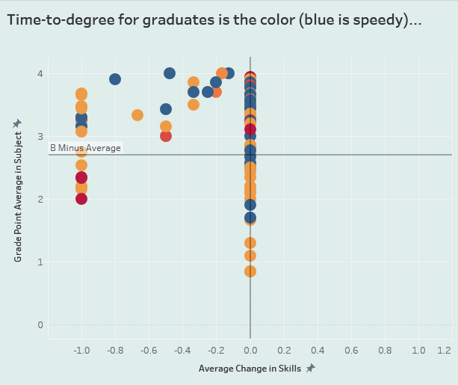
Quantitative Skills on Entry – Time to Degree
Very Poor
Poor
Fair
Audience
Engagement
Good
Very Good
Excellent

Slide 15
Epilogue: On the Bright Side/Dark Side
Careful… Just because you can drive a car doesn’t mean you should drive it everywhere. In some hands, in some conditions, it could be dangerous…
It’s kind of cool to have a tool that people can click through, something that makes them feel empowered.

Slide 16
UC Davis: Success at Graduation
Graduation rates and time to degree get the most attention.
Institutions all (should) have stated learning outcomes.
Survey data and grades each tell part of the story.
How can we fit these pieces together?
Notes:
While graduation rates and time to degree often get the most attention, they are shallow measures of success in many ways. Institutions set out to do far more than just graduate students and at the time of graduation we should be evaluating more than just whether the student finished on time. But how can an IR office participate in this analysis? Ideally this would be through a partnership with Undergrad Education or Associate Deans but it could start via proposed work like this that utilizes data that IR offices regularly deal with – survey data and grades data at the time of completion. Institutions all have learning outcomes stated and collaboration with assessment people or chairs or ADs can help you understand what those are. Then you can connect survey data and grades data, each indirect measures of student learning, to see how it all fits together. I’ll walk you through an example of how we are imagining working with these data on the UCD campus…

Slide 17
Match Campus Learning Outcomes to Survey Data
UC Davis Campus Learning Outcomes |  | UCUES Questions (Please describe your rate your level of proficiency in…)
Develop effective communication skills |  | - Ability to be clear and effective when writing
 |  | - Oral Communication Skills
 |  | - Interpersonal Skills
 |  | - Ability to prepare and make a presentation
Develop higher cognitive skills |  | - Ability to design, conduct, and evaluate research
 |  | - Quantitative (mathematical and statistical) skills
 |  | - Analytical and critical thinking skills
Cultivate the virtues |  | - Social class and economic differences/issues
 |  | - Racial and ethnic, gender, and sexual orientation differences/issues;
 |  | - Physical or psychological disability issues
Develop focus and depth in one or more disciplines |  | - Understanding your field of study (i.e., college major)
 |  | - Ability to read and comprehend academic material
Develop leadership skills |  | - Leadership skills
Develop a global perspective |  | - Ability to understand international perspectives
Prepare for lifelong learning |  | - Library and online information research skills
 |  | - Analytical and critical thinking skills

Slide 18
Learning v. Proficiency: What do/should we measure?
Are our students learning?
Are our students proficient when they graduate?
Notes:
It is possible that some students are learning and some are achieving mastery but no one is doing both and THAT would be a problem. So we should rigorously examine both learning and proficiency TOGETHER.

Slide 19
Learning v. Proficiency: What do/should we measure?
 | no learning occurred | learning occurred
proficiency did not occur | X | ?
proficiency occurred | ? | ü
Notes:
Example of no learning/no mastery
Example of learning/ no master – starting low, learned a lot, still doesn’t have mastery
Example of no learning/master – started high
Example of learning/mastery = complete success!

Slide 20
Learning v. Proficiency: What do/should we measure?
Are our students learning?
Are our students proficient when they graduate?
Are our students BOTH learning and achieving proficiency?
learning
proficiency
Notes:
It is possible that some students are learning and some are achieving mastery but no one is doing both and THAT would be a problem. So we should rigorously examine both learning and proficiency TOGETHER.

Slide 21
Learning v. Proficiency: What do/should we measure?
 |  | Senior Year
 |  | very poor | poor | fair | good | very good | excellent | Total
Freshman Year | very poor | 0% | 0% | 1% | 1% | 0% | 0% | 3%
 | poor | 0% | 0% | 1% | 3% | 3% | 1% | 8%
 | fair | 0% | 0% | 2% | 14% | 19% | 3% | 39%
 | good | 0% | 0% | 0% | 6% | 20% | 8% | 35%
 | very good | 0% | 0% | 0% | 1% | 6% | 5% | 12%
 | excellent | 0% | 0% | 0% | 0% | 1% | 3% | 4%
 | Total | 0% | 0% | 5% | 25% | 49% | 20% | 100%
Notes:
A walk through of where the four quadrants map on to here…

Slide 22
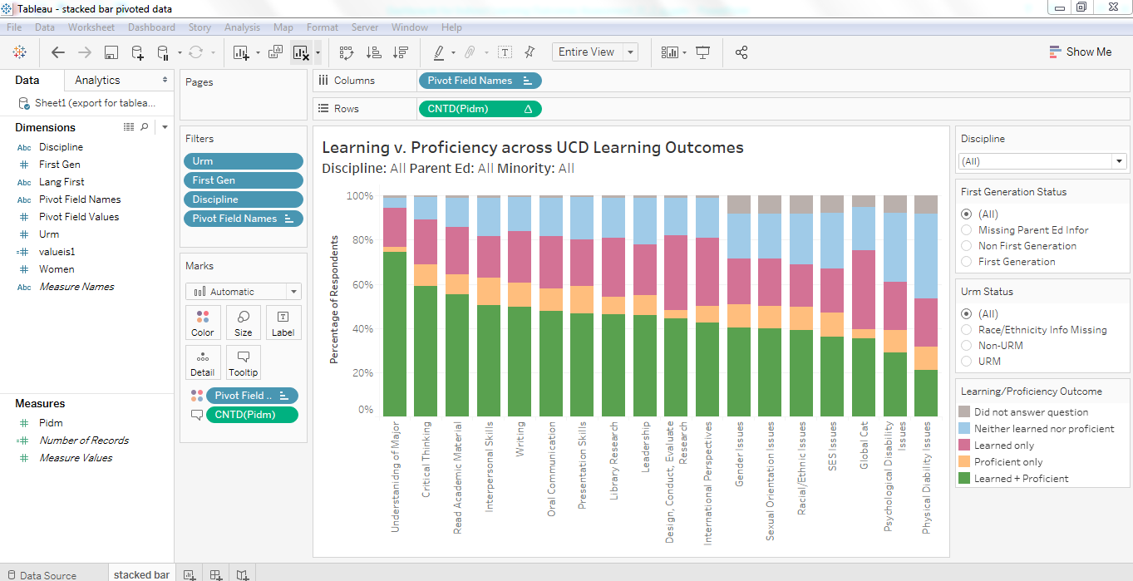
Learning v. Proficiency: What do/should we measure?
Notes:
Proficiency & Learning slide
Show how we can look at multiple items for multiple subgroups via tableau

Slide 23
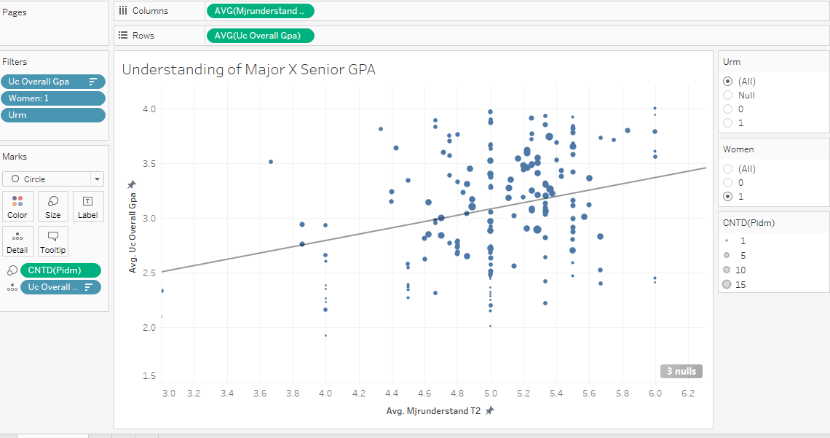
Measuring Proficiency: How Do Grades Compare to Self Reported Skill Levels?
Notes:
Proficiency X Proficiency slide
Does T2 proficiency on individual items correlate with GPA?
Use tableau to Click between questions and demographic groups to see how self reports of T2 skills related to Grades

Slide 24
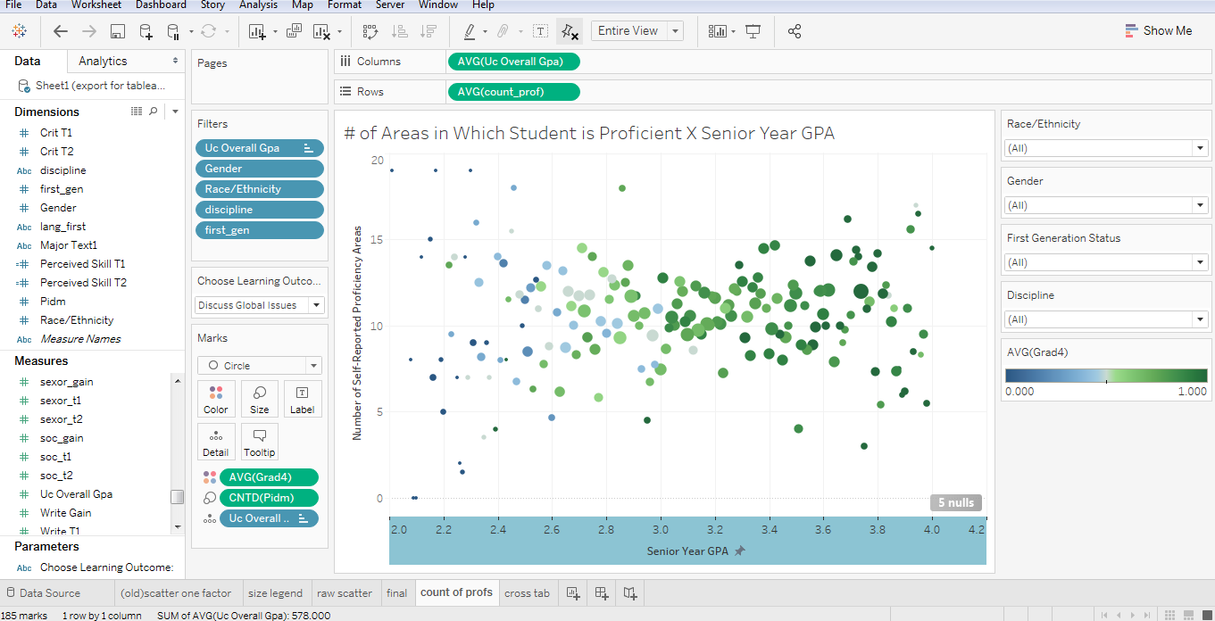
Measuring Proficiency: How Do Grades Compare to Self Reported Skill Levels?
Notes:
Looking at all of the learning outcomes together might track better to GPA
How are these useful? Gives you a descriptive look at something you haven’t looked at before
Who might these be useful to? Program review, assmt people, chairs, profess, deans, administrators, etc.

Slide 25
Issues left hanging in the air…
We don’t have self-ratings from all students.
We don’t have the context on which students based their initial self-ratings. (e.g., Their high school? Their perception of all students entering college? Their test scores? Their guess as to what level of quantitative skills are expected in college?)
We don’t have the basis for their re-evaluation. (e.g., Are they comparing themselves to other students in their classes? To an ideal college student? To what they think professors want?)
We don’t know which students experienced norm-referenced grading, which disguises the actual level of achievement recorded by a grade.
We don’t know to what extent the students had the same basis for evaluation in each course compared to all others. (e.g., Did the student skip an assignment and turn from an ‘B’ student into a ‘C-’ student? Did the student take too many courses while having to hold down a job?)

Slide 26
Even Worse…
We had to use the word “perhaps” a lot when interpreting the graphs. This means that theories can and will abound.
Good grades could indicate learning.
Self-ratings could be accurate.
Finishing a degree on time could indicate the necessary progressive mastery of the discipline.
Or…
Grades could show less learning than is taking place.
Self-ratings could be a sloppy metric for improvement, proficiency, or learning.
Taking longer to finish could indicate multiple majors or time off for important educational experiences.

Slide 27
The Mystery Learning Outcome
Analyze the extent to which indirect methods of assessing student learning outcomes – even when several are used at once – fall short when compared to direct assessment of student learning.
Choose Outcome
Capture Student Work
Assess
Analyze
Take Action

Slide 28
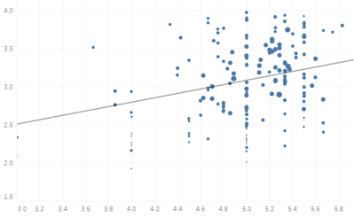
Dashboards for Indirect Student Learning Outcomes Assessment
Erika Jackson, UC Davis
Kelly Wahl, UCLA

