Slide 1
Predicting Students’ Course Success Using Machine Learning Approach
Akira Kanatsu
Research Analyst
Tanner Carollo
Assistant Director
Amanda Bain
Graduate Student Research Assistant
CAIR 2018 Annual Conference - November 14, 2018

Slide 2
Outline
At a Glance
Why Course Success
Machine Learning Approach
Data and Model Training
Results
Next Steps

Slide 3
At a Glance
Undergraduate Student Population
17,854 (89%)
Fall 2018 Lecture/Seminar Undergraduate Courses (< 500 level)
656 courses
1,380 sections
58,370 total enrollments
2,800 (5%) of enrollments are repeats
8,023 attempted enrollments (courses full)

Slide 4
Why Course Success

Slide 5
Impact on Retention, Graduation, and Y2D
Notes:
73% of non-retained F’17 FTF had at least two DFWI’s (vs. 31% of retained)
Only 3% of F’14 FTF with 2 or more 1st year DFWI’s graduated within 4 years

Slide 6
Impact at the Course Level
2017-18 Lower Division LEC/SEM Courses
55 (16%) had a DFWI rate of 20% or higher
10,418 of the course enrollments were repeats
8,012 attempted enrollments received a course is full message
DFWI’s
REPEATS
COURSE IS FULL
A lower division (major) course. DFWI rate of 21%
184
175
138

Slide 7
Machine Learning Approach

Slide 8
Machine Learning
A branch of artificial intelligence
Learn from data
Identify patterns
Make decisions
Application Examples
Online recommendations
Self-driving cars
Fraud detection
Notes:
ML uses statistical techniques to give computer the ability to "learn" from data, without being explicitly programmed.
Supervised (known output/DV) and unsupervised. The purpose of supervised ML is to learn a function that, given a sample of data and outputs of interest, best approximates the relationship between input and output observable in the data
Compared to traditional statistical modeling…
Pros - No need to define specific models. Automatically improve/adjust models when new data is added.
Cons - Identified patterns may not make sense/difficult to explain.

Slide 9
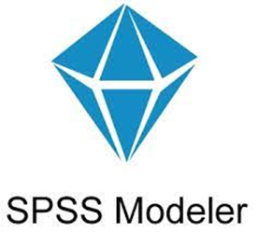
Application
IBM SPSS Modeler (2018 CSU Innovation Minigrant)
Powerful data mining software
Accepts various data sources
Visual interface without programing Language
Automated modeling/model training
Ability to apply trained models to a separate data
Notes:
Separate program from SPSS (annual license $3,000 per account)

Slide 10
Data

Slide 11
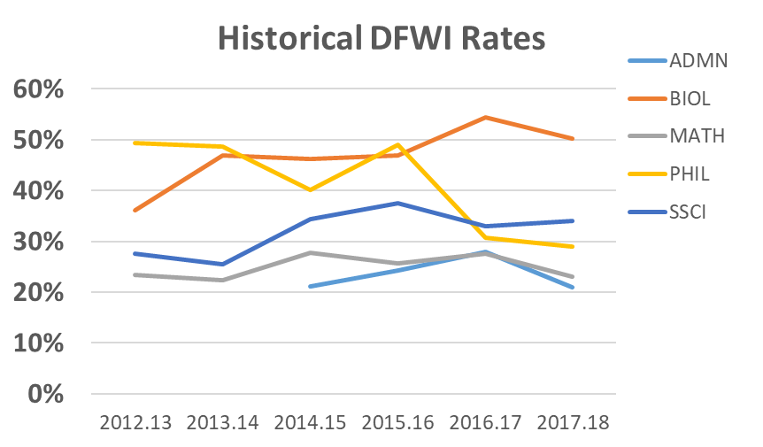
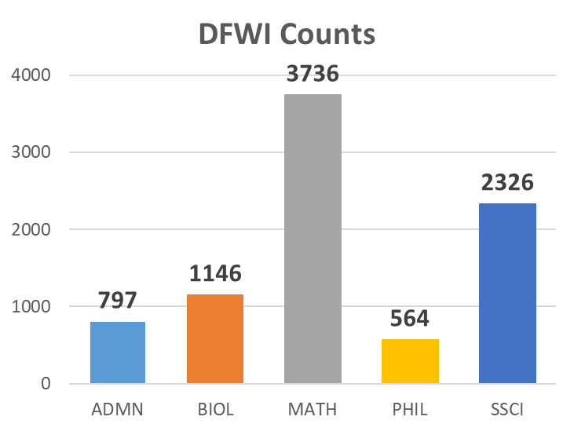
Courses Examined
ADMN
BIOL
MATH
PHIL
SSCI
Course Selection
Lower Division
High Enrollment
High Failure Rate

Slide 12
Course Success Predictors
Student Information
General
Term Specific
Course Information
Instructor Information
Demographics (e.g., Sex & URM)
Student Level
Basis of Admission
Degree Type (e.g., BA)
College of Major
Incoming GPA (i.e., HS & TR GPA)
SAT & ACT Scores
Developmental Math/Placement

Slide 13
Course Success Predictors
Student Information
General
Term Specific
Course Information
Instructor Information
Cumulative GPA
Term Attempted Units
Course Repeat/Highest Previous Grade
# of High DFWI Courses (>25%)
Average DFWI Rates
# of Concurrent Courses with 10% Higher DFWI Rates When Taken Together

Slide 14
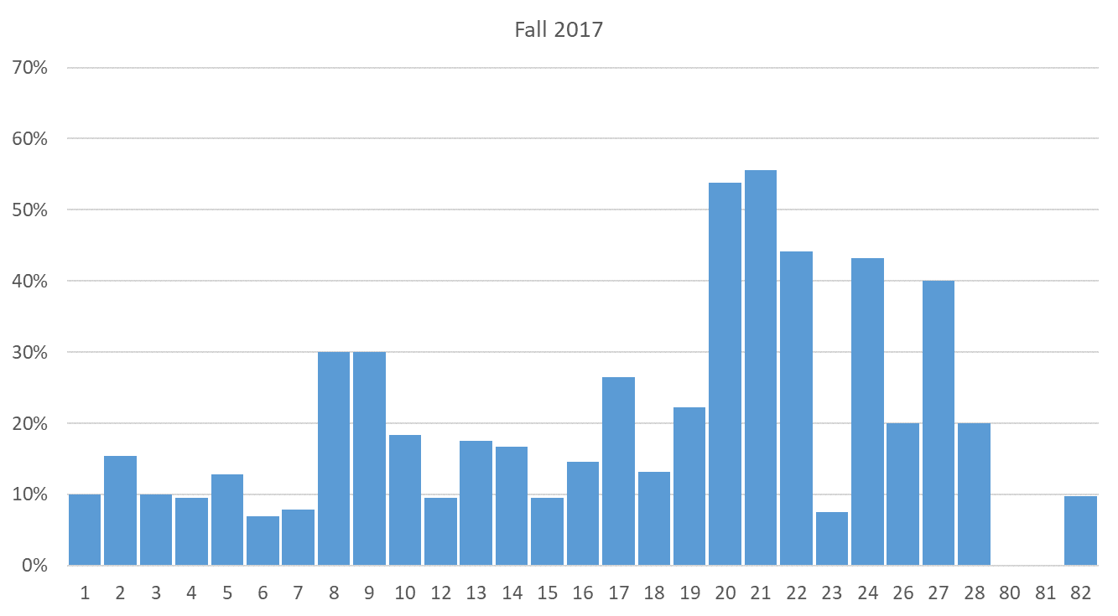
DFWI Rates by Math Course Sections

Slide 15
Course Success Predictors
Student Information
General
Term Specific
Course Information
Instructor Information
Term (e.g., Fall)
Campus (SB & Palm Desert)
Meeting Days (e.g., MWF)
Class Begin Time
Instruction Mode (e.g., Online)
Class Size

Slide 16
Course Success Predictors
Student Information
General
Term Specific
Course Information
Instructor Information
Tenure Status
Previous Course Teaching Experience
Average GPA
Average DFWI Rates

Slide 17
Model Training

Slide 18
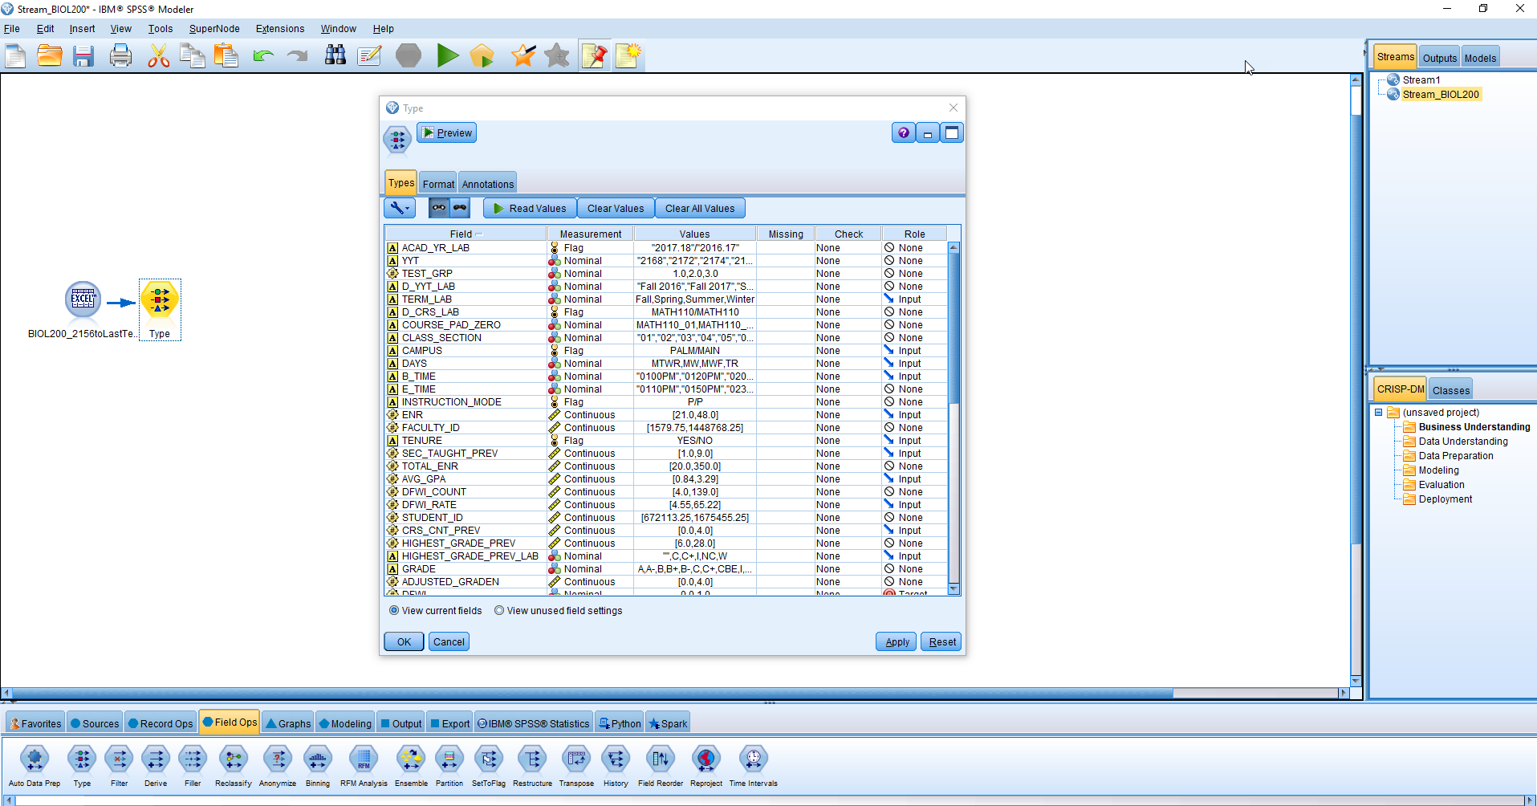
Notes:
Data under “Sources”
Type under “Field Ops”

Slide 19
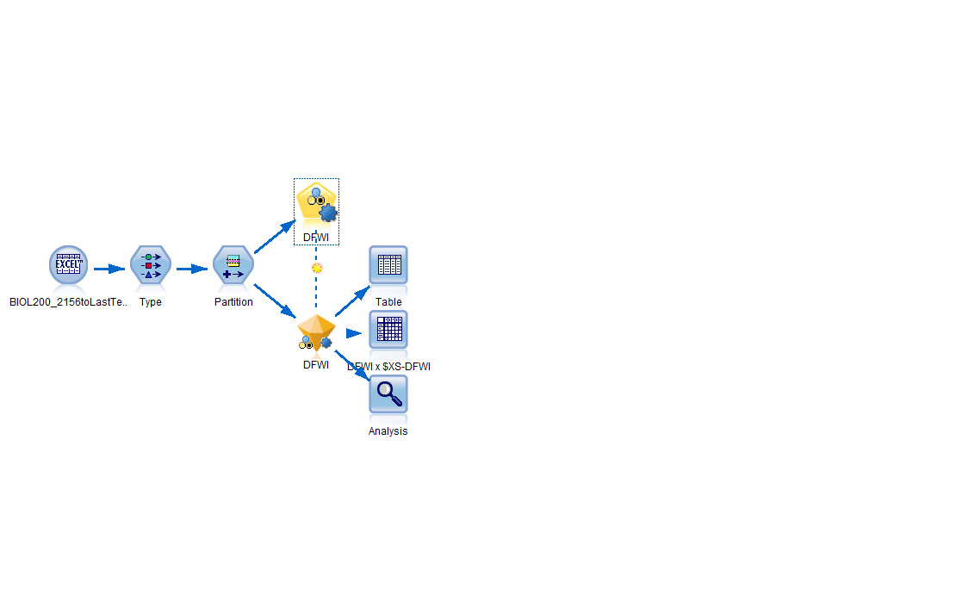
Notes:
Auto Classifier Node train and test machine learning models using up to 16 statistical techniques and list most accurate models.

Slide 20
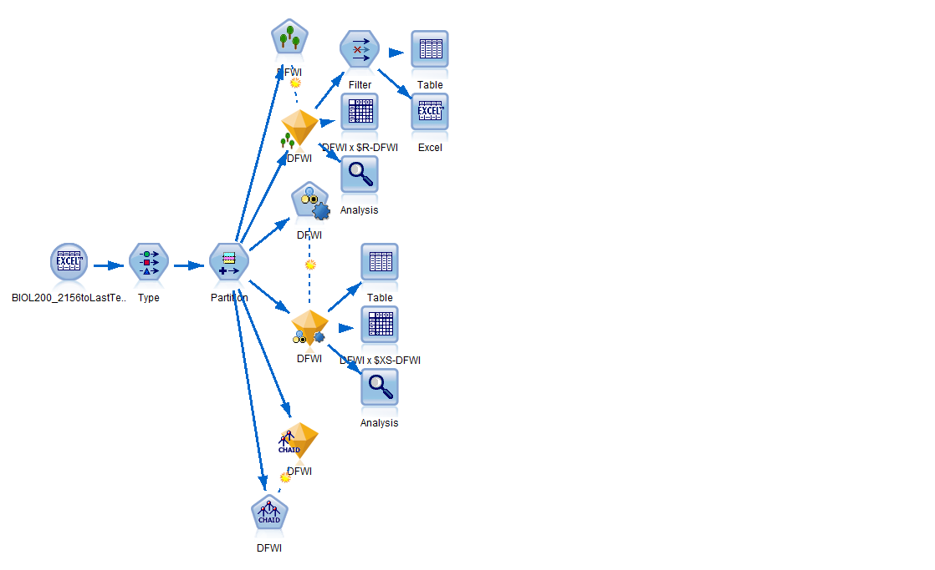
Notes:
Random Tree and CHAID models

Slide 21
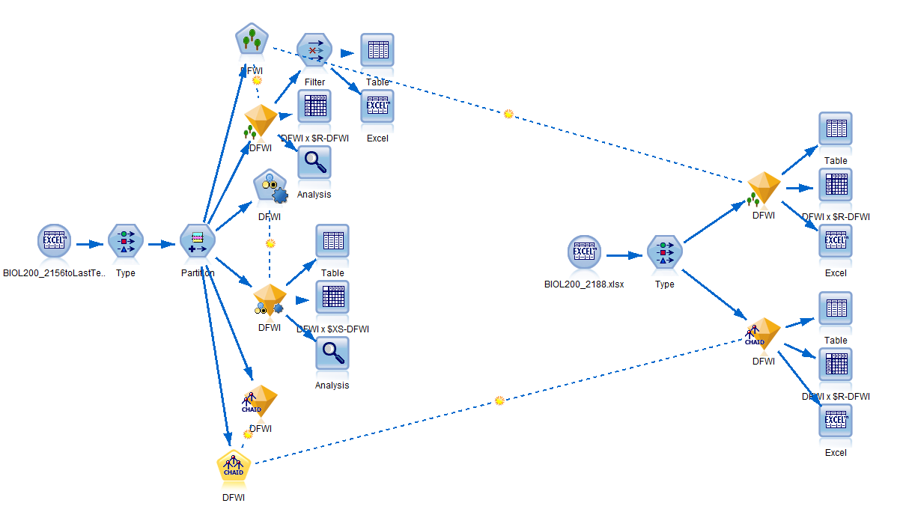
Notes:
Output as Excel file, but can also create reports in Modeler, or using Pyson and R syntax.

Slide 22
Results

Slide 23
Model Output
Prediction – whether students are likely to receive DFWI (1=Yes, 0=No)
Confidence – how likely these predictions are correct (range: 0 to 1)
 | Prediction | Confidence
Student 155 | 1 | 0.777777778
Student 156 | 1 | 0.666666667
Student 157 | 1 | 0.666666667
Student 158 | 1 | 0.888888889
Student 159 | 1 | 0.888888889
Student 160 | 1 | 0.777777778
Student 161 | 1 | 0.666666667
Student 162 | 0 | 0.777777778
Student 163 | 0 | 0.777777778
Student 164 | 0 | 0.777777778
Notes:
In Modeler, a machine learning model produces predictions at student level.

Slide 24
Model Prediction & Accuracy
Course | Enrollment | Historical (Summer 2015 to Summer 2018) |  |  |  |  | Fall 2018
 |  | Predicted DFWI (n) | Predicted DFWI (%) | Actual DFWI (n) | Actual DFWI (%) | Overall Model Accuracy on Historical Data | Enrollment | Predicted DFWI (n) | Predicted DFWI (%)
ADMN | 2709 | 598 | 22% | 641 | 24% | 80% | 133 | 39 | 29%
BIOL | 1276 | 629 | 49% | 645 | 51% | 77% | 408 | 175 | 43%
MATH | 8363 | 2287 | 27% | 2136 | 26% | 81% | 681 | 102 | 15%
PHIL | 653 | 267 | 41% | 241 | 37% | 79% | 103 | 34 | 33%
SSCI | 3557 | 1004 | 28% | 1231 | 35% | 74% | 407 | 84 | 21%

Slide 25
Top 5 Predictors (CHAID Model)
Rank | ADMN | BIOL | MATH | PHIL | SSCI
1 | Cumulative GPA | Cumulative GPA | Instructor DFWI Rate | Cumulative GPA | Cumulative GPA
2 | Instructor DFWI Rate | Student Level | Cumulative GPA | Instructor Average GPA | Tenure Status
3 | Tenure Status | Dev. Math Tenure Status | Dev. Math Grade | Days | College of Major
4 | Class Size | SAT Score | Incoming GPA | Concurrent CRS | Term
5 | Term | URM Status | Concurrent CRS | Sex | SAT Score
Notes:
Blue = Student Academic Characteristics
Red = Instructor Characteristics
Yellow/Orange = Student Demographic Characteristics
Green= Course Characteristics
Purple = Concurrent Courses

Slide 26
MATH Course Prediction by Section

Slide 27
Other Possible Report: MATH Student with Concurrent Course
 | Identified Concurrent Course | Number of Concurrent Courses
Student 234 | Yes | 1
Student 241 | Yes | 2
Student 267 | Yes | 1
Student 277 | Yes | 1
Student 278 | Yes | 1
Student 279 | Yes | 1
Student 280 | Yes | 1
Student 284 | Yes | 1
Student 287 | Yes | 1
Student 299 | Yes | 2

Slide 28
Next Steps

Slide 29
Process Improvement
Exploration and Automation
Targeted Supplemental Instruction
Advising
Notify students where/when appropriate (e.g., concurrent courses)
Reporting outputs and structures

