Slide 1
Analyzing Qualitative Survey Data
Institutional Assessment and Research California State University, Monterey Bay

Slide 2
Open-Ended Questions on Surveys
Often open-ended questions are included on surveys but rarely receive the analysis and attention of quantitative items
Most tools oriented towards qualitative data expect small numbers of interviews rather than thousands of cases and don’t scale
What worked for 150 NSSE responses in 2008 would not do for 3568 CSUMB Experience Survey responses in 2009
Like many departments, IAR could not dedicate the necessary human resources to qualitative analysis with manual processing

Slide 3
Goals for a tool
Attach academic and demographic variables to open-text responses
Redact names from the responses
Allow users to read full text responses with appropriate security
Integrate with campus authentication
Categorize (tag) the responses and aggregate
See common themes across instruments and administrations
Data not locked into a particular tool

Slide 4
Tools evaluated
NVivo in combination with an Excel VBA. Distribute Excel workbooks.
Access database for processing. Distribute Excel workbooks.
Custom, secured web app for display only.
Initially, data still processed in Access
Add offline processing with SPSS Text Analysis for Surveys in combination with R
Add additional cleanup facilities (redaction, categorization) to an online tool
Notes:
VBA
VBA (Visual Basic for Applications) is the programming language of Excel and other Office programs.

Slide 5
Qualitative Survey Reporting Tool (QSRT)
Custom web app built on a LAMP stack (Linux, Apache, MySQL, PHP)
Relational database design
Integrated with OKTA for single sign on authentication
Web app fully accessible (Section 508 compliant)
Somewhat responsive design
Browser agnostic

Slide 6
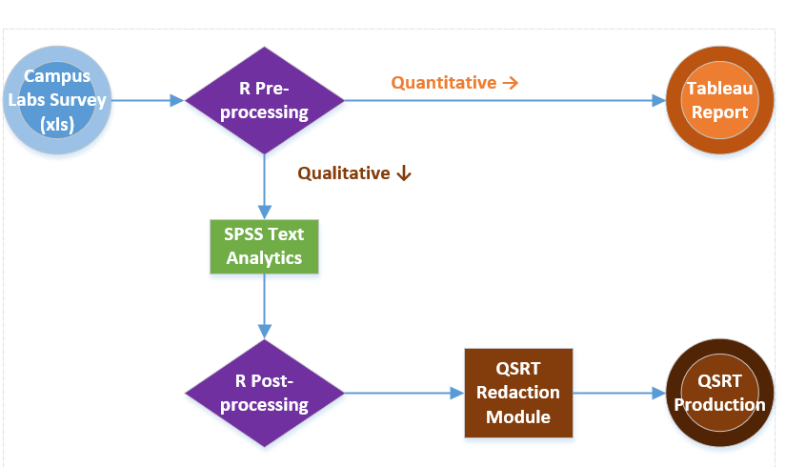
QSRT: Data Flow

Slide 7
Data Preprocessing (R)
Extract keys and open-ended questions from Campus Labs file
Drop cases without qualitative responses
Attach demographics and academic variables
Set appropriate values for missing data
Write extract to Excel file

Slide 8
SPSS Text Analytics for Surveys (TAS)
Loads from Excel, SPSS Statistics or Data Collection file, or ODBC
Assigns phrases to semantic concepts
Facilitates development of mapping rules from concept to category
Applies rules based on a customizable dictionary
A whole response is tagged with a concept, and thus a category
Displays case identifiers and attributes as needed
Output to Excel, SPSS Statistics or Data Collection

Slide 9
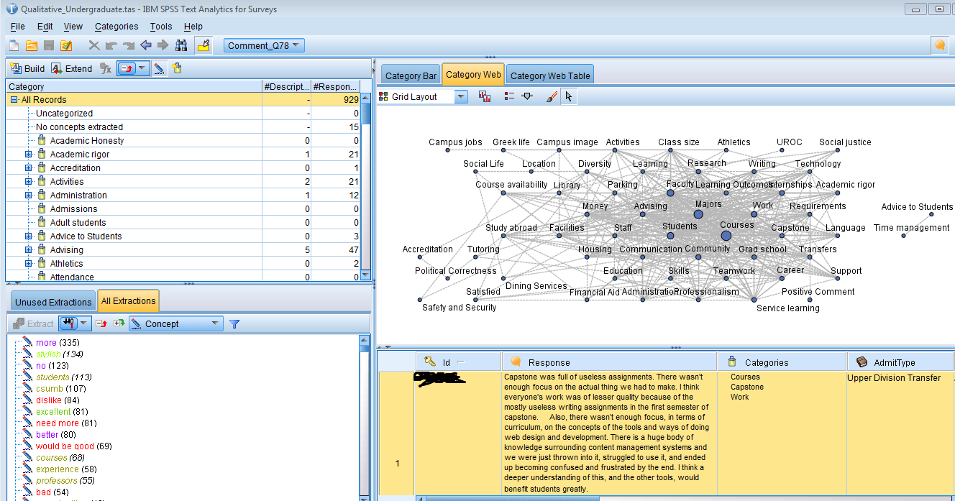
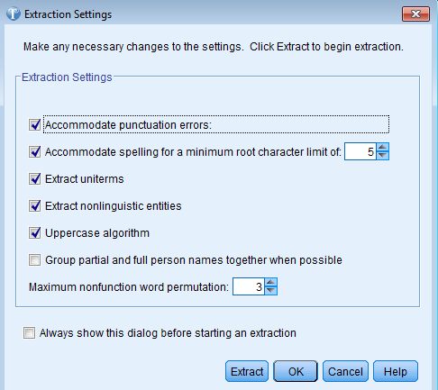
SPSS Text Analytics for Surveys (TAS)

Slide 10
Data Post-processing (R)
Load SPSS TAS output Excel file
Anonymize and assign key (CaseID). Add foreign keys.
Split to two data frames: responses and categories
With packages stringr and reshape2, explode the comma-delimited list of categories and reorganize the categories data frame from wide to long
Insert into the QSRT staging table for redaction
Insert metadata into setup tables

Slide 11
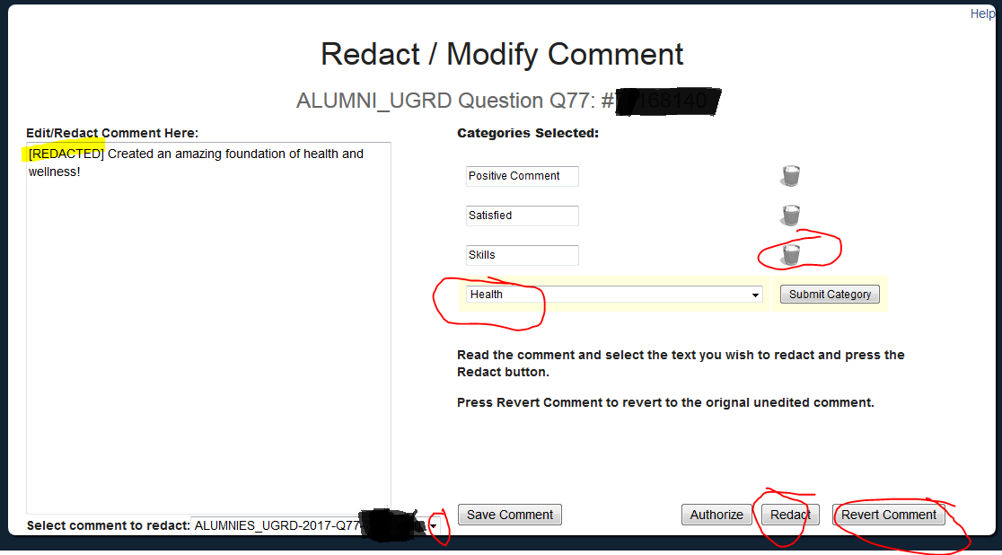
QSRT: Redaction Module

Slide 12
QSRT: Available data by the numbers
5 survey instruments
NSSE, CSUMBES, HEDS Alumni, Alumni Grad, Alumni Ugrad
10 administrations (2008 - 2017)
10 demographic / academic variables
17,720 student / alumni responses
499 redactions (since we started logging this)
109 categories
34,193 category assignments
62 authorized users

Slide 13
QSRT: Ways of browsing the data
QSRT Demo: IAR's Qualitative Survey Reporting Tool.
Everything, paginated
Filter by Survey, Administration, and Question
Filter by Class Year
Filter by Major
Attach demographics
Full text search
Annotating and highlighting the survey responses

Slide 14
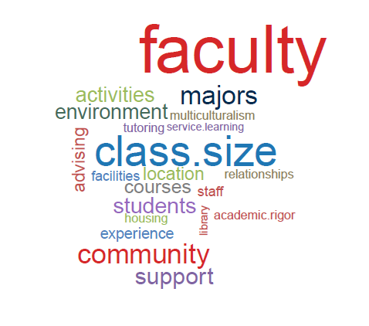
QSRT: Extensibility
QSRT has a secured API to pull aggregates into any tool which supports MySQL over an SSH tunnel, such as Tableau Desktop or R.
Example: Tag cloud created in R with the RMySQL, tm, and wordcloud packages
Using open-source technologies prevents lock in. (At least the data can be moved)

Slide 15
Use of QSRT by Campus Leaders
Academic Program Review
Administrative reviews
Curriculum change
WASC and Graduation Initiative

Slide 16
Questions?
Institutional Assessment and Research - https://csumb.edu/iar
Veronica Chukwuemeka
Director of Institutional Assessment and Research
vchukwuemeka@csumb.edu
Michael Dorsch
Data and Visualization Analyst
mdorsch@csumb.edu
Sathyan Sundaram
Research Analyst
ssundaram@csumb.edu

