Slide 1
Is the value of a college degree equivalent for all?
2018 California Association for Institutional Research Conference
Anaheim, CA
Brianna Moore-Trieu, Ph. D. & Joey Van Matre, MA
Notes:
The value of a college degree has been a topic of much conversation recently. In this presentation we defining value as earnings after graduation, we recognize there are lots of other definitions of value that are important to consider. What instead we will be focusing on today, if we are defining value as Earnings after graduation, that value is or benefit assumed equitably by alumni, or are there differences in that value based on race/gender.

Slide 2
Agenda
Gender – Race Wage Gap in the United States
Research Questions for College Graduates
Data Sources
Early Career Earnings and Academic Achievement (GPA)
Mid Career Earnings and Graduate Degrees
Discussion
Notes:
To kick off this explorations
We’ll start off with a look at look national trends in wage gaps by gender and race. The we want to see if those trends apply to our sample of our college grads sample of college grads, we’ll take you through our research, the data sources we used and an investigate if there are gaps in early career earnings, taking GPA into account and if there are gaps in Mid career earnings taking terminal degree type into account. Once you see how weve approached well have a discussion about what data like this could be used for

Slide 3
Gender Wage Gap
In 1975 the average pay gap between Men and Women was 43 percent (57 cents on the dollar)
As of 2016 the pay gap has narrowed to about 19 percent (81 cents on the dollar).
- Carnevale, Smith & Gluish (2018), Women Can’t Win. Georgetown University Center on Education
Notes:
What do we know about the gender wage gap?
Women were making approximately 57 cents on the dollar, now in 2016, women are making 81 percent on the dollar, well hey that’s progress.

Slide 4
Gender – Race Wage Gap
-AAUW (2017) The Simple Truth about the Gender Pay Gap
Notes:
However when we also include race into, while there has been some closure of the pay gap for all women, the rate of progress has not been equal for all women.

Slide 5

What about major?
Are you comparing assistants to CEOs?
Don’t women tend to work in lower paying industries?
Do they have similar levels education?
Aren’t women worse at negotiating?
What about childbearing?
Notes:
But we known looking at aggregate statistics by race and gender isn’t the whole story. We know there are other factors that might mediate or moderate the affect race and gender. These are some of the thoughts that might come up when hearing statistics about the gender/wage gap, we wont be able to address all these concerns with our analysis, but we will address some.

Slide 6
Research Questions
How do undergraduate major and industry of work relate to earnings?
Are gender and academic achievement (GPA) associated with early career earnings?
Can the race-gender gap be explained by graduate degree completions? Are there differences in the effects of race and gender by industry?

Slide 7
Data Sources
UC Graduating Classes of 1999 to 2014
Annualized wages from California Employment Development Department
Student Data: Race, Gender, Campus Attended, Major, GPA at Graduation, Graduate Degrees Earned (NSC)
North American Industry Classification Schedule (NAICS) codes for industry of work
Limitations:
Does not include alumni working outside California
Does not include self-employed, federal, or military workers.
No information about occupation.

Slide 8
Methods
Descriptive Statistics
Multinomial Logistic Regression
Multiple Regression
Hierarchical Linear Modeling (HLM)
Dependent Variables:
Early career earnings (2 years)
Mid-career (10 and 15 years) after graduation

Slide 9
Research Question #1
How do undergraduate major and industry of work relate to earnings?

Slide 10
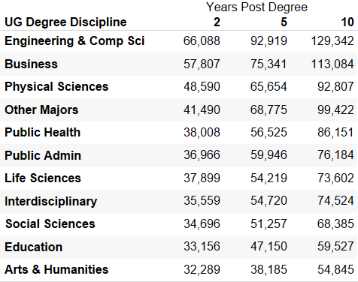
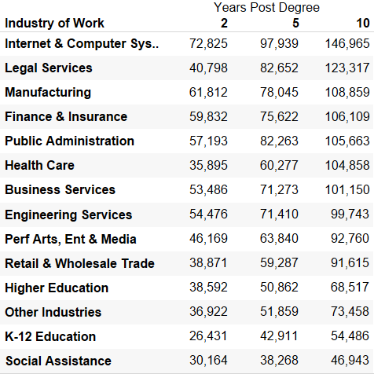
Average Earnings by UG Major and Industry: Both undergraduate major and industry of work affect alumni earnings
Average earnings by UG Discipline
Average earnings by Industry of work
UC Female Alumni are less likely to major in Computer Science and more likely to major in Social Sciences and Arts & Humanities
Includes undergraduate degree earners from the graduating classes of 1999 to 2014
Notes:
The chart on the left hand side shows earnings at 2, 5 and 10 years after graduation by major of undergraduates there are clear differences in outcomes. We've grouped majors into disciplines. Engineering comp science are clearly out earning social science and arts and humanities.
The chart on the right shows average earnings by industry for UC alumni, similarly there are clear differences in earnings depending on which industry you are working in… So we want to know are females more likely to graduate in different majors or work in certain industries.

Slide 11
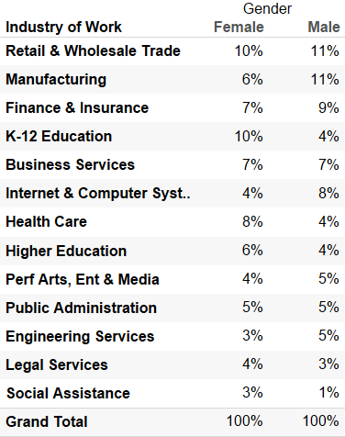
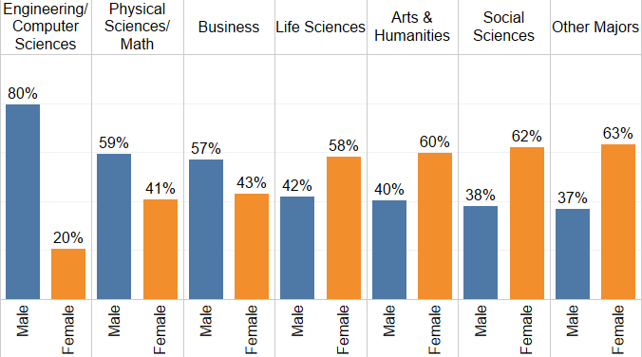
Major and Industry of Work by Gender: Female UC alumni are less likely to major in Computer Science and more likely to major in Social Sciences and Arts & Humanities than male alumni
Percentage of UC Alumni in Industry of Work by Gender
Percentage of Degree Earners by Gender
Female UC alumni are also less likely to work in Internet and Computer Systems and more likely to work in K-12 Education than male alumni
Includes undergraduate degree earners from the graduating classes of 1999 to 2014. Industry of work is as of five years after graduation.
Notes:
Yes there are some differences in gender, females are less likely to major in computer science or engineering, and more likely to major in social sciences.
While for most industries there are similar percentages of male and female UC alumni, males are twice as likely to work in Tech and females are more than twice as likely to work in K-12 education.

Slide 12
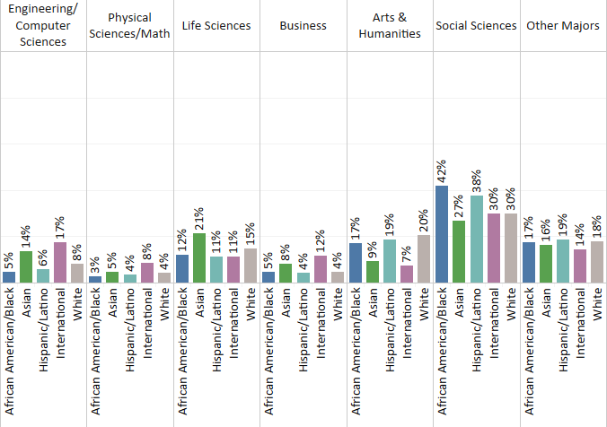
Majors by Race: Social Sciences are a popular major for all UC degree earners, Latinx and African American UC Alumni are less likely to have majored in Engineering & Computer Science
Includes undergraduate degree earners from the graduating classes of 1999 to 2014
Notes:
If we look at degrees earned by race we see less Latinx and African Americans are majoring in Computer science.

Slide 13
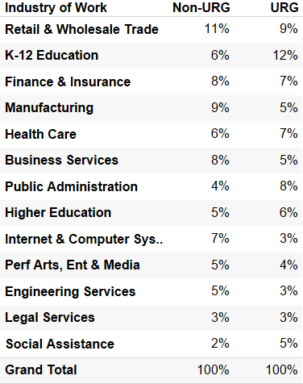
Industry by Race: UC URG alumni are less likely to work in Internet & Computer systems and Business and more likely to work in K-12 education than Non-URG alumni
Percentage of UC Alumni in Industry of Work by URG Status
URG = Underrepresented Groups; Includes African American, Latinx and Native American
Non-URG=White, Asian-American and International
Includes undergraduate degree earners from the graduating classes of 1999 to 2014. Industry of work is as of five years after graduation. Excludes Domestic Unknowns
Notes:
URG are also less likely to work in Tech and more likely to work in K-12.
Okay so maybe by this point none of this is a surprise to you, What I really want to know is for those African Americans who are working in Tech or those females who are majoring in computer science is there a wage gap?

Slide 14
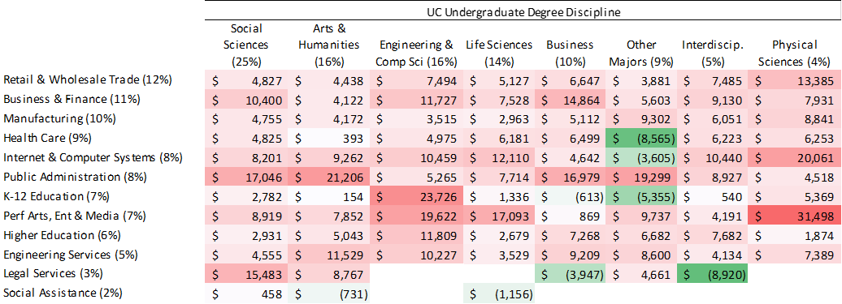
Differences in Earnings by Gender: At ten years after graduation, UC female alumni tend to earn less than male alumni in most industries, regardless of undergraduate major
Differences between median earnings of male and female UC alumni
Analysis Results
Industry of Employment
(%) Indicates percentages of female alumni working in industry or graduating with major.
Post-graduate earnings at 10 years after graduation, graduating classes of 1999 to 2006.
Bachelor’s degree recipients only.
Notes:
Here’s where we start to answer this. This chart shows the difference between median earnings of UC male and female alumni at 10 years after graduation who graduated with similar major and are working with in the same industry. The red cells show where males are earning more than females, the green shows where females are earning more than males, so sometimes that happens.

Slide 15
Differences in Earnings by URG Status: At ten years after graduation, UC URG tend to earn less than Non-URG, alumni in most industries, regardless of undergraduate major
Differences between median earnings of URG and Non-URG UC alumni
Industry of Employment
(%) Indicates percentages of URG alumni working in industry or graduating with major.
Post-graduate earnings at 10 years after graduation, graduating classes of 1999 to 2006. Bachelor’s degree recipients only.
Notes:
We similar evidence across industries and majors when we look at the difference in median salaries by URG status, but before we get into a more detailed look at this data using more advance statistical techniques. I am going to turn it over to Joey who will be discussing other factors to consider like GPA when thinking about earning and gender or race pay gaps.

Slide 16
Research Questions #2 & 3
Does academic achievement (GPA) influence alumni choices of industry?
Do gender and academic achievement (GPA) influence early career earnings?
Notes:
These two questions go together because we want to look at how UC graduates enter the workforce [the estuary, if you will, of students leaving UC and entering the California labor market.] Specifically, here we are looking at how student’s academic performance at UC affects their choice of industry to enter and, what we are thinking of as their “starting salary.”
This is particularly important because we know that early career salaries have persistent consequences for later career salaries as well.
Exclusions:
Only include full-time workers
Unemployed
Exclude enrolled students

Slide 17
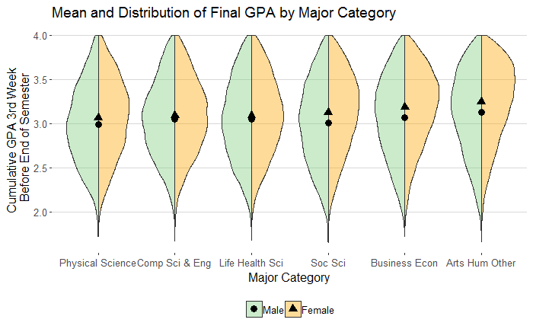
Mean GPA by Gender and Major Category
with GPA distribution
Small but statistically significant differences in average GPA by major category.
Women have higher GPAs across all major categories.
 | Df | Sum Sq | Mean Sq | F val | Pr(>F)
Major Category | 5 | 485 | 97.01 | 477.9 | .000
Resids | 201527 | 40913 | .20

Slide 18
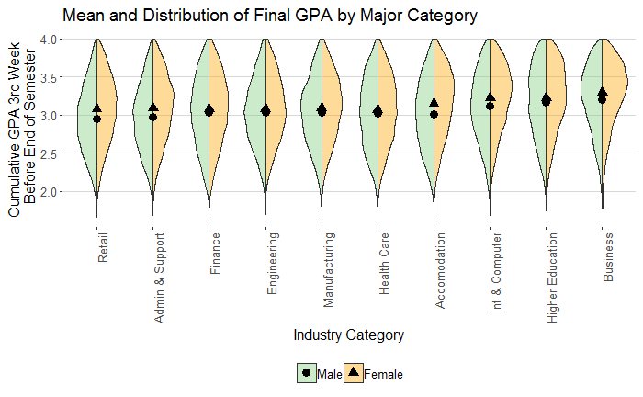
Mean GPA by Gender and Industry
with GPA distribution
Women have higher GPAs across all industries.
 | Df | Sum Sq | Mean Sq | F val | Pr(>F)
Major Category | 28 | 1254 | 44.48 | 223.2 | .000
Resids | 201504 | 40153 | 0.20
Notes:
Statistically significant differences across industries (not all industries are listed here.)
Small differences on average, but there is heterogeneity within industries and it is a relatively small scale we are working on.

Slide 19
The Model:
Multinomial Logit
$$\ln\left(\frac{Pr(industry=industry_{j})}{Pr(industry=retail)}\right)= β_{j0}+β_{j1}\left(gender_{i}=Female\right)+β_{j2}\left(GPA_{i}\right)+β_{j3}\left(gender_{i}=Female∗GPA_{i}\right)+β_{ji}X+ε_{ji}$$
Gender dummy variable
Effect of GPA on entering industry
Female specific effect of GPA on entering industry
Fixed Effects:
Campus
Earnings Year
Relative probability of entering industry j to Retail & Wholesale
(reference industry)
Six models, one for each major category:
Life Health Science | Physical Sciences | Computer Science & Engineering | Business & Economics | Social Sciences | Arts, Humanities, Other
Pharmacy, Nursing, Public Health, Other Life Sciences, Biology, Agriculture | Physics, Other Physical Sciences, Chemistry, Architecture | Mathematics, Computer Science, Engineering | Business, Economics | Public Administration, Geography, Legal Studies, Anthropology, History, Communications, Sociology, Political Science, Psychology, Other Social Science | Education, Other Humanities, Philosophy, Foreign Language, English/Literature, Arts, Other
Notes:
In order to identity correlations between academic achievement, we used a multinomial logistic regression model.
This is set up with the probability of entering a given industry divided by the probability of entering a reference industry, in this case we chose retail. Retail is both the largest industry and the industry with the lowest average wages. We include a gender dummy variable, GPA and a Gender-by-GPA variable. This will show differences in the probability of entering a given industry with increasing GPA, and whether that relationship is different for men and women graduates.

Slide 20
Relationship between GPA and entering a given industry (relative to Retail)
 | Accommodation | Admin & Support | Business | Engineering | Finance | Health Care | Higher Ed | Internet & Computer | Manufacturing
Arts Hum Other | 1.428*** | 1.028 | 1.36** | 1.196 | 0.615*** | 0.821 | 1.734*** | 1.247* | 1.134
 | (0.408) | (0.296) | (0.419) | (0.5) | (0.19) | (0.288) | (0.547) | (0.377) | (0.365)
Business Econ | 0.952 | 1.077 | 5.995*** | 1.285 | 2.029*** | 1.476** | 1.459** | 2.056*** | 1.369***
 | (0.3) | (0.296) | (1.545) | (0.542) | (0.501) | (0.573) | (0.543) | (0.594) | (0.405)
Comp Sci & Eng | 0.785 | 0.96 | 2.168*** | 1.59*** | 1.971*** | 1.101 | 2.037*** | 2.044*** | 1.968***
 | (0.303) | (0.27) | (0.629) | (0.424) | (0.605) | (0.453) | (0.653) | (0.525) | (0.494)
Life Health Sci | 1.093 | 1.095 | 2.12*** | 1.619*** | 1.062 | 1.91*** | 4.17*** | 1.217 | 1.02
 | (0.369) | (0.324) | (0.702) | (0.481) | (0.382) | (0.563) | (1.224) | (0.442) | (0.306)
Physical Science | 1.181 | 0.767 | 0.898 | 1.183 | 0.765 | 0.906 | 2.397*** | 1.253 | 0.728
 | (0.598) | (0.331) | (0.424) | (0.489) | (0.459) | (0.479) | (1.091) | (0.624) | (0.307)
Soc Sci | 1.443*** | 1.214** | 2.154*** | 1.774*** | 1.101 | 1.276*** | 2.095*** | 1.674*** | 1.249**
 | (0.368) | (0.301) | (0.569) | (0.637) | (0.276) | (0.346) | (0.57) | (0.456) | (0.362)
Notes:
I’m now breaking the first rule of PowerPoint: don’t have a whole heap of numbers up on screen, but I think this will be worth it, so here we go.
First: How to interpret these numbers: This shows that for Business Econ majors, every 1 point increase in their graduating GPA leads to a 5% decrease in the probability that they will enter the Accommodation and Recreation field, relative to Retail and Wholesale. But in this case, that relationship is not significant.
Different Majors (different models):
Students coming out of business/econ need higher GPA for many industries (not business services)
In almost no case does Physical Science matter
Social Sciences GPAs matter a lot
Different Industries
Business Services really care about GPAs
Higher Ed gets lots of high GPA students, even though it’s not the highest paying industry. Interesting because they aren’t enrolled. We removed all of the enrolled students; so they are actually doing emplyment at these universities.

Slide 21
Relationship between GPA/gender and entering a given industry (relative to Retail)
Female gpa | Accommodation | Admin & Support | Business | Engineering | Finance | Health Care | Higher Ed | Internet & Computer | Manufacturing
Arts Hum Other | 0.998 | 0.971 | 1.107 | 0.878 | 1.074 | 0.77 | 0.821 | 1.115 | 0.89
 | (0.32) | (0.317) | (0.383) | (0.421) | (0.372) | (0.293) | (0.289) | (0.393) | (0.325)
Business Econ | 1.073 | 1.027 | 0.983 | 0.579* | 0.605*** | 0.705 | 0.959 | 0.894 | 1.198
 | (0.424) | (0.353) | (0.312) | (0.292) | (0.187) | (0.324) | (0.419) | (0.329) | (0.442)
Comp Sci & Eng | 0.806 | 1.121 | 1.44* | 0.94 | 0.978 | 0.991 | 0.975 | 1.054 | 0.828
 | (0.449) | (0.47) | (0.601) | (0.366) | (0.421) | (0.543) | (0.452) | (0.417) | (0.311)
Life Health Sci | 1.213 | 1.07 | 1.029 | 0.858 | 0.954 | 0.813 | 0.805 | 0.86 | 1.088
 | (0.473) | (0.371) | (0.395) | (0.296) | (0.399) | (0.275) | (0.273) | (0.375) | (0.384)
Physical Science | 0.959 | 1.412 | 1.186 | 1.22 | 0.93 | 0.748 | 1.052 | 1.336 | 1.321
 | (0.596) | (0.743) | (0.682) | (0.618) | (0.659) | (0.455) | (0.588) | (0.866) | (0.687)
Soc Sci | 0.934 | 0.877 | 0.893 | 0.701* | 0.721*** | 0.839* | 0.946 | 1.082 | 1.013
 | (0.267) | (0.245) | (0.264) | (0.282) | (0.205) | (0.248) | (0.283) | (0.337) | (0.333)
Notes:
Notes:
The relationship between gender and GPA and what industry you go into is very limited and highly specific.
One interesting storyline: Higher achieving women who major in Computer Science/Engineering are more likely to go into Business, but not other areas (e.g. Engineering) than their male peers. High achieving Business Econ majors are less likely to go into their Engineering or Finance than their male peers (high paying industries that otherwise attract high achieving men). My conclusion: Business Services are better for women.

Slide 22
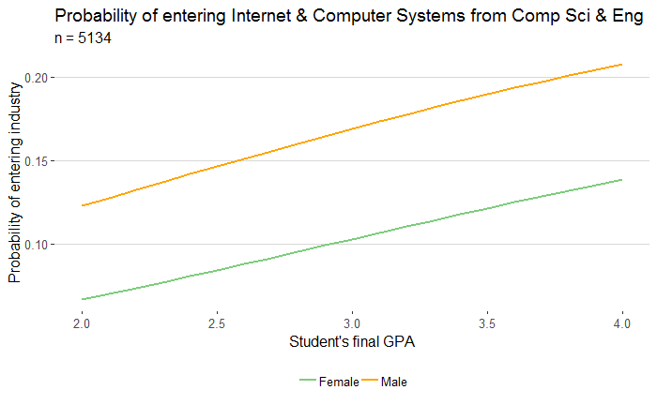
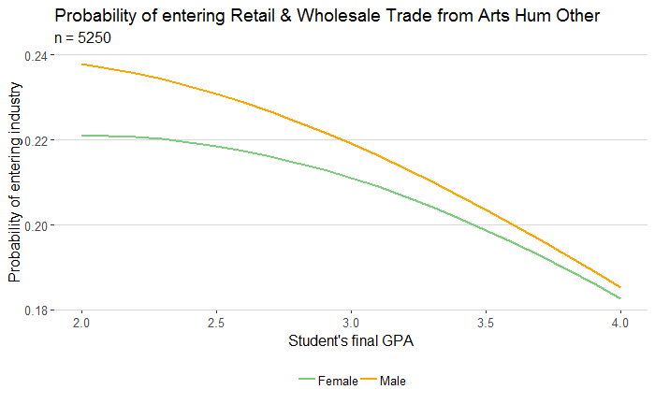
GPA Matters
GPA Matters by Gender | X
Notes:
Visualizations of the storyline described in last slide

Slide 23
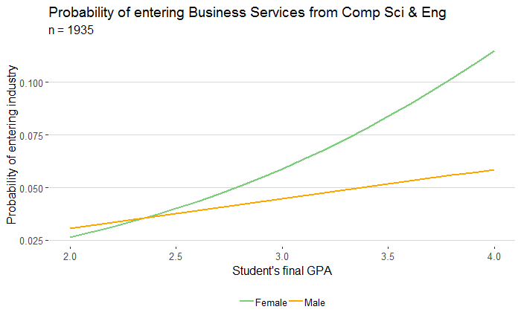
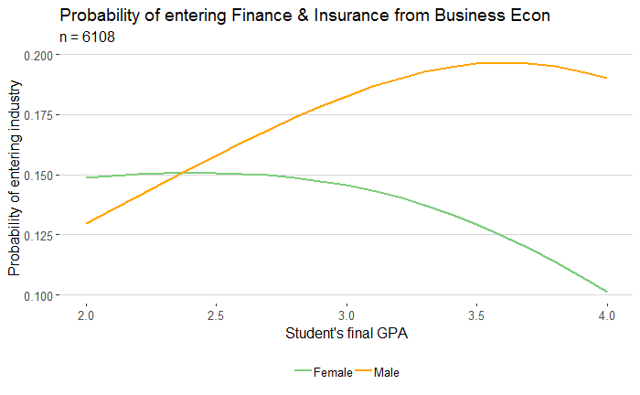
GPA Matters
GPA Matters by Gender
Notes:
Visualizations of the storyline described in last slide

Slide 24
The Research Question 2
Takeaways:
Small, but statistically significant differences in GPA across majors and industries (Women higher achieving in all cases)
GPA has large correlation with Industry for Business Econ and Social Science majors. Low/no correlation for Physical Science.
Higher GPA has large correlation with entering Business Services and Higher Education.
High GPA female Business Econ majors are less likely to ender Finance or Engineering industries than their high GPA male peers.

Slide 25
Research Question #2
Do gender and academic achievement (GPA) affect early career earnings?

Slide 26
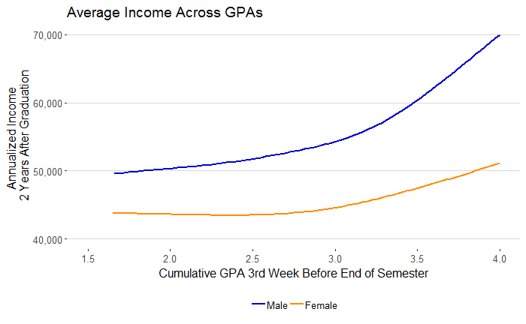
Mean Income by GPA
Two Years after Graduation by Gender

Slide 27
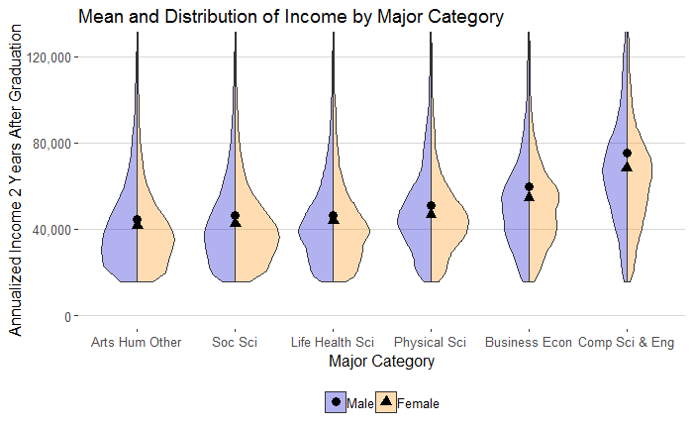
Mean income by Gender and Major Category
with income distribution – 2 years after grad

Slide 28
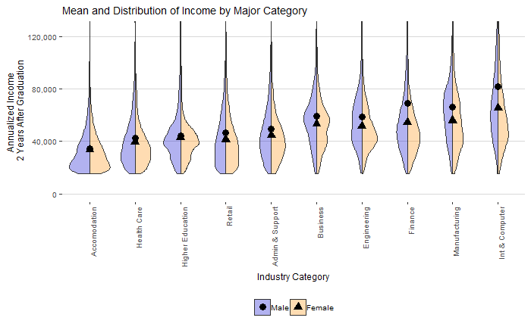
Mean income by Gender and Industry
with income distribution – 2 years after grad

Slide 29
Differences in Income between
Major Category and Industry
ANOVA – ln(inc) ~ major category
 | Deg of Freedom | F stat | P-val
Major Category | 5 | 6653 | .000
Residual | 201527
Intraclass Correlation = .142
ANOVA – ln(inc) ~ Industry
 | Deg of Freedom | F stat | P-val
Industry | 28 | 1435 | .000
Residual | 201504
Intraclass Correlation = .166

Slide 30
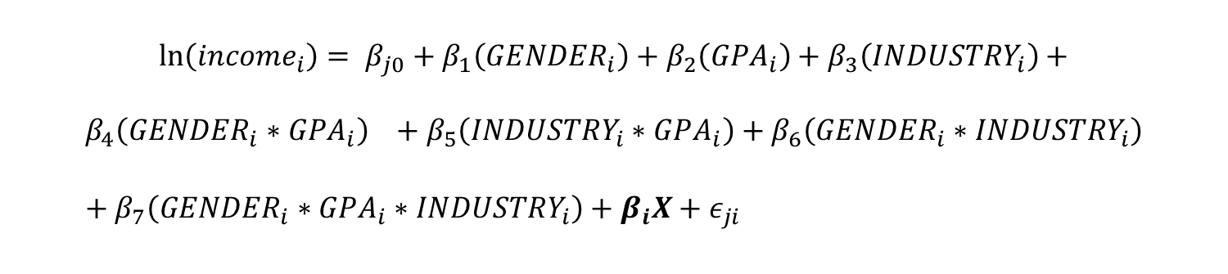
Model:
Multivariable Linear Regression
Gender, GPA, and industry
$$\ln\left(income_{i}\right)= β_{j0}+β_{1}\left(GENDER_{i}\right)+β_{2}\left(GPA_{i}\right)+β_{3}\left(INDUSTRY_{i}\right)+$$
$$β_{4}\left(GENDER_{i}∗GPA_{i}\right) +β_{5}\left(INDUSTRY_{i}∗GPA_{i}\right)+β_{6}\left(GENDER_{i}∗INDUSTRY_{i}\right)+β_{7}\left(GENDER_{i}∗GPA_{i}∗INDUSTRY_{i}\right)+β_{i}X+ε_{ji}$$
GPA Analysis Results
Interactions
Campus, earnings year
Clustered SEs
Life Health Science | Physical Sciences | Computer Science & Engineering | Business & Economics | Social Sciences | Arts, Humanities, Other
Pharmacy, Nursing, Public Health, Other Life Sciences, Biology, Agriculture | Physics, Other Physical Sciences, Chemistry, Architecture | Mathematics, Computer Science, Engineering | Business, Economics | Public Administration, Geography, Legal Studies, Anthropology, History, Communications, Sociology, Political Science, Psychology, Other Social Science | Education, Other Humanities, Philosophy, Foreign Language, English/Literature, Arts, Other

Slide 31
The Takeaways:
Business Services, Internet Services, and Finance & Insurance had mostly significant GPA and GPA-by-gender coefficients
Most other industry-by-gender-by-major slopes had insignificant coefficients
Major Category | Overall |  | Business Services |  | Finance & Insurance |  | Internet Systems
 | GPA | GPA-Gender | GPA | GPA-Gender | GPA | GPA-Gender | GPA | GPA-Gender
Business Econ | -0.077# | 0.092 | 0.257*** | 0.199 | 0.477*** | -0.148* | 0.196*** | -0.051
 | (0.04) | (0.06) | (0.043) | (0.192) | (0.045) | (0.069) | (0.049) | (0.076)
Physical Sci | -0.076 | 0.136 | 0.084 | 0.329 | 0.361* | -0.462# | 0.304* | -0.003
 | (0.092) | (0.139) | (0.114) | (0.504) | (0.182) | (0.252) | (0.14) | (0.212)
Life Health Sci | -0.074# | 0.075 | 0.113* | 0.004 | 0.363*** | -0.268** | 0.171* | -0.09
 | (0.039) | (0.052) | (0.055) | (0.222) | (0.073) | (0.09) | (0.068) | (0.102)
Social Sci | -0.043# | -0.015 | 0.152*** | -0.09 | 0.18*** | -0.08* | 0.067# | 0.09#
 | (-0.043) | (0.028) | (0.034) | (0.132) | (0.033) | (0.04) | (0.037) | (0.048)
Comp Sci & Eng | 0.09 | 0.009 | -0.001 | -0.381 | 0.181* | -0.053 | 0.186** | 0.043
 | (0.066) | (0.137) | (0.069) | (0.421) | (0.076) | (0.15) | (0.068) | (0.144)
Arts Hum Other | -0.01 | 0.002 | 0.081# | 0.026 | 0.146** | -0.073 | 0.094* | 0.012
 | (0.026) | (0.034) | (0.042) | (0.173) | (0.048) | (0.059) | (0.045) | (0.059)

Slide 32
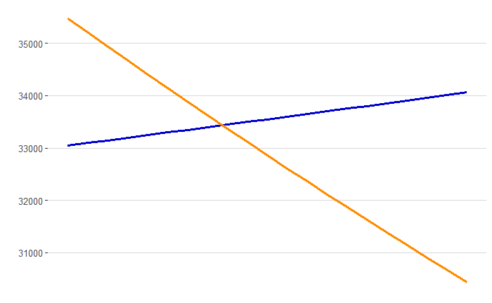
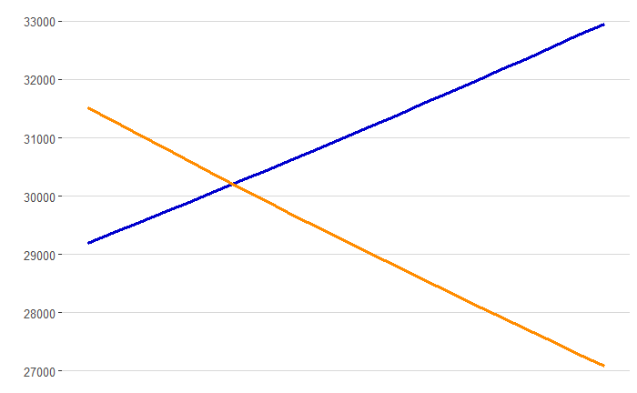
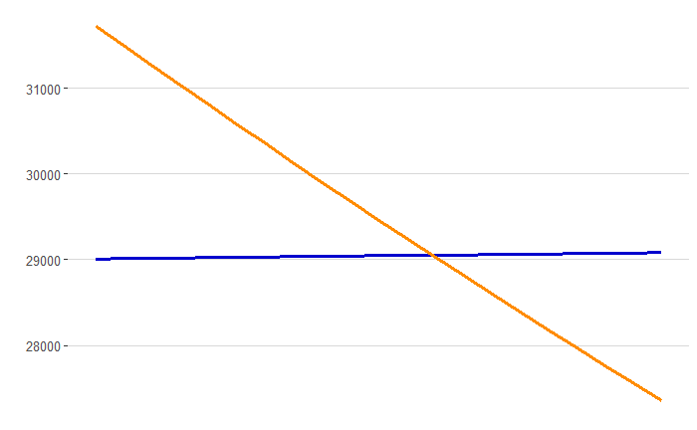
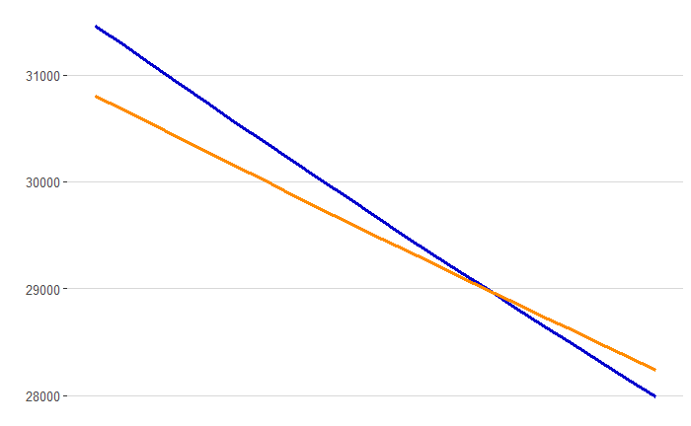
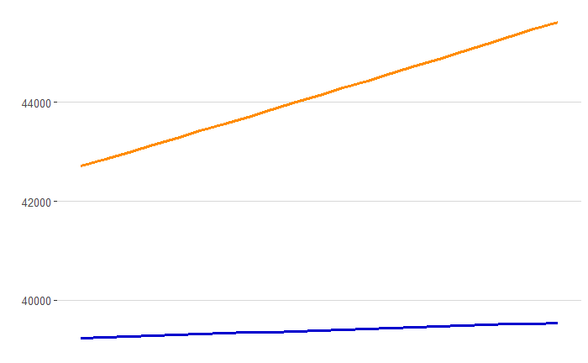
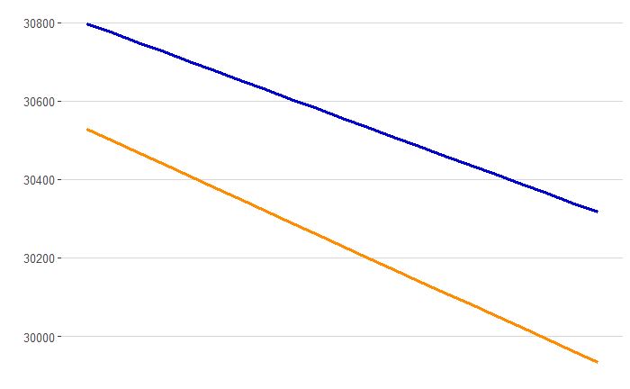
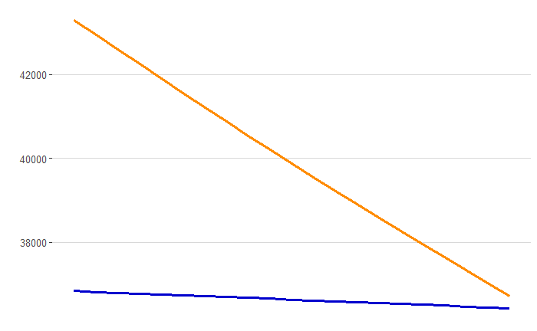
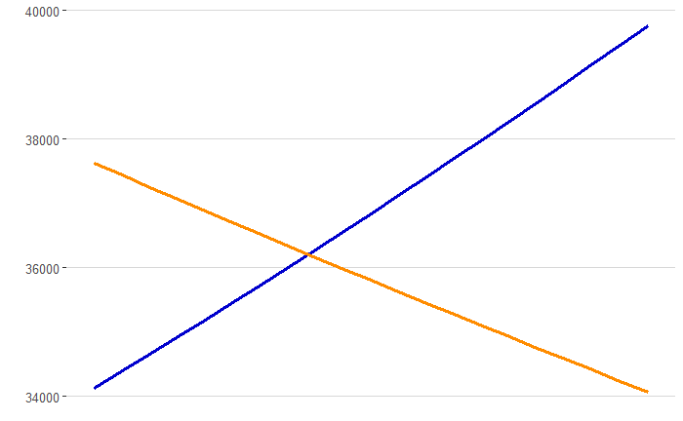
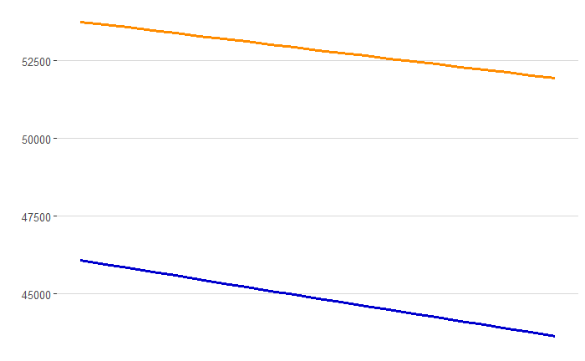
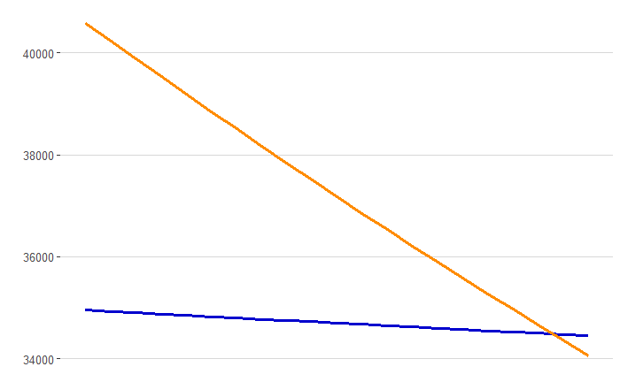
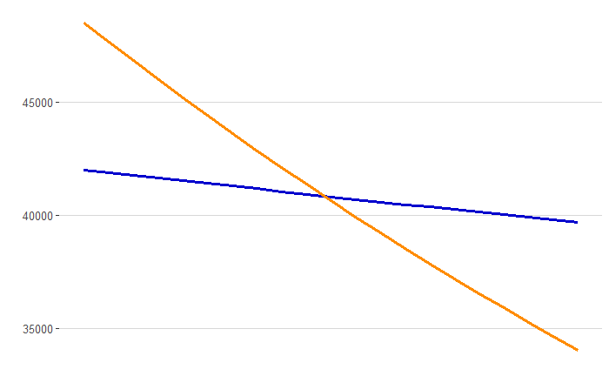
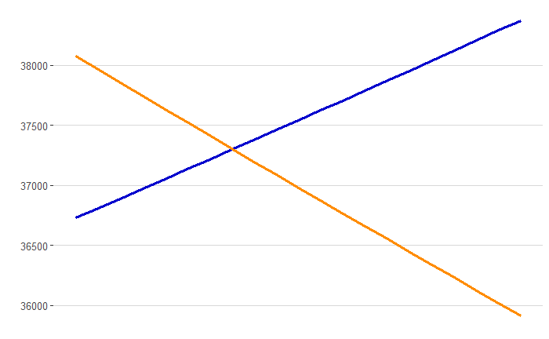
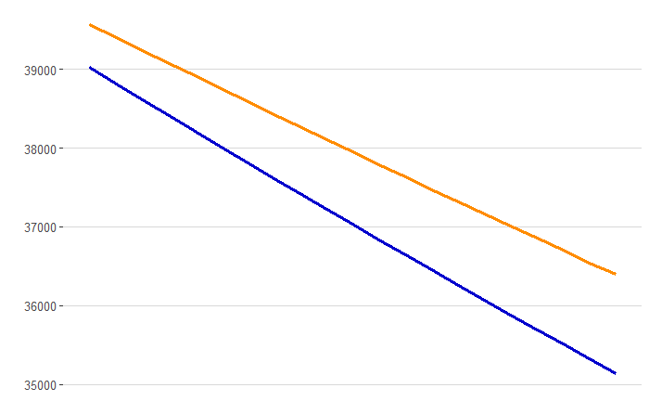
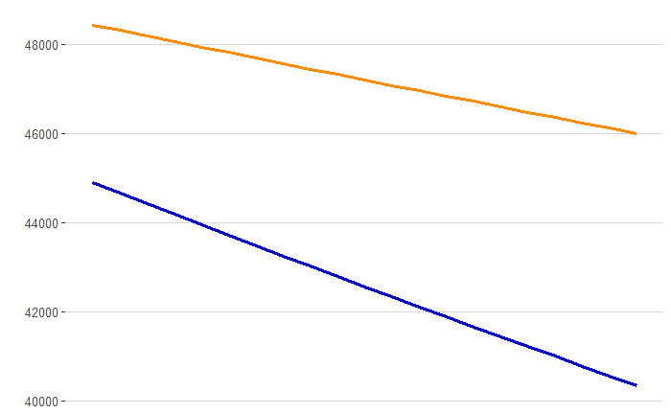
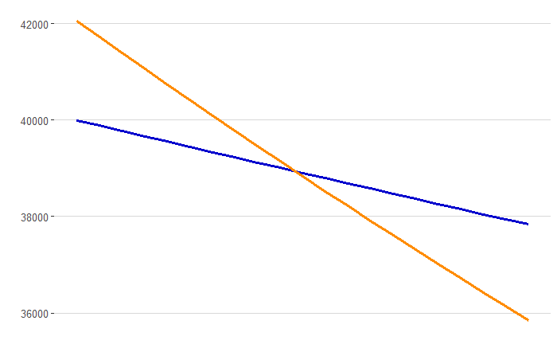
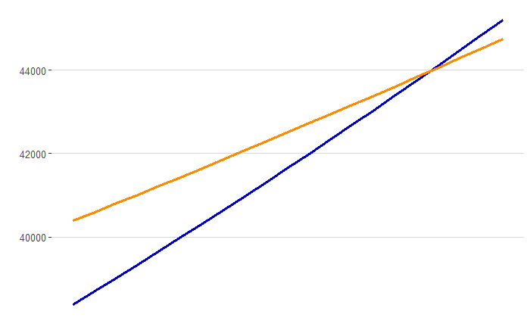
Different Relationships in Different Industry
Income →
GPA →

Slide 33
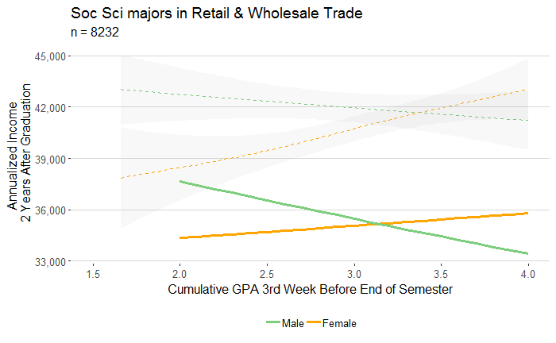
Different Industry-Majors have very different relationships
Industry and major category
Lowess regression for all alumnae in all years
GPA Analysis Results
Modeled estimates for one campus’ alumnae
in 2014
Notes:
How to read this graph.
The dashed lines are smoothed mean incomes for all of the alumni in the data.
The solid lines are the modeled estimates for alumni from one campus in 2014 (a representative sample)
We want to look if the shapes are the same, not whether they overlap.

Slide 34
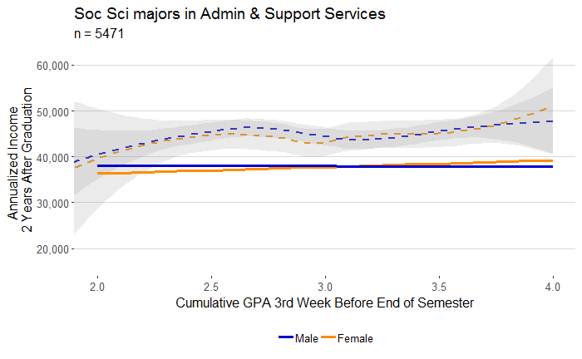
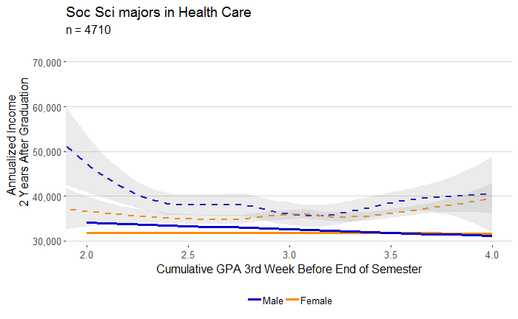
GPA Matters | X
GPA Matters by Gender | X
Notes:
There is no one relationship that reflects

Slide 35
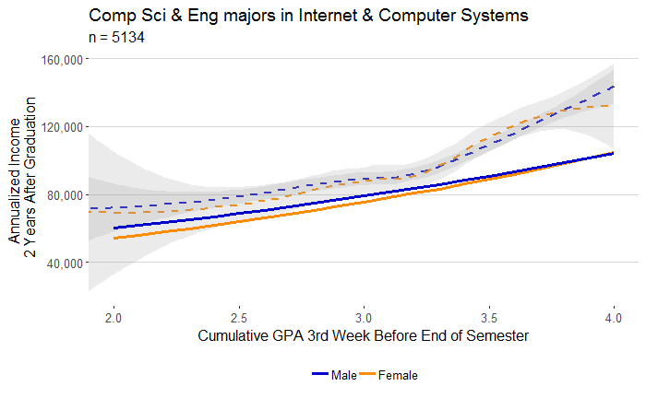
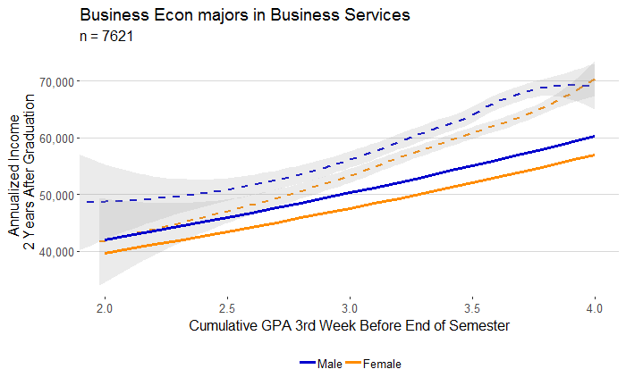
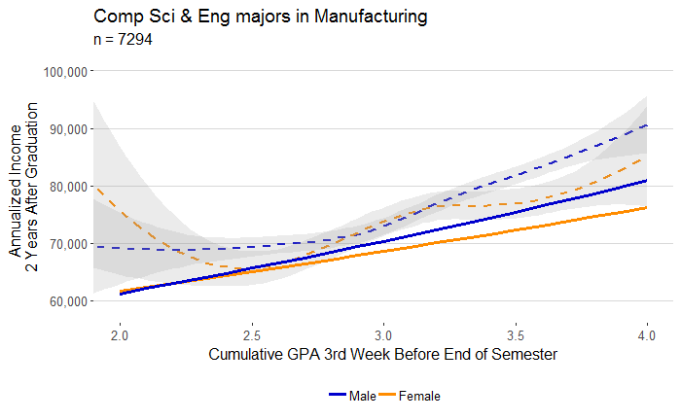
GPA Matters
GPA Matters by Gender | X

Slide 36
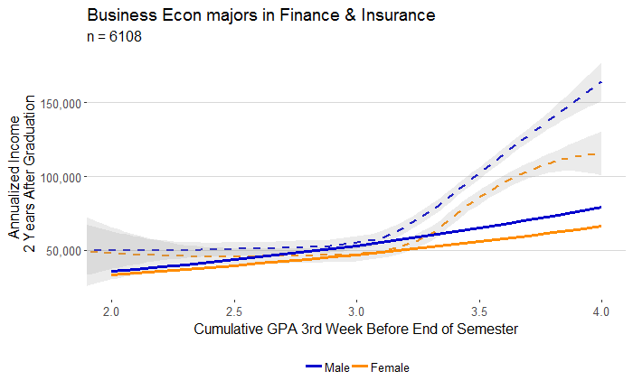
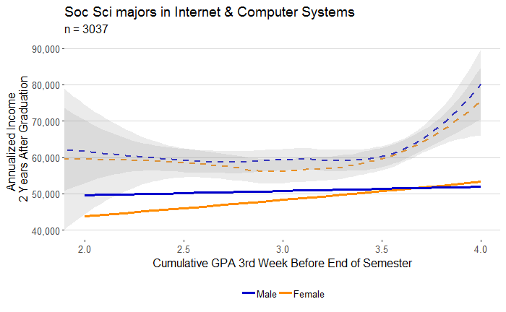
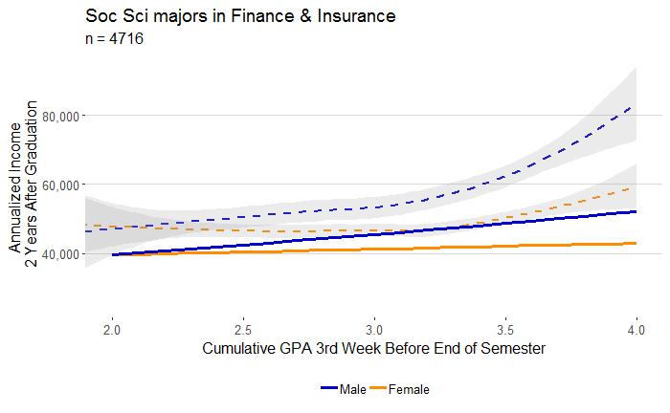
GPA Matters
GPA Matters by Gender | ?

Slide 37
The Research Question 2
Takeaways:
Large and statistically significant differences in income across majors and industries
Business Services, Finance & Insurance and Internet & Computer Systems have the largest returns to GPA in terms of income.
Non-linear relationships that occur around 3.0 GPA may play a key roll in income in some industries.

Slide 38
Research Question #3
Can the race-gender gap be explained by graduate degree completions? Are there differences in the effects of race and gender by industry?

Slide 39

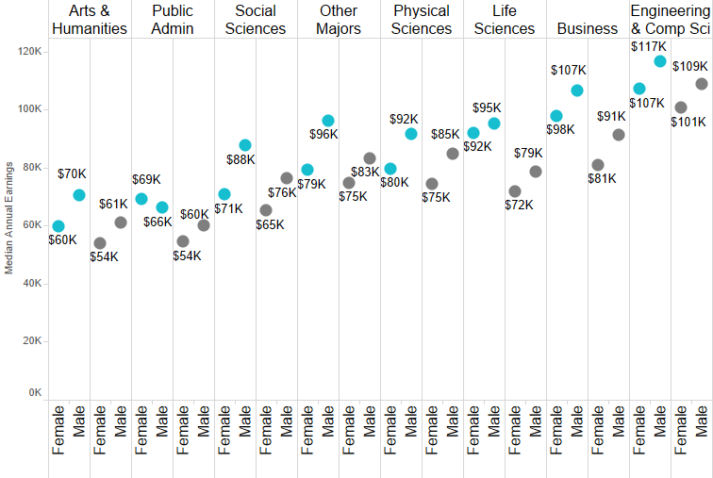
Earnings by Gender and Graduate Degree Completion: At ten years after graduation, female UC alumni with graduate degrees earn as much as male UC alumni that complete a bachelors degrees only
Undergraduate Degree Discipline
Post-graduate earnings at 10 years after graduation, graduating classes of 1999 to 2006
Notes:
First lets look descriptively at graduate degree completions an the impact on earnings, this chart shows the median salaries by major for males and female UC alumni based on whether or not they completed a graduate degree. What can you see here? Engineering computer science majors tend to earn the highest salaries followed by business, arts and humanities the lowest. But whats another interesting phenomenon here? For most alumni regardless of undergraduate major, female alumni must complete a graduate degree to achieve parity of earnings with male alumni. For life sciences student this isn’the case.
But we don’t know what type of graduate degree, are women more likely to earn masters in teaching or men more likely to earn an MBA.
Yes there is some disparity there…

Slide 40

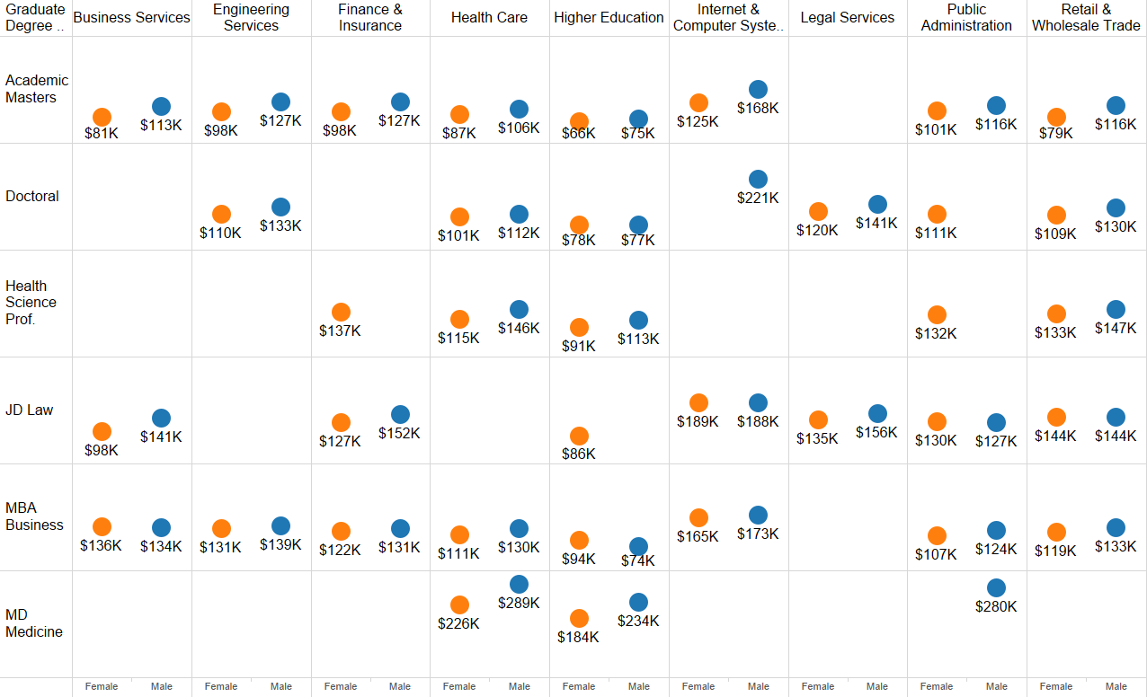
Earnings by Graduate Degree Type, Gender and Industry: Difference in earnings persist between male and female UC alumni
Industry of Employment
Graduate Degree Type
Post-graduate earnings at 15 years after graduation, graduating classes of 1999 to 2006
Notes:
If we look at the median salaries of male and female alumni with the same graduate degree type and industry of work we still see evidence of gaps.
For some industries these gaps do not exist, for others they are larger than we would hope.
Okay enough with the descriptive we want to know at what magnitude do these effects are across industries and if there are any industries in particular that have larger effects for Race and Gender relative to earnings.

Slide 41

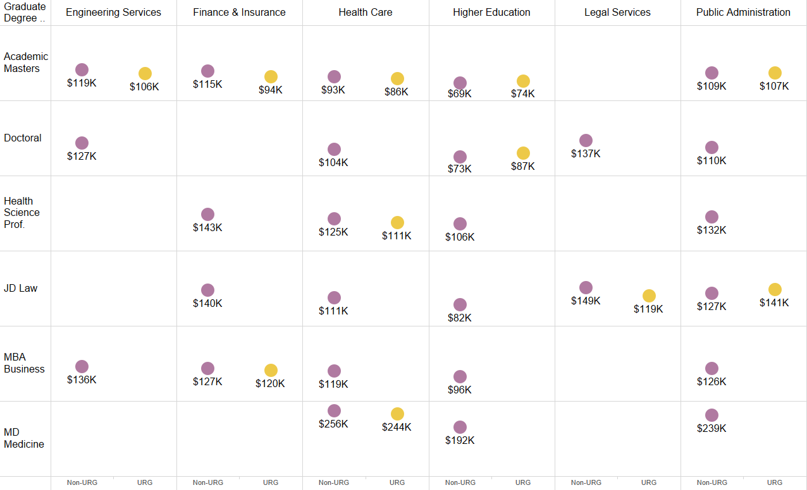
Earnings by Graduate Degree Type, URG and Industry: Difference in earnings persist between URG and Non-URG UC alumni
Industry of Employment
Graduate Degree Type
Post-graduate earnings at 15 years after graduation, graduating classes of 1999 to 2006
Notes:
IF we look at the median salaries of URG and non-URG alumni with the same graduate degree type and industry of work we still see evidence of gaps.
For some industries these gaps do not exist, for others they are larger than we would hope.
Okay enough with the descriptive we want to know at what magnitude do these effects are across industries and if there are any industries in particular that have larger effects for Race and Gender relative to earnings.

Slide 42

Hierarchical Linear Modeling (HLM)
Internet & Computer Systems($146K)
Health Care ($104K)
Finance & Insurance ($104K)
K-12 Education ($54K)
UC Graduates
Higher Education ($68K)
Level 2: Effects of Gender and URG, adjusted for Industry
Male, non-URG. Computer science, no graduate degree
Female, non-URG. Engineering, no graduate degree
Female, non-URG. Life sciences, has graduate degree
Male, non-URG. Computer science, has graduate degree
Female, non-URG. Arts & Hum, no graduate degree
Female, non-URG, Computer science, no graduate degree
Male, URG, Biology, has graduate degree
Male, URG, Business, no graduate degree
Female, non- URG, Social sciences, has graduate degree
Male, URG, Physical Sciences, has graduate degree
Female, URG, Social Sciences, no graduate degree
Female, non-URG, Computer science, no graduate degree
Female, URG, Social Science, has graduate degree
Female, non-URG, Social Sciences, no graduate degree
Female, URG, Social Science, has graduate degree
Level 1:
Effects of Gender, URG status, Major, Graduate Degree Completion and Campus
Notes:
Were going to do that using a technique called HLM (hierarchical linear modeling) because we want to look at a couple of things. We already know that earnings differ by industry and that females and URG are more likely to work in certain industries than others. We also know within industries there are differences in alumni characteristics such as their race and gender, major, what campus they attended and whether or not they got a graduate degree. We want to know if each of these characteristics has an effect and we also want to know if there is a differential effect of gender and race by industry.
We use HLM to answer all of these questions by separating out variables into level 1 variables here where we estimates the effects of gender, urg status, campus etc.
And also keeping variance in earnings by industry at level 2, as estimating the effects of race and gender adjusted for the industry.
Multi-level modeling multilevel-,mixed level-, mixed linear-, mixed effects-, random effects-, random coefficient (regression)-, and (complex) covariance components-modeling (Raudenbush & Bryk, 2002).
“Hierarchical Linear Modeling (HLM) is a complex form of ordinary least squares (OLS) regression that is used to analyze variance in an outcome variables when the predictor variables are at varying hierarchical levels… HLM accounts for the shared variance in hierarchically structured data and allows for estimating lower level slopes”
HLM accounts for the shared variance in hierarchically structured data: The technique accurately estimates lower level slopes (e.g., student level) and their implementation in estimating higher-level outcomes (e.g., classroom level;

Slide 43
Model 1: Gender effects
Hierarchical Linear Model (HLM)
Overall mean intercept adjusted for gender
Overall mean intercept adjusted for gender
Level 2:
Β_{0j} = γ₀₀ ₊ γ₀₁(Gender)_{j} + U_{0j} β _{1j} = γ₁₀ + γ₁₁ (Gender) _{j} + U_{1j}
Intercept for the jth industry
Coefficient associated with being female relative to industry j intercept
Slope for the jth industry
Coefficient associated with being female relative to industry j slope
Earnings for alumni i in industry j who is male, social science major from Campus H without a graduate degree
Random error associated with alumni i in industry j
Level 1:
ln(earnings)_{ij}= β_{0j} + β _{1j}(Gender)_{ij} + β _{2j}(Major)_{ij} + β _{3j}(Campus)_{ij}+ β_{4j}(Has GraduateDegree)_{ij +} ε_{ij}
Log of earnings for alumni i in industry j
Coefficient associated with being female for industry j
Fixed effects of major campus and graduate degree
Analysis Results
Notes:
Here’s a look at the underlying models for how we are doing that…. At level one we are predicting earnings based on alumni characteristics, then at level two we are going to predict intercepts and slopes adjusted by gender and industry.
U 0j = Random effects on the jth level of industry adjusted for gender on the intercept
U 1j = Random effects on the jth level of industry adjusted for gender on the \slope

Slide 44
Model 2: Gender and URG effects
Hierarchical Linear Model (HLM)
Level 2:
Β_{0j} = γ₀₀ ₊ γ₀₁(Gender)_{j} + γ₀₂(URG)_{j} + U_{0j}
β _{1j} = γ₁₀ + γ₁₁ (Gender) _{j} + U_{1j}
β _{2j} = γ₂₀ + γ₁₂(URG)_{j} + U_{2j}
Level 1:
ln(earnings)_{ij}= β_{0j} + β _{1j}(Gender)_{ij} + β _{2j}(URG)_{ij} + β _{3j}(Campus)_{ij}+ β_{4j}(Has GraduateDegree)_{ij +} β_{4j}(Has GraduateDegree)_{ij} + β _{5j}(Major)_{ij} + ε_{ij}
Notes:
Model 2 we do the same thing but also include an effect for URG status at level 2
U 0j = Random effects on the jth level of industry adjusted for gender on the intercept
U 1j = Random effects on the jth level of industry adjusted for gender on the \slope

Slide 45
Results: Earnings at 10 years and 15 years after graduation
Hierarchical Linear Model (HLM)
Bold indicates estimates are significant at α=.05
 | Ten Years After Graduation |  |  |  | Fifteen Years After Graduation
 | Model 1 |  | Model 2 |  | Model 1 |  | Model 2
 | Estimate | Interpretation | Estimate | Interpretation | Estimate | Interpretation | Estimate | Interpretation
Intercept | 11.089 | $ 65,447 | 11.10 | $ 66,416 | 11.29 | $ 80,234 | 11.30 | $ 81,064
FEMALE | -0.09 | -8% | -0.08 | -8% | -0.14 | -13% | -0.14 | -13%
URG |  |  | -0.06 | -6% |  |  | -0.05 | -5%
Arts Hum Other | -0.05 | -5% | -0.05 | -5% | -0.10 | -6% | -0.06 | -6%
Business Econ | 0.17 | 18% | 0.16 | 17% | 0.23 | 18% | 0.17 | 18%
Comp Sci & Eng | 0.24 | 28% | 0.23 | 26% | 0.31 | 22% | 0.21 | 23%
Life Health Sci | 0.12 | 13% | 0.12 | 12% | 0.17 | 17% | 0.16 | 17%
Physical Scienc | 0.06 | 6% | 0.06 | 6% | 0.09 | 5% | 0.05 | 5%
Soc Sci | 0.00 | 0% | 0.00 | 0% | 0.00 | 0% | 0.00 | 0%
HAS_GRAD_DEGREE | 0.12 | 13% | 0.12 | 13% | 0.15 | 14% | 0.15 | 16%
 | ICC =.20 |  |  |  | ICC = .13
Pseudo-R2 | 25% |  | 26% |  |  | 21% |  | 22%
Analysis Results
Campus used as a control in the model
Model 1 Intercept is for a male, social science major from Campus H without a graduate degree
Model 2 Intercept is for a male, non-URG, social science major from Campus H without a graduate degree
Notes:
What did we find out? We found out at both 10 and 15 years controlling for major and campus that there is an effect of being female that is negatively associated with earnings, and an effect of being URG that is also negatively associated with earnings, good news is gradute degree is positively associated. Not inclusion of URG doesn’t really effect estimates of female in either 10 or 15 years showing independence of these effects and some confounding of these effects for URG females.
But these charts only show us an effect of female and Urg status, we want to know if this differs by industry.

Slide 46
In high paying industries female and URG alumni earn significantly less than male or non-URG alumni, in lower paying industries they earn more
Intercept and slope estimates by Industry, for UC alumni 10 years after graduation
Female and URG earn less on average in Finance & Insurance
Bold indicates estimates are significant at α=.05
Significantly different from fixed effects of:
Female and URG employees earn more on average in
K-12 Education
FEMALE | -0.08 | -8%
URG | -0.06 | -6%
 | Positive relationship
 | Negative relationship
Notes:
This chart shows the industries in which the URG or Female effect is amplified. We can see that in finance and insurance there are even more negative associations with being female and URG than from the overall effects.
Conversely….

Slide 47
Takeaways: Mid-Career Earnings
Completing a graduate degree increases earnings
UC female alumni may have to earn a graduate degree to earn as much as male alumni who do not
Females earn 8-14% less in mid-career earnings, and URG earn 5-6% less in mid-career earnings, controlling for major, industry, campus and graduate degree completion.
Stronger effect of gender and URG status in Finance, Legal Services and Health Care industries
Lessened effects of gender and URG status in K-12 Education and Accommodation and Recreation industries

Slide 48
Conclusion: Research Questions
1) How do undergraduate major and industry of work relate to earnings?
  UC female and URG alumni are less likely to major in computer science or engineering and twice as likely to work in K-12 Education than males and non-URG alumni.
  UC female and URG alumni are half as likely to work in the Internet & Computer Systems industry.
 | Highest Paid | Lowest Paid
Major | Computer Science & Engineering | Social Sciences, Arts & Humanities
Industry | Internet & Computer Sys. | K-12 Education, Social Assistance

Slide 49
Conclusion: Research Questions
2) Do gender and academic achievement (GPA) affect early career earnings?
Business Services, Finance & Insurance and Internet & Computer Systems have the largest returns to GPA in terms of income.
Non-linear relationships that occur around 3.0 GPA may play a key roll in income in some industries.

Slide 50
Conclusion: Research Questions
3) Can the race-gender gap be explained by graduate degree completions? Are there differences in the effects of race and gender by industry?
  Gender and race effects are significant, after controlling for major, campus, industry and grad degree completions.
  Differential effects of race and gender are present in the finance, legal, health care, accommodation and K-12 education industries

Slide 51
Other factors to consider
Bertrand, Goldin & Katz (2009) Found that female MBA graduates were less likely to:
  Take finance classes
  work longer hours and
  more likely to have interruptions in their careers (such as childbearing duties) may impact earning potential and opportunities for promotions.
Goldin(2014) suggests that the labor market
  “disproportionately rewards individuals for long hours “at particular times
  Flexible time opportunities might help: technology, science and health field have adopted flex time
  Corporate, financial and legal worlds” have not
Ellen Kullman (former CEO of DuPont) suggests:
  Women need longer to prove themselves in a job than men, “We were promoting women every 30 to 36 months into same kind of jobs as we were promoting men every 18 to 24 months.”
  Recommends bias training for employers as a way to remedy inequalities in promotion opportunities.
Notes:
There are different ideas about what causes the gap, probably it’s a bit of everything.
These findings focus on what women can do to help close the pay gap.

Slide 52
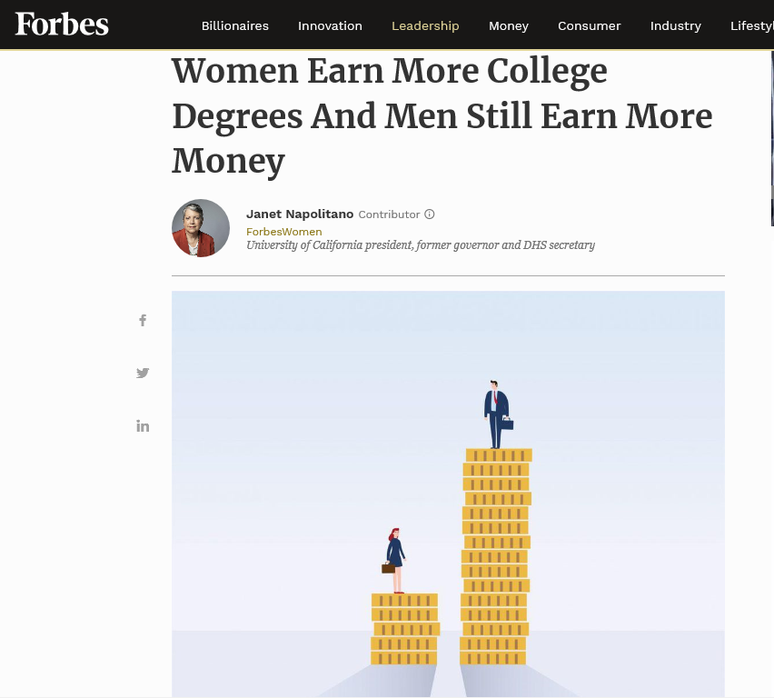
College leaders can increase transparency using data
Notes:
Initially we didn’t know how leadership would react to these findings, it turns out that UC leadership and President Napolitano were interested in these results and wanted to be transparent. She write an Op-ed in forbes and linked to the work we did.
Leadership might surprise you sometimes. What are others doing?

Slide 53
Industry efforts to close the gender wage gap
Salesforce CEO Marc Benioff invested $3 million to close the wage gap between males and females (women’s salaries needed to be increased by 10% to achieve parity with men)
Nike also corrected a longstanding gender pay gap, by dismissing several top executives and increase in pay to 10% of their workforce.
Notes:
Salesforce CEO Marc Benioff invested $3 million to close the wage gap between males and females at his company. After being convinced by his Head of Human Resources, Cindy Robbins, to conduct an audit of salaries for men and women in the same positions, they found women’s salaries needed to be increased by 10% to achieve parity with men. After the initial investment succeeded in closing the wage gap, it largely returned within a short period of time due to advancement practices that favor men, and their acquisition of companies that brought their own longstanding pay gaps into Salesforce. This highlighted the importance of ongoing vigilance and proactive compensation and advancement policies to mitigate gender pay gaps rather than one-time financial corrections. Nike also recently joined the list of major companies seeking to correct a longstanding gender pay gap. After a number of complaints from employees about a workplace culture and compensation practices that are hostile to women, the company dismissed several top executives and conducted an in-depth audit that revealed a significant gender pay imbalance. They announced that ten percent of their workforce (over 7,000 employees) would receive pay rises to begin to correct the imbalance. Company leaders also pledged to alter compensation and management training programs to reflect the company’s goals for equal pay and work force diversity. Additionally, former CEO of DuPont, Ellen Kullman, now co-chair of Paradigm for Parity (a group of CEOs that are advocating for gender equity at the top of organizations) is pushing for company leaders to commit to making 50% of Senior Leadership female. She cites unconscious bias in promotion as a factor in the gender pay gap. That is, that women need longer to prove themselves in a job than men, “We were promoting women every 30 to 36 months into same kind of jobs as we were promoting men every 18 to 24 months. So if you go out ten years, they're being paid vastly differently” Her group recommends bias training for employers as a way to remedy inequalities in promotion opportunities.

Slide 54
Policy efforts to close the gender wage gap
In 2017, Governor Jerry Brown enacted AB168, a bill that “prohibits an employer from relying on the salary history information of an applicant for employment as a factor in determining whether to offer an applicant employment or what salary to offer an applicant.”
Senate Bill 826 requires corporate boards to have at least one woman on the board by the end of 2019, by mid 2021, companies need to have at least two women on boards of five members and at least three women on larger boards.
Notes:
California is also leading in what states can do to close the gender wage gap. The primary goal of this bill is to narrow the gender wage gap.

Slide 55
Efforts from many groups are necessary to close the gender-race wage gap
Gender-Race Pay Gap
Government
Industry
Individuals
Universities

Slide 56
Discussion
What can universities do, how can data like this be used to help students or work with employers?
Other questions?
Notes:
Brianna and Joey
What about the STEM pipeline?

Slide 57
Appendix

Slide 58
The wage gap exists between men and women in similar occupations
-AAUW (2018) The Simple Truth about the Gender Pay Gap
Notes:
Joey - Salesforce CEO Marc Benioff invested $3 million to close the wage gap between males and females at his company. After being convinced by his Head of Human Resources, Cindy Robbins, to conduct an audit of salaries for men and women in the same positions, they found women’s salaries needed to be increased by 10% to achieve parity with men. After the initial investment succeeded in closing the wage gap, it largely returned within a short period of time due to advancement practices that favor men, and their acquisition of companies that brought their own longstanding pay gaps into Salesforce. This highlighted the importance of ongoing vigilance and proactive compensation and advancement policies to mitigate gender pay gaps rather than one-time financial corrections. Nike also recently joined the list of major companies seeking to correct a longstanding gender pay gap. After a number of complaints from employees about a workplace culture and compensation practices that are hostile to women, the company dismissed several top executives and conducted an in-depth audit that revealed a significant gender pay imbalance. They announced that ten percent of their workforce (over 7,000 employees) would receive pay rises to begin to correct the imbalance. Company leaders also pledged to alter compensation and management training programs to reflect the company’s goals for equal pay and work force diversity. Additionally, former CEO of DuPont, Ellen Kullman, now co-chair of Paradigm for Parity (a group of CEOs that are advocating for gender equity at the top of organizations) is pushing for company leaders to commit to making 50% of Senior Leadership female. She cites unconscious bias in promotion as a factor in the gender pay gap. That is, that women need longer to prove themselves in a job than men, “We were promoting women every 30 to 36 months into same kind of jobs as we were promoting men every 18 to 24 months. So if you go out ten years, they're being paid vastly differently” Her group recommends bias training for employers as a way to remedy inequalities in promotion opportunities.

